Slide 4
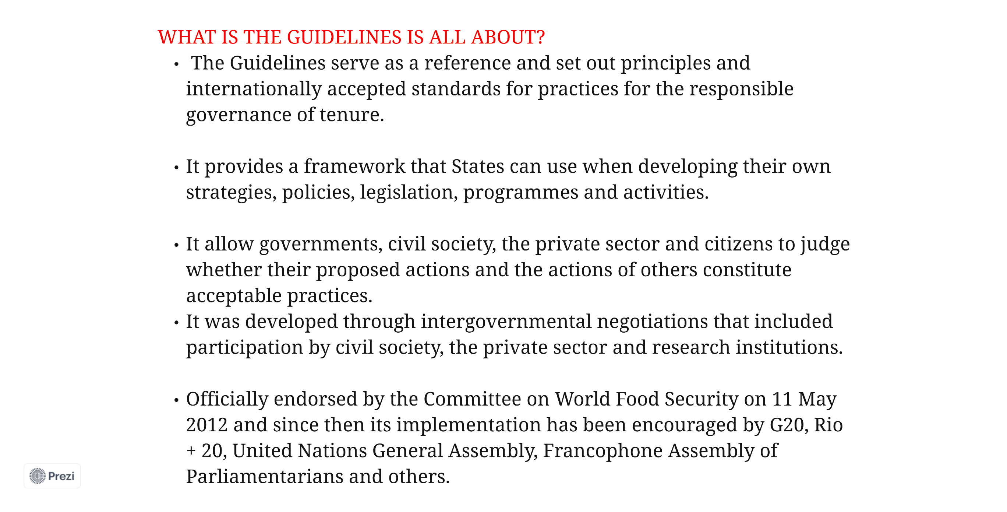

Slide 17
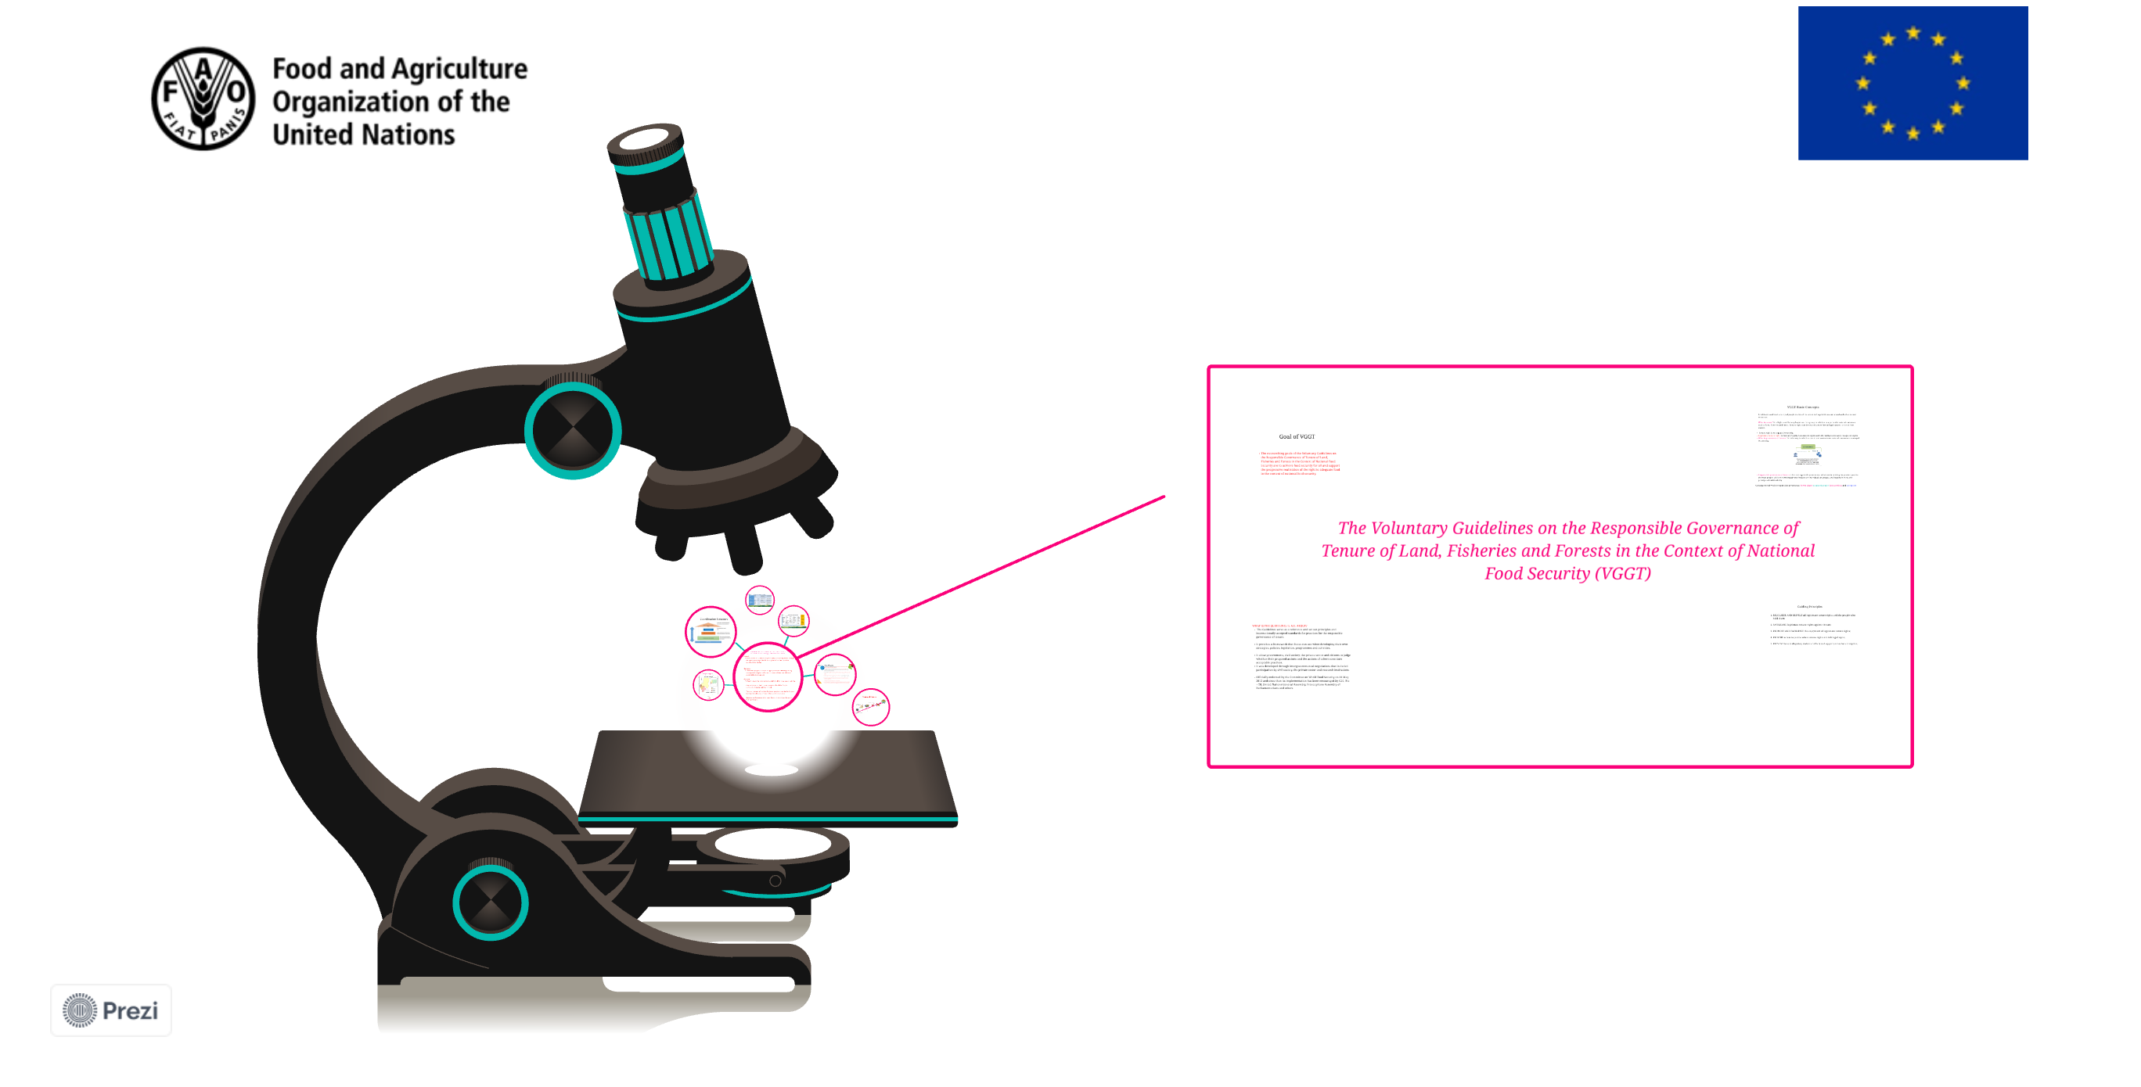

Slide 18
Thank you!
Project funded by the European Union

