Slide 1
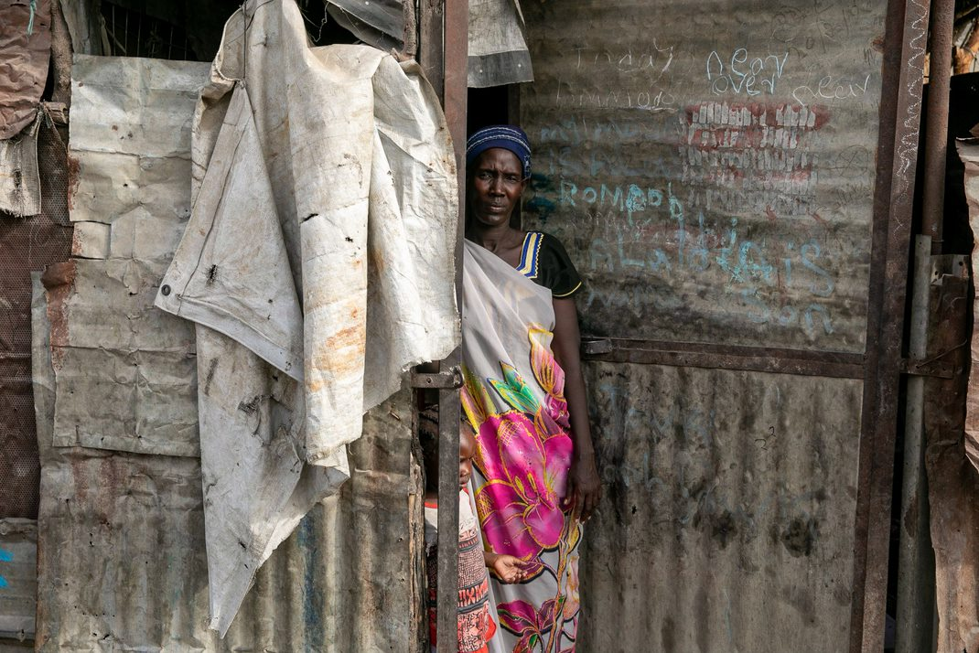
Sudan Crisis Response

Slide 2
Anecdotal reporting of Child Mortality
There have been reports from affected communities and humanitarian partners of child mortality on humanitarian facilitated boat movements between Renk and Malakal, and between Malakal and onward locations.
Contributing factors
The population displacing from Sudan is already highly vulnerable, and has become more vulnerable as the conflict has gone on
Delays in onward transportation have caused returnees to remain in ‘transit’ locations for up to a month before being moved on
Food assistance provided at transit centres does often not cover the duration of transit, resulting in substantial gaps
Preventative nutrition care has been substantially disrupted in transit centres, particularly Malakal
Limited access to food and nutrition services have been compounded by poor multisectoral service provision including WASH, shelter, NFI, and healthcare
The provision of foods during boat transit is also a significant gap
The combination of these contribution factors points towards an increased risk of child mortality

Slide 3
Recommendations
For U5s and PLWs who are admitted for treatment of acute malnutrition (in-patient care) in transit centres, transportation is to be delayed to a later date until the patient is fully recovered, referred to outpatient care, and can travel to limit premature exit/discharge from the health and nutrition programmes.
All children and PLWs screened and enrolled in the nutrition programme (outpatient care) must be provided with nutrition and food supplies to cover the journey to the final destination.
Improved information sharing regarding onward transportation and enrollment to the health and nutrition programmes is necessary in transit centres and locations of final settlements to ensure strong referral pathways and continuity of service provision for vulnerable returnees.

Slide 4
FSL Recommendations
At the transit centres, food assistance is provided to returnees for a period of one week. Assistance should be made available for the duration of the transit, as access to alternative sources of food and livelihoods is extremely low.
The food response while on facilitated movements needs to be strengthened provide a pack of HEB per person, per day, for the duration of the journey.
Congestion at transit centres will increase competition over limited resources between host community and returnees, and could exacerbate tensions along ethnic and regional lines and between communities and humanitarian actors.
Ensure that equal support is provided to returnees facilitated by both boats and planes, if onward movement resumes.
Upon arrival at final destination, returnees should be supported with a combination of food assistance and seasonally relevant livelihoods support to increase productivity and to alleviate pressure on limited host community resources.

