Slide 1

TEAM FARMER FAMILY
Harvest and post harvest handling of horticultural crops
October 2022

Slide 2
Introduction
The quality of horticultural produce can only be protected through good harvest and post-harvest handling practices. However adoption of good practices at harvest and post-harvest does not change poor produce into good ones, but preserves the quality of good crops through long shelf life and hence higher income for individuals, community and the economy of nations at large
Farmers spent much time (about 3-6 months) from land preparation to harvesting, but can lose all the benefits of the crop in a few seconds through improper harvesting and postharvest handling
Harvesting by dropping fruits like mangoes and oranges to the ground can result into serious damages of fruits leading to significant postharvest losses. Transportation mishandling for produce like bananas in trucks without packaging accounts for serious losses.
It is estimated that in many cases post-harvest loss contribute to over 60% of horticultural produces. This is through improper harvesting time i.e. immature or over mature harvesting, lack of use of packing and packaging materials, improper transport means, poor storage at the farm and beyond i.e. no shelter and cold storage facilities etc.

Slide 3
Specific Objective
Apply postharvest physiology principles to control postharvest losses of perishable plant
Properly harvest fresh vegetables enhanced postharvest quality
Explain the importance of packaging and the requirements for packaging of perishable vegetables
Definition
Harvesting: Is a deliberate action of separating a product or plant part from its mother plant or origin
Post-harvest: The period after the produce has been detached from the mother plant or origin
Post-harvest physiology: Refers to the metabolism of produce after harvest

Slide 4
I. Pre Harvest Factors
1. Genetic / variety
2. Light
3. Temperature
4. Humidity
5. Mineral nutrition
6. Water relation/ Irrigation
7. Canopy manipulation
8. Rainfall
9. Seasons / Day and day length
10. Carbon dioxide
11. Use of agrochemicals
12. Pest and diseases
In order to reduce these losses, the following must be observed:-

Slide 5
    Timely harvesting
This varies depending on; crop type and market/consumer preferences
Different crops have different maturity indicators such as size, color, shape, texture etc. In this case it is important for farmers and other stakeholders to know the time for harvesting of a certain crop. For example tomatoes mature when the color starts changing from green to yellow but this is not the case for green pepper, cucumber, eggplants, okra, amaranth, watermelon etc.
Both over maturity and pre mature harvesting can have negative effects on both quality and shelf life of produce. These effects can result in poor taste and color of produces and quick deteriorations after harvest as well as high transportation and storage losses.
When immature, fruits tend to have high acid content than sugar content but with maturity, the sugar content increases with decreased acid content.

Slide 6
Maturity signs/indicators for different crops
Leafy vegetables: Crops like Amaranth, collards, spinach and cabbages; this depend on size and/or time (days) from planting
Melons: Knocking gently by finger for striking sound instead of dull sound that is heard when the fruits are young. This can also be useful for crops like cabbages. Another sign for these crops is tight and bright looking fruits when mature. When melons mature, the tendrils near the fruit stocks change color from green to brown. However these methods need a bit of experience to master.

Slide 7
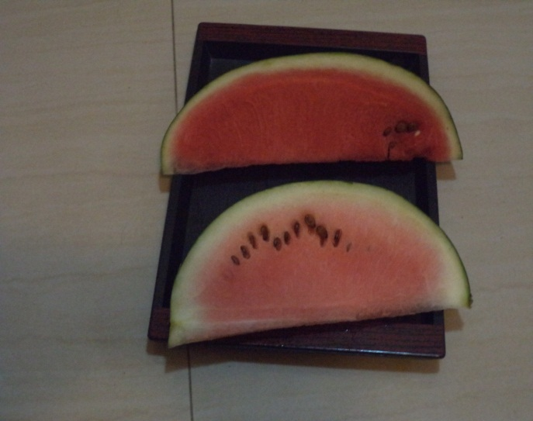
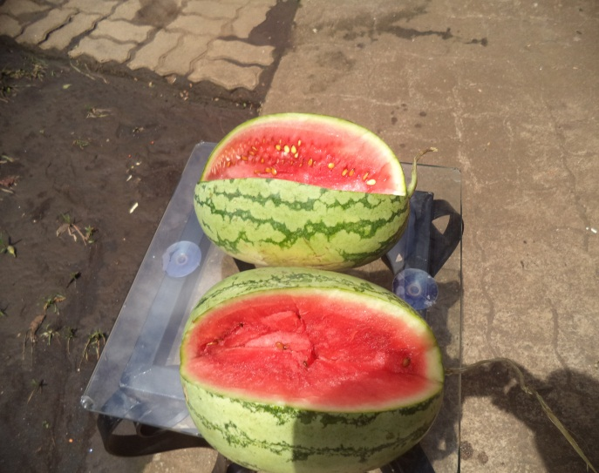
A
B
Looking at the two watermelon pieces, the differences in color indicate that on top is a piece from mature fruit and below is from pre mature fruit, Plate (a). Plate (b) shows two mature melons but looking at the seeds, even these, their level of maturity differs

Slide 8
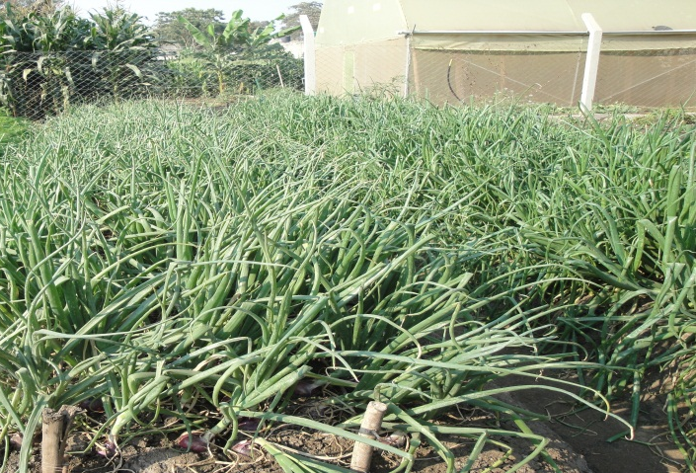
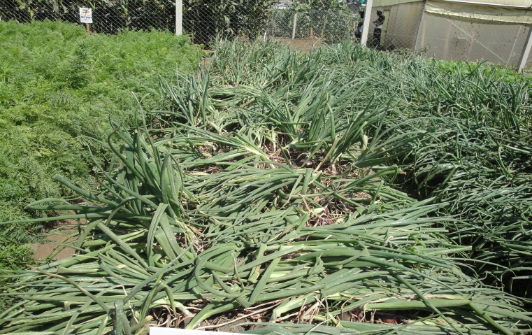
Banana: This crop takes about 75 days from the on-set of a bunch to maturity. But the best way of judging about maturity of bananas is to look at the edges of banana fingers. At maturity the finger edges are slightly seen. At this stage, the fingers are not smoothly rounded
Onions: At maturity, the necks of onion plants collapse and fall. The right time for harvest is when 60% or more of the plants have fallen down. At this stage irrigation should be minimum. Harvesting is done by uprooting, and using the foliage, the bulbs are covere to protect from strong radiation. The crop is left for 3 to 5 days then the foliages are chopped off at the necks with at least 5cms of stocks.
(a) Onions before maturity
(b) Onions ready for harvest

Slide 9
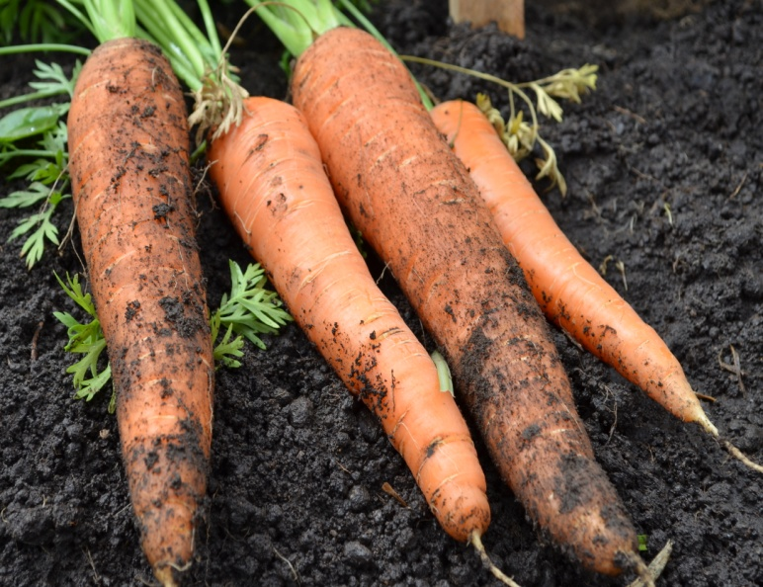
Carrot: Maturity depends on days from sowing and size
Mature carrots
Papaya, Oranges, Mango, Pineapple and tomato: Maturity is decided by colour and texture. At maturity fruits change color to yellow, orange or red and softens

Slide 10
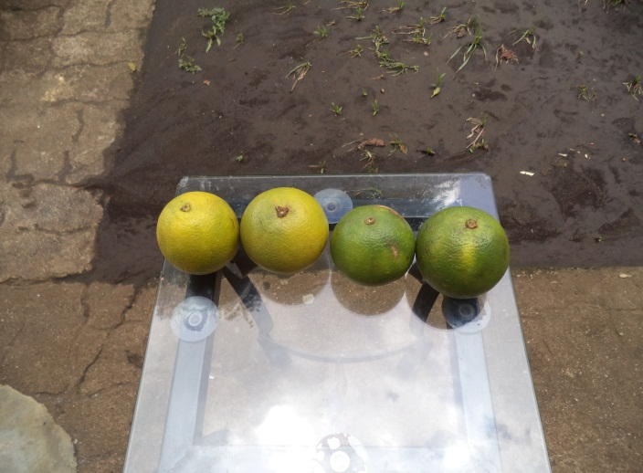
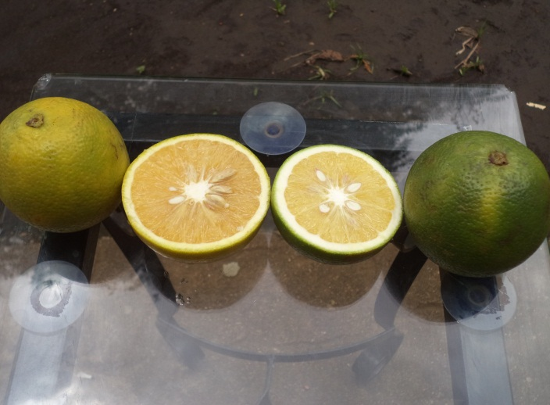
Number 2, 3, 4 and 5 on the photos above are right stages for harvest. 0, 1are pre mature while 6 and 7 are over mature
(a)
(b)

Slide 11
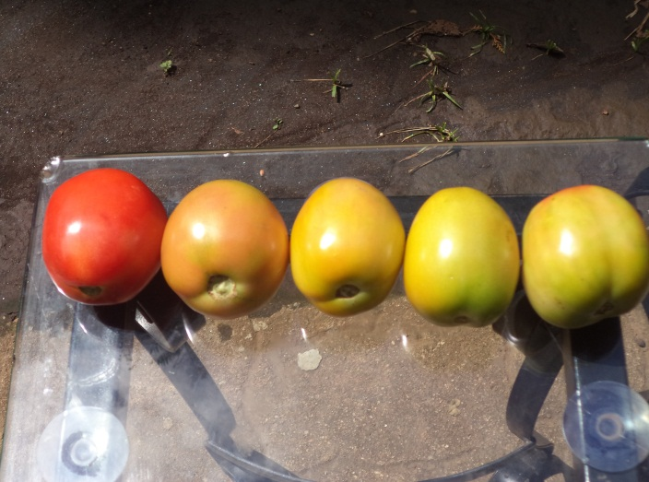
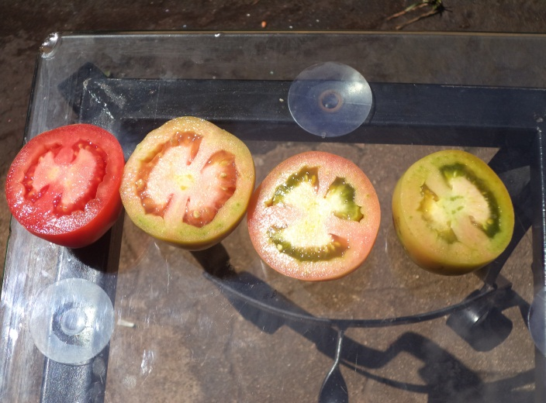
(c)
(d)
Plate (c) and (d) shows tomato fruits at different stages of maturity. The right stages for harvest as seen on plate (c) are 3 fruits in between. The first fruit from left is overripe while the last one is pre mature. The difference of the fruit quality are clearly seen on sliced pieces, plate (d)

Slide 12
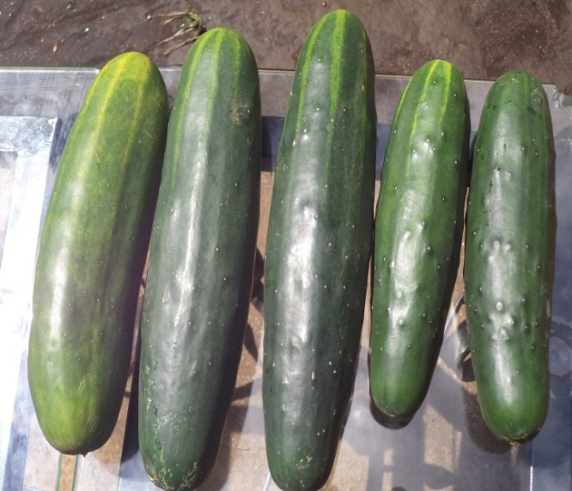
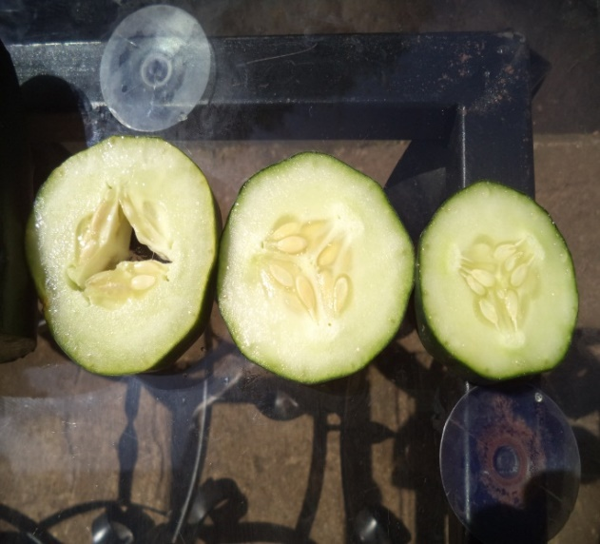
Cucumber: Should be harvested at medium size, green in color while they are still with edges and rough surface. At this stage, when cut, the fruit is soft and the seeds are also soft and tender and the center is interct and closed with no opening
(e)
(f)
Photos on Plate (e) above shows 2 cucumber fruits at over maturity stage, left (note color changes, size and skin texture). The other 3 fruits are suitable for harvest. The first piece from left on plate (f) was cut from the first fruit from left plate (e). A piece at the center on plate (f) was obtained from the second fruit from left on plate (e) and the first piece from right on plate (f) is from the second fruit from right on plate (e) which also represents what could be seen from the first from right and the fruit at the center on plate (e) Look at the difference and see how quality can be affected with delayed harvest

Slide 13
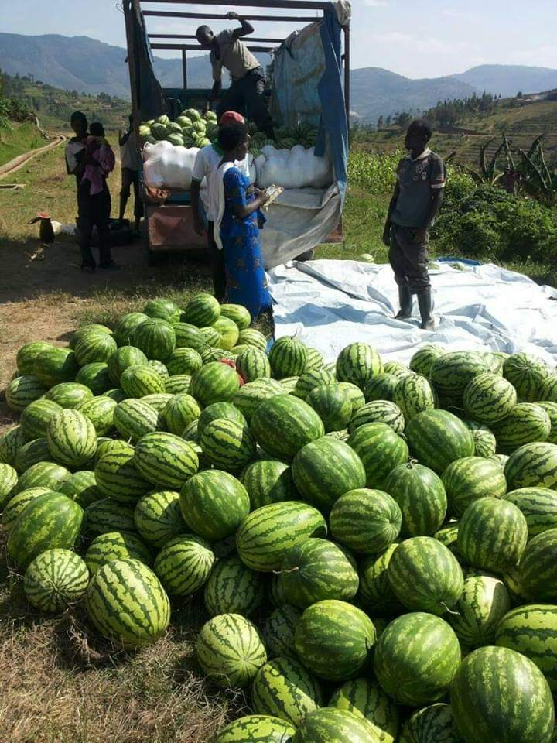
Sweet paper
Harvesting techniques
When harvesting horticultural crops, care must be taken to avoid dropping, injuries, bruise and damages for good quality produces. It is also very important to harvest with a piece of fruit stock of about 3cm remaining on a fruit for longer shelf life
(a)
(b)

Slide 14
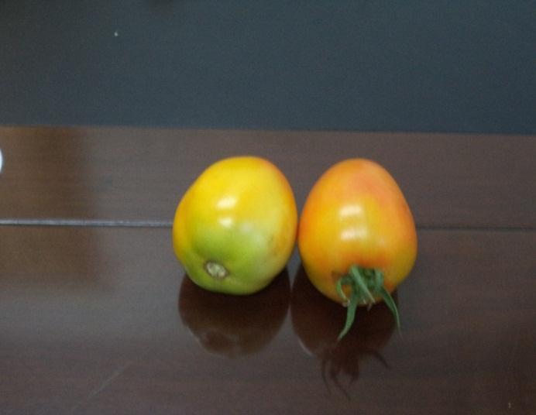
(c)
(d)
Plate (a)-(c) shows the importance of a fruit stock for latex draining to avoid damage cause by it on fruits (sap burn) the fruits are then dipped into saw dust that absorbs the oozing latex
Plate (d) shows the proper way of harvesting fruits like tomatoes for longer shelf life with stock first from right as contrally to improper way second

Slide 15
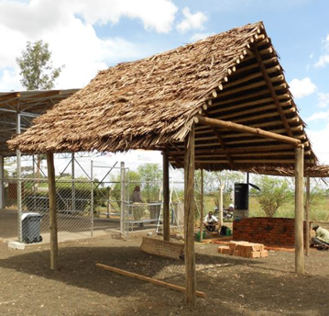
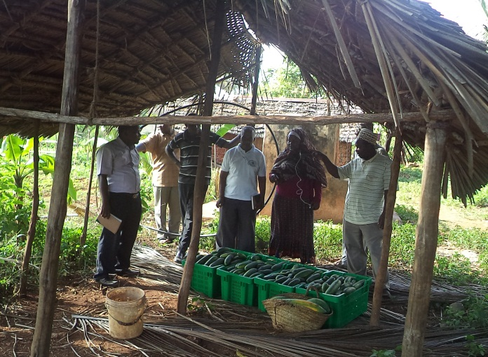
Field shelters
These are important structures in the farm to reduce post-harvest damages through too much sun and rains. Simple shelters can be made in farms where crops will be collected and packed ready for storage or transportation to market. In case of cold condition that can cause chilling injuries, heating systems can be made. In case of high temperature, simple cooling structures such as charcoal coolers can be made
(a)
(b)

Slide 16
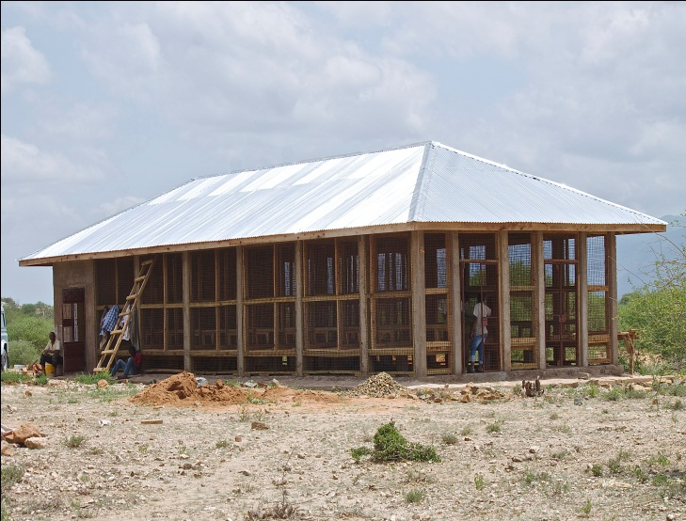
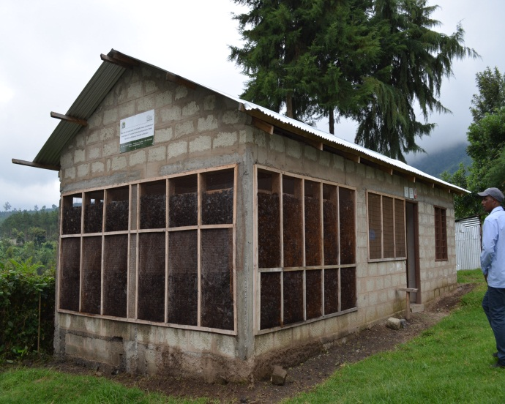
(c)
(d)
Plate (a) and (b) above shows temporally farm shelters for post-harvest crop handling during harvesting, While plate (c) shows a modern onion store and (d) shows a charcoal cooler for cool storage of fresh produces

Slide 17
sorting and grading of produce sorting and grading of produce is one very important post harvest handling practice .immediately after harvest produce is separated in to categories depending on size , damages , malformations , maturity level etc. the best ones are grouped as grade 1, followed by 2 3 and rejects. Grade 1 are sold at higher price than 2 and 3 and rejects can be used as animal feeds.
plate [a] and [b] shows fruits with different conditions .The first from left fruits of orange and cucumber represent excellent quality fruits for marketing while the rest have different disorder to be categorized in to 2 and 3 categories .The disorders as seen above are damages, malformities, disease and over –and pre-maturity.

Slide 18
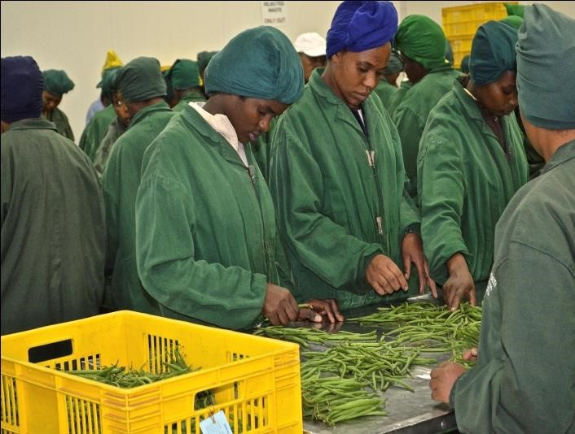
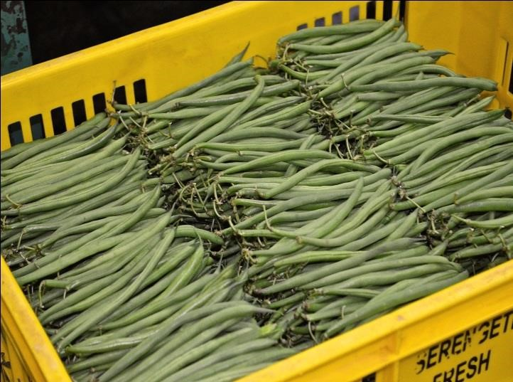
Sorting and grading of French Beans for Export
After sorting and grading , produce should be packed and stored under cool conditions . Care should be taken when sorting produce in a cool conditions as different crops have different requirements in terms of temperature limits and duration at these temperatures, to avoid losses due to chilling injuries.

Slide 19
Table showing different storage temperature and durations for different crops
Crop | Temperature | Relative Humidity (RH) | Duration
Sweet potato | 3-15ºC | 85-90% | 16-27 weeks
Green corn | 0ºC | 95-98% | 5-8 days
Green pepper | 7-13ºC | 90-95% | 2-3 weeks
Ripe tomato | 13-15ºC | 90-95% | 4-7 days
Tomato (unripe) | 18-22ºC | 90-95% | 1-3 weeks
Cucumber | 10-13 | 95% | 10-14 days
Hot chili | 7-13 | 90-95% | 2-3 days
Cabbage | 0 | 98-100% | 3-5 weeks
Letuce | 0-2 | 98-100% | 3-5 weeks
Ripe mango | 10-13 | 85% | 2-3 days
Mango (unripe) | 18-20 | 85% | 2-3 days
Packing and packaging materials
Packing and packaging of produce is another very important post holding process. The use of excellent quality packaging materials helps to safeguards the produce from damages and injuries during transportation as well as adding value to produce. There are many types of packaging materials, such as crates, boxes, baskets, nets, bags, pannets etc. one use any of these depending on costs, availability and consumers, requirements. It is important to ensure that produce is cleaned by piece of cloth from dust and chemical residues before packing

Slide 20
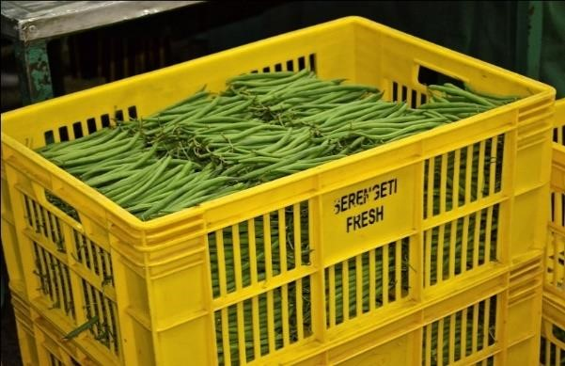
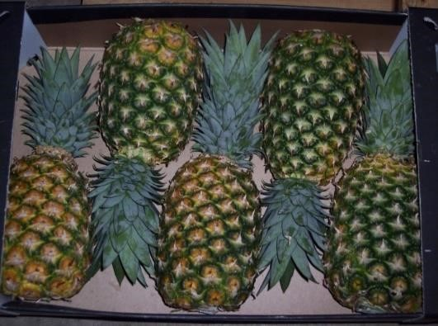
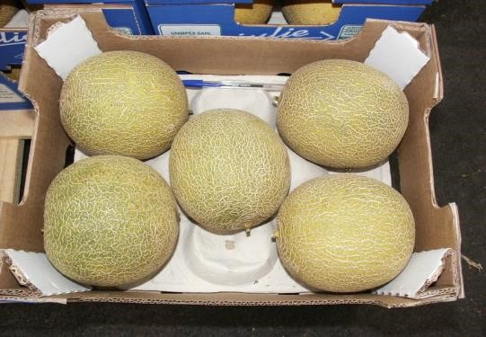
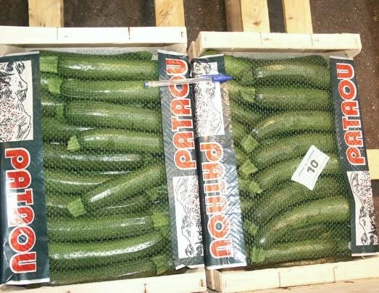
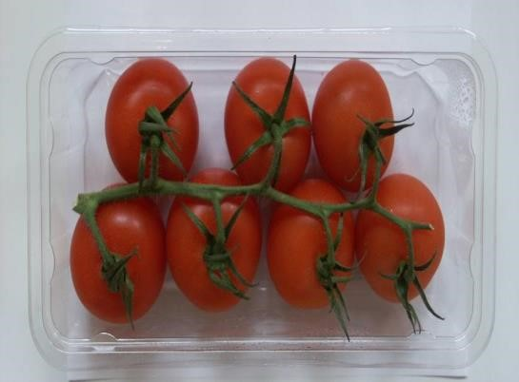
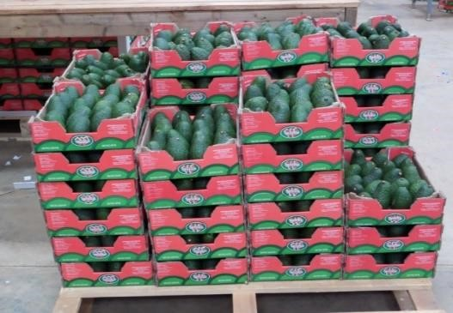

Slide 21
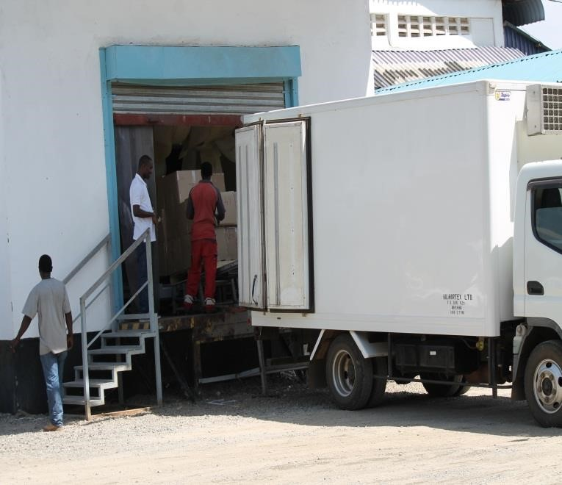
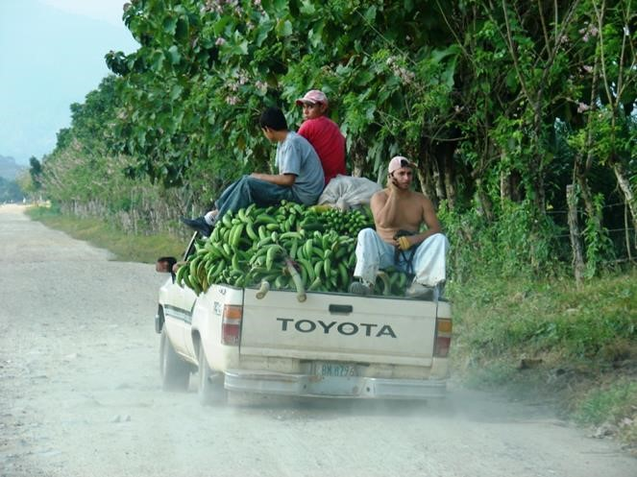
Transportation use of special trucks is essential when transporting horticultural produce. The trucks need to be covered and only loaded with produce and not anything else[not even passengers are allowed to sit on top!]since most horticultural crops are fresh and highly perishable, use of refrigerated trucks is highly recommended especially when the travel distances are far.
Top, left is a proper truck for horticultural produce transportation while the photo on the right shows an improper way of transporting horticultural crops to the market

Slide 22
Factors affecting quality of horticultural produces
Challenge | Mitigation | Example
Wilting due to hot temperature and solar radiation | Keep under shade and cool condition all the time after harvest | Build shelters and charcoal coolers
Damage from injuries | Use good packaging materials and proper transport | Use of plastic crates
Price fluctuation | Proper storage for sale during fair prices | Use of refregerators or underground storage
Supply higher than demand | Processing, off season production | Drying, canning

Slide 23
Thanks
majora

