Slide 1
The Strengthening Agricultural Markets and Food Security (SAFE) Program and The Market System Development Approach June 20, 2021 Presented to the National FSL cluster, Sudan by: Otim Emmanuel Consortium Director, Agricultural Market Systems, Mercy Corps Europe eotim@mercycorps.org

Slide 2
The Strengthening Agricultural Markets and Food SEcurity (SAFE) Program
Swedish International Development Cooperation Agency (SIDA)
30,000 SHFs (180,000 individuals)
Seed companies, Produce buyers/ contract farming Co, Banks, MFIs, Telecoms & VAS
USD 13 million
July 2019- Dec 2022
South Kordofan & Blue Nile
States
Donor
Target
Budget
Duration
Mercy Corps & ADRA
Consortium
JASMAR &
Vet Care
NNGOs
Partners
Approaches
1. Market Systems Development (MSD)
2. Resilience

Slide 3
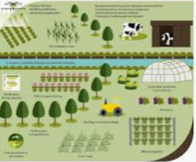
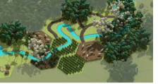
SAFE Program Objectives and key Activities
Increased and more climate-resilient yields
Farmer groups and Cooperatives
Resilient design
Agriculture training
Digital extension
Improved PHH bags
Storage and marketing hubs
Digital Agriculture Extension
2. Increased sustainable NRM
practices
Climate info sharing
system & info
Improved soil water management
Community NRM and resilience projects
Tree seedling
businesses

Slide 4
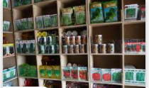
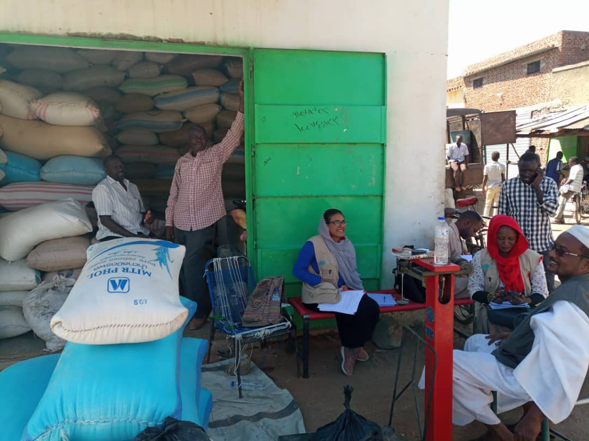
SAFE Program Objectives and key Activities
3. Improved market linkages
Last-mile input sales networks
Subsidised inputs
Contract Farming/
Produce market
PSP VSLA model
Formal Fin Serv.
Digital market platform
Transport infrastructure
4. Increased equality and empowerment in smallholder agric market systems
Gender & Social Inclusion analysis
Systemic barriers to women’s participation in markets (rules, norms, agency, voice, business models, pdtive R)
Study on land tenure, ownership, access & gender
5. Increased preparedness and ability to respond to disasters
Public health awareness campaigns
Strengthen community HCs& markets
Protection and early warning systems

Slide 5
SAFE programs’ main approach: Market systems development (MSD) Disrupting business as usual: - facilitating development and or expansion of inclusive business models with market players to improve access for smallholder farmers

Slide 6
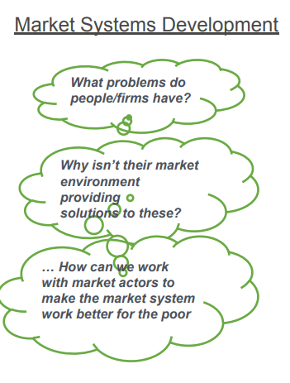
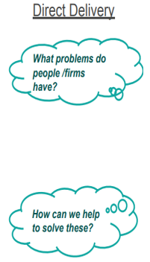
Facilitating systemic change: asking different a set of questions compared to conventional aid programs
Even the poor take part in markets
If econ. assumptions hold, markets work well (rationality, information flow, incentives, competition, externalities)
Markets often fail letting down people &biz

Slide 7
MSD introductory Videos
1. Introduction to MSD:
https://www.youtube.com/watch?v=3sEOtVhsqX0 (to be viewed before the FSL meeting
2. What is different about MSD approach https://www.youtube.com/watch?v=7CUX0wKherQ
3. MSD in financial inclusion https://www.youtube.com/watch?v=OrP8gpO6bV8
NB: Paying private companies to deliver goods and services (fee-for-service) to beneficiaries is NOT MSD.

Slide 8
Introducing the market system and connection to social and economic problems
MSD Donut
Supporting functions
Problems in the core market….
Infrastructure
Information
Market systems are multi-function and
multi-player
Driven by incentives and capacity
Inputs
…are often related to functions and rules in the wider system
Services
Core function
Supply
Demand
Laws
Informal norms
Regulations
Rules and norms

Slide 9
MSD: Introduction to the Agric market system map
Supporting Functions
Tillage services
Market information
Input/. Seeds
Climate and weather information
Business skills Services
Agriculture Extension
Agency and brokerage
Transportation
Storage
Communications Services
Core Function
Harvesting and PHH services
Formal and
informal financial services
SUPPLY
DEMAND
Male and female Smallholder farmers
Groundnuts,
Sesame & Sorghum
Small, medium and large agribusinesses and customers
Export regulations
Custom Control
Produce Quality standards
Local natural resource governance
Peace and security
Forex exchange rate
Government entities
Min of Agric &NR,
Min. of Finance
Min of Social Development
Market Actors:
Seed companies
Banks and MFIs
Tractor and ox-tillers
Telecom companies
Seed quality standards
Land tenure and agreements
Land use policies
Culture and Gender Norms
Rules and Norms

Slide 10
MSD: working in the supporting function and in interconnected markets for sustainable and scalable change
SUPPORTING FUNCTIONS
SUPPLY
DEMAND
SUPPORTING FUNCTIONS
SUPPORTING FUNCTIONS
Extension services
Agriculture inputs
SUPPLY
DEMAND
Market Information
RULES
Weather info
SUPPORTING FUNCTIONS
Agriculture extension / training
RULES
Finance
SUPPLY
DEMAND
SUPPLY
Core System
DEMAND
SUPPORTING FUNCTIONS
RULES
SUPPORTING FUNCTIONS
Cultural norms
Taxes and subsidies
SUPPLY
DEMAND
SUPPLY
DEMAND
Agriculture laws
RULES
RULES
RULES
Market systems development programs – as their name suggests - seek to influence how an entire market system works - not just a specific enterprise.
Notes:
Agriculture Economy of NU has been studied and mapped by various development programmes from the very strict market development initiatives to the smaller scale and bottom up initiatives like RAIN and DYNAMIC
So mapping this in theory is not too difficult. To recap what we know and add to this lets go over the functions….
Define the core
Define the supporting functions – which ones to write?
Define the rules – identifying the cultural norm that impact the target beneficiaries
Identifying that each supporting function is a market system in its own right – what does this mean? Discuss with the team and get their perspectives facilitating the discussion to a common understanding.
From the supporting functions – identify the KEY constrained supporting functions – what supporting function is not working for the poor and limiting the growth in the core market system – agriculture economy of Northern Uganda?
Discuss Extension services in detail

Slide 11
Systems Analysis and Identifying Leverage Points
Supporting System #2:
Financial Services
Supporting functions
Inputs /Seeds
Supporting functions
Sesame
Financial services
Inputs/Seeds
Supporting functions
Financial services
Rules
Rules
Principal System:
Sesame & Groundnut
This is where our target group is (smallholder farmers)
Rules
Supporting System #1:
Inputs

Slide 12
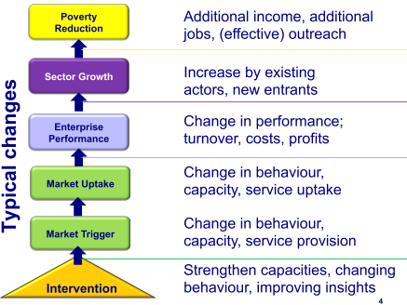
Market systems development strategic framework
New inclusive business models, supporting actors
Both farmers and related businesses
Farmers: Buy seeds, access financial services, modern practices
Business: Rural agents, promotions, FS, POS trainings
Notes:
Interventions should catalyze sustainable change among key market players (supply and demand side) to provide goods and services.
Engine analogy

Slide 13
FACILITATION OPTIONS: Type of Interventions
We should be trying other facilitation options before offering financial support.
-Willingness to pay
-Demand for goods/services
-Supply of pdts
-Consumer product trials
Do nothing
Low
Market research and information-sharing
Business-to-business meetings,
Digital /mobile platforms
Market linkages and networks
Risk of unsustainability
Market distortion
-Agent model,
-Pricing strategy,
-marketing strategy
Agent training,
Business Dev’t services
Mentoring
Business model development and planning
Capacity-building (exposure visits, mentoring, technical and business training)
-Build village retailers
-Support village retailers
-Promotions and marketing
Organisational capacity of beneficiaries
High
Financial support / subsidies

Slide 14
MSD: Finding the right leverage Point
Prospects for: scale and sustainability
1,000,000
farmers
500,000
farmers
50,000
farmers
5,000 farmers
Market 4
Work with supply chain firms to train input suppliers
Market 3
Work with input suppliers to train retailers
Market 2
Work with retailers to offer info/advice to farmers
Market 1
Direct delivery of advice to farmers
Market / business intermediary
Lead firms
Beneficiaries

Slide 15
Market System Development
Notes:
30k: 8.5K on CETs x2; 15k on donkey carts and training materials and 30K on digitization-content
40K: 20K x 2 on Access Agric; 96,000 for 64 training projectors
30K –Dig- on IVR and SMS system
140k –bags have to be imported first

Slide 16
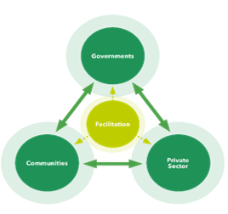
Additional key MSD areas for attention:
Embracing & manage complexity, adaptive management.
Addressing incentives and capabilities
of permanent players to create change
Addressing the root causes; not symptoms of why markets often fail to meet the needs
How/approach: – research, identify potential partners, pilot – adapt, re-design, fail and redesign or scale.
Notes:
30k: 8.5K on CETs x2; 15k on donkey carts and training materials and 30K on digitization-content
40K: 20K x 2 on Access Agric; 96,000 for 64 training projectors
30K –Dig- on IVR and SMS system
140k –bags have to be imported first

Slide 17
Developing expertise in MSD
Documents, resources and evaluations
Beam exchange
https://beamexchange.org/
MSD Documents and resources
Donor committee on enterprise development
https://www.enterprise-development.org/implementing-psd/market-systems/
MSD training and evaluations
Springfield center
https://www.springfieldcentre.com/training/
Notes:
30k: 8.5K on CETs x2; 15k on donkey carts and training materials and 30K on digitization-content
40K: 20K x 2 on Access Agric; 96,000 for 64 training projectors
30K –Dig- on IVR and SMS system
140k –bags have to be imported first

Slide 18
Thank you for listening
Happy to respond to your questions

