Slide 1
Food Security Cluster Meeting
Beira
^{06th} May 2020
MOÇAMBIQUE

Slide 2
MOÇAMBIQUE
Agriculture WG Update
Crop yield assessment
Land Access Survey
Seed distribution

Slide 3
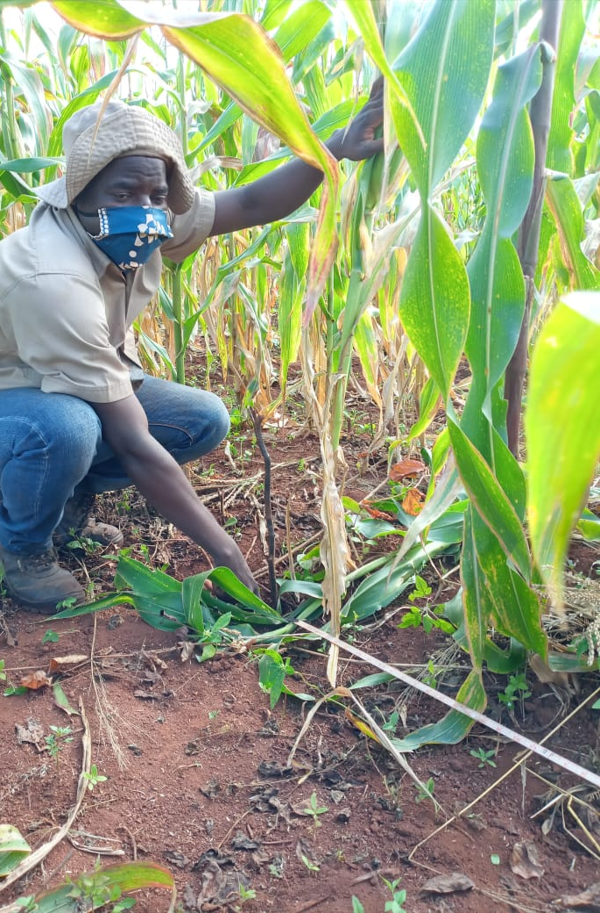
Crop yield assessment

Slide 4
Main Agric. Campaign 2019/20
Crop
yield assessment
Manica
Sofala
Gondola
Sussundenga
Macate
Vanduzi
Mossurize
Nhamatanda
Buzi
Machanga
Chibabava
Caia
Maringue
Marromeu
Muanza
Dondo
E-voucher
In-kind
In-kind

Slide 5
Land Access Survey
Activities | Dates
Identification of field team members | 19 – 25 April 2020
Training field team members | 08 th May 2020
Conduct survey in resettlement in Dondo | 11 – 13th May 2020
Conduct survey in resettlement in Buzi | 15 – 19th May 2020
Conduct survey in resettlement in Nhamatanda | 18 – 22nd May 2020
Conduct survey in resettlement in Caia | 18 – 22nd May 2020
Conduct survey in resettlement in Chibabava | 21 May – 29 May / 2nd June 2020
Conduct survey in resettlement in Sussundenga | 21 May – 29 May / 2nd June 2020
Notes:
If we’re already bringing food to people in emergencies, shouldn’t that already take care of their nutrition?
Let’s look at an example

Slide 6
Seed distribution
Sussundenga
HH- 3 000
Quant. – 12 000 Kg
Marromeu
HH- 1500
Quant. - 6000 Kg
Chibabava
HH- 4000
Quant. - 16000 Kg
Caia
HH- 2500
Quant. – 10 000 Kg
Mussurize
Muanza
HH- 3 000
Quant. – 12 000 Kg
HH- 2 000
Quant. – 8 000 Kg
Marringue
Machanga
HH- 1500
Quant. – 6 000 Kg
HH- 1500
Quant. – 6 000 Kg

Slide 7
Obrigado
MOÇAMBIQUE

