Slide 1
IPC VIRTUAL ANALYSES PROCESSES AND TOOLS

Slide 2
KEY PRINCIPLES OF VIRTUAL ANALYSIS:
Extraordinary measure due to COVID-19 (workshop will resume when possible)
Same protocols (processes and tools), different modality, streamlined analysis
Key principle of IPC remains at the core, namely technical rigor, evidence based, plurality/consensus, country ownership
IPC responsibility to inform Decision Makers : Need to timely disseminate due to rapidly evolving COVID-19 situation

Slide 3
MAIN DIFFERENCE WITH ‘PHYSICAL IPC’:
Smaller ANALYSIS TEAM composed with the following criteria
Higher level of certification/ # of analysis done, Proficiency in IPC
Full time availability, Good connection
Those who have not these requisites, but are very knowledgeable of the context can be engaged as local context focal points
More strict planning and preparation phase
ISS/worksheets 100% prepared, all evidence received, no popping up information unless really last minute
All joint meetings previously scheduled, organized and documented
Induction plenary, Daily facilitators meeting, vetting, validation plenary
Higher availability and support from GSU
Buddy/coaching system for small groups
Lead facilitation done by level 3 and Level 3 applicants (country and GSU staff), small groups facilitation done by IPC Level 2 or by experts having already fulfil this role in analysis workshop

Slide 4
PROCESS:
Preparation phase:
Definition of AT team and roles: Identification of core facilitators, identification of core analysts, identification of local context focal points, areas attribution, set up of working groups, all contacts shared, check of good repartition in groups of different agencies
Evidence gathering: creation of shared dropbox, Data mapping matrix, HFA matrix, gathering of information in relation to contributing factors (expecially linked to COVID) and outcome indicators
Core facilitation group definition of analysis parameters and preparation of the worksheets, except conclusions by element and areas
Set up of main meetings/ agenda of the analysis

Slide 5
PROCESS:
Analysis phase:
Day #1: First morning plenary: setting parameters, assumptions for projection, main drivers, etc… in general. Continue in small groups, analysis of all areas for 5 days
Day #1 - #5:
Small groups work by skype groups/ conference, etc..
Daily co-facilitators meeting (all small groups facilitators and lead facilitators) with documented decisions
From day#3 the co-faciltiators start quality checks on they group work and other group work
Day #5: vetting process by group/plausibility checks
Day #6: plenary validation, drafting of Key messages
Day #7-9: preparation of the communication brief => fast track

Slide 6
THANK YOU

Slide 7
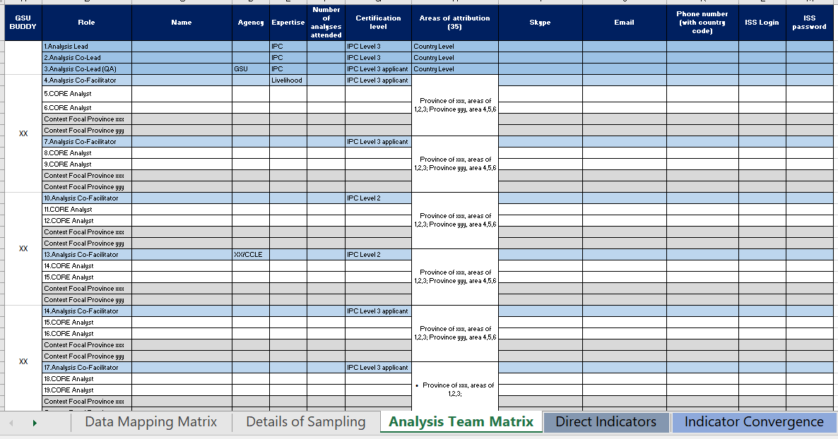
ANALYSIS TEAM MATRIX

Slide 8
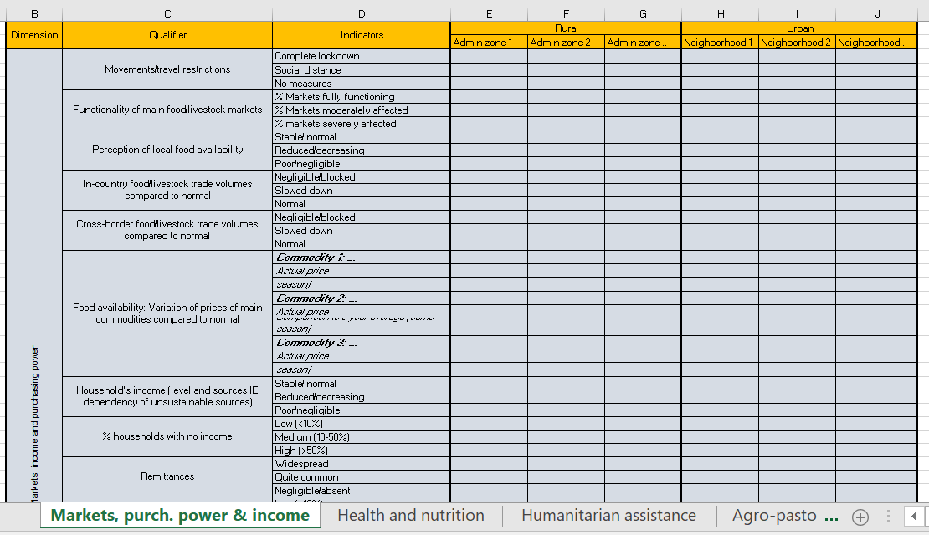
COVID IMPACT EVIDENCE

