Slide 1

Food Security & Agriculture Sector
National Working Group Meeting
April 12th, 2022

Slide 2
Agenda
Food security and market situation analysis – WFP/RAM updates including impact of the war overview.
Activity-info updates (LCRP, ERP…)
LHF new allocation updates: status of the Expression of Interest
Impact of the war on projects implementation: a quick round table
ERP revision process
FSAS Core Group renewal
Monitoring of ad-hoc Ramadan activities: what is in place within the FSAS coordination.
Partners key updates (round table for new activities launched and other relevant communications

Slide 3
Activity Info Update
April 12, 2022
  Food Security and Agriculture Sector

Slide 4
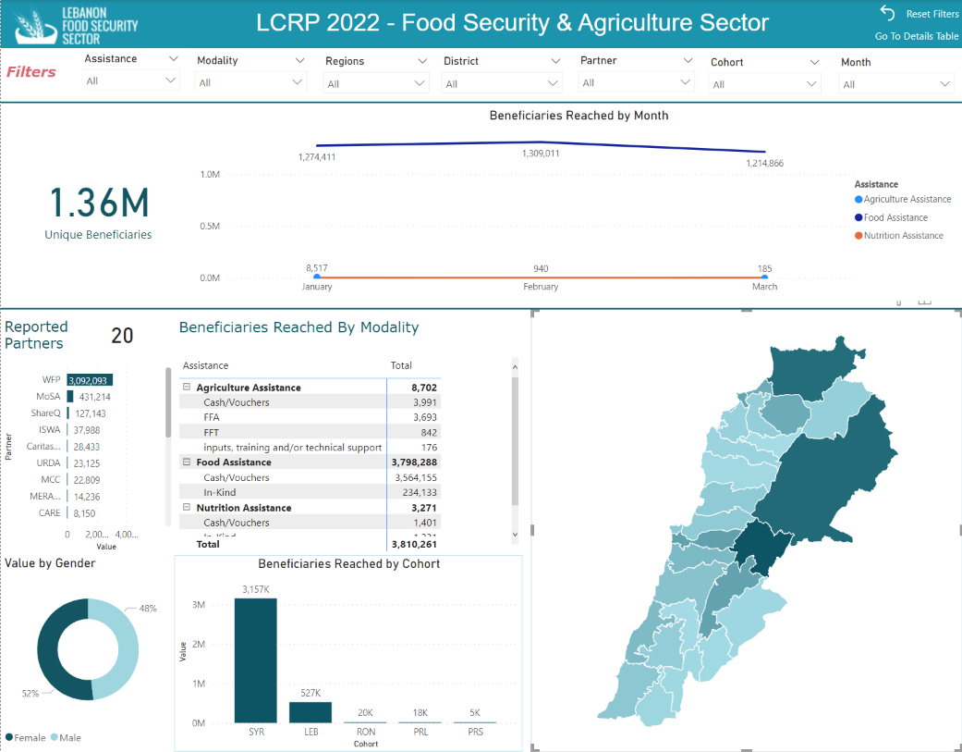

Slide 5
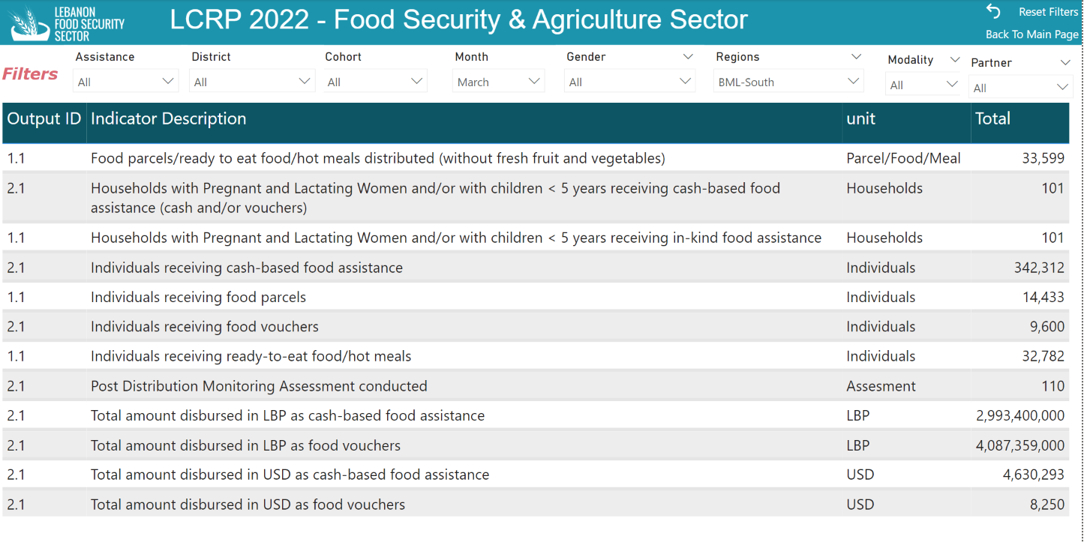

Slide 6
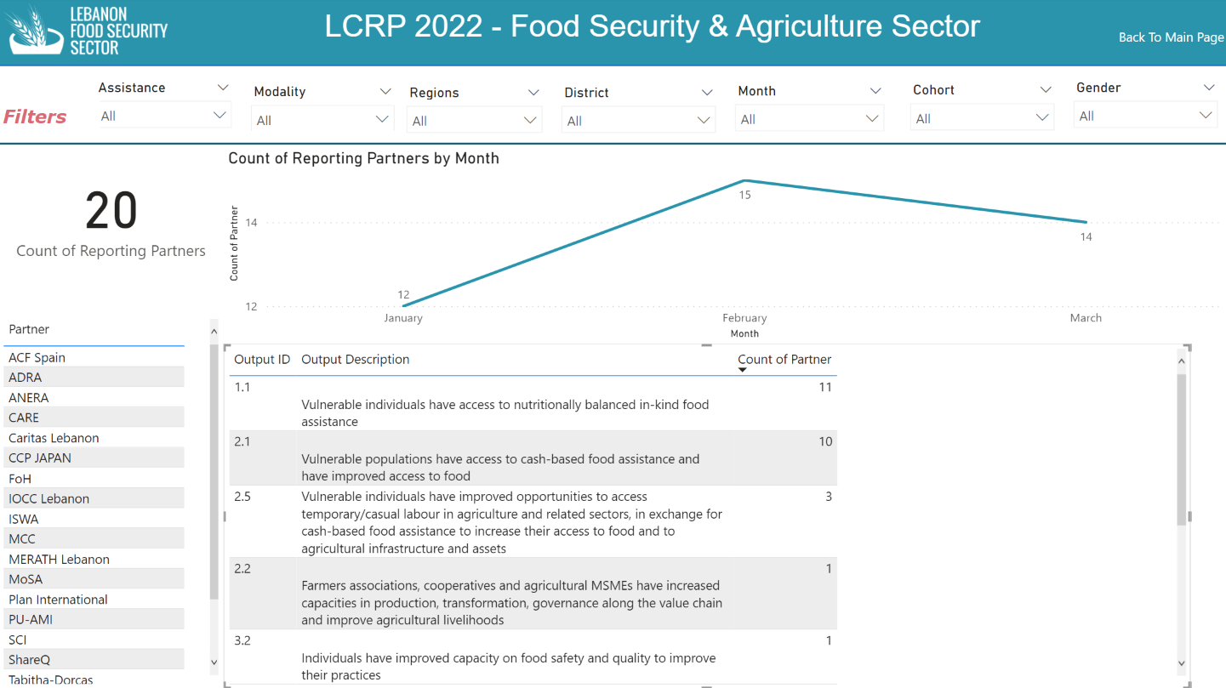

Slide 7
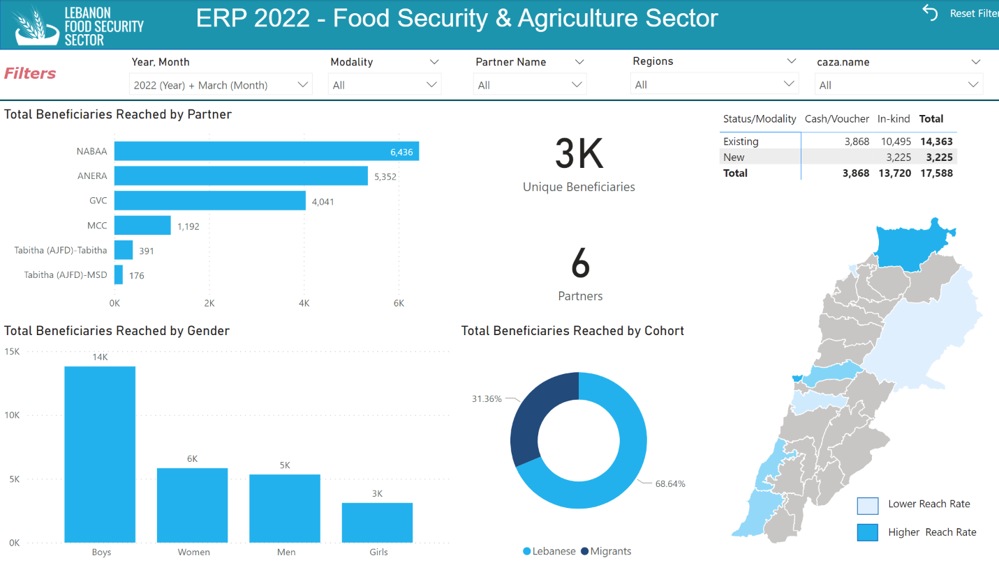

Slide 8
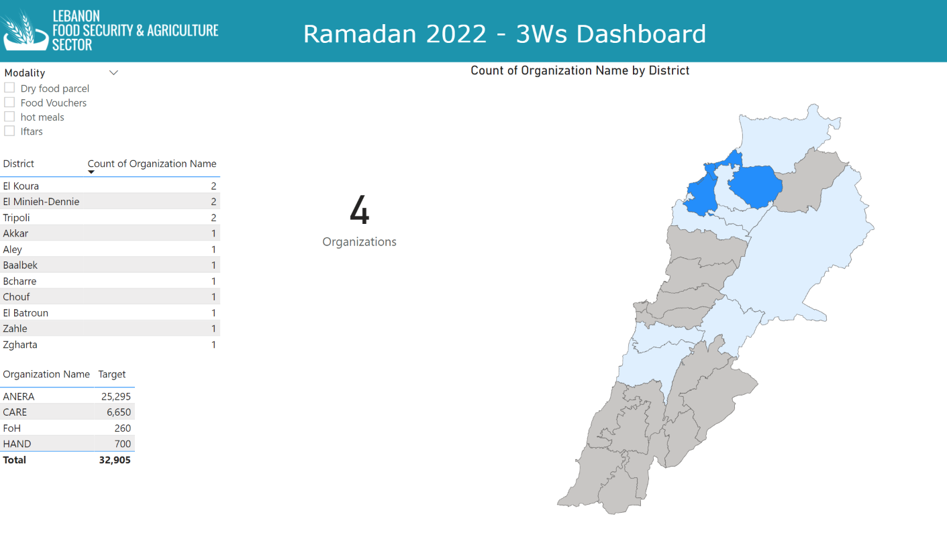

Slide 9
  Reminder
Activity Info reporting Deadline is on Friday April 15th COB
Sector’s online dashboard link
Ramadan 3Ws Survey link

Slide 10
LHF 1st Allocation
Express of Interest update
April 12, 2022
  Food Security and Agriculture Sector

Slide 11
  LHF – EOI: Projects and Organizations
9 Projects, 8 Organizations
Districts and Partners presence:
El Hermel : 0
Akkar: 5
Tripoli: 6
Baalbek: 1
Rachaya: 0
Zahle: 0
El Minieh-Dennie: 3
Others: Hasbaya Marjeyoun Area, Bekaa and Beirut

Slide 12
  LHF – EOI: Projects Activities
Activity 1: Direct access to food through CBT assistance
Activity 2: Direct food provision through in-kind assistance
Activity 3: Urgent support to vulnerable smallholder farmers through CBT or
direct provision of essential agricultural inputs. Scope is Food Security at HH level.
EOI deadline is on Friday April 15th COB
Link

Slide 13
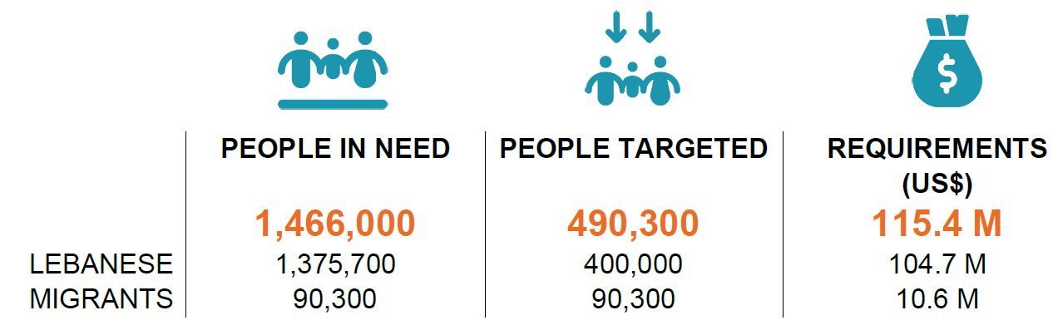
ERP revision process
Strategic Objective
Address the unmet immediate basic needs, including food needs, of the most vulnerable Lebanese and migrant populations.
Activity 1
Emergency food and basic needs assistance (cash or in kind)
Activity 2
Emergency food assistance through various modalities
Activity 3
Basic assistance through cash
Current ERP figures

Slide 14
ERP revision process
Draft updated figures based on reviewed PiN, pending confirmation of Partners capacity and validation for Migrants
2,164,523
710,300
167 M
2,074,223
620,000

Slide 15
ERP revision process
Next steps
Validation of existing FSAS objective and activities
Organisations with projects under the current ERP will receive a communication asking for reviewing their projects until Dec-2022
Organisations with ongoing projects reported to the FTS but not under the current HRP will be contacted in order to evaluate the opportunity to include those projects under the HRP
Finalisation by end of April

Slide 16
FSAS Core Group renewal
FSAS Core Group TOR

Slide 17
Ramadan activities
Monitoring of ad-hoc Ramadan activities: what is in place within the FSAS coordination.

Slide 18
Partners key updates
Partners key updates (round table for new activities launched and other relevant communications

