Slide 1
FSMS Findings
January 2022

Slide 2
FSMS introduction
The 32nd round of the Food Security Monitoring System (FSMS) was conducted between June and August 2021;
Data collected from 12,600 refugee and IDP households across 122 locations in 13 states, including Tigray refugees.
Field teams collected data from a set number of sentinel sites. Within fixed sentinel sites, sampled households were selected randomly.
Results aggregated to groups of camps and locations, called clusters (around 3 camps per clusters), and statistics reported at that level.
Questionnaire include information at household level on demographics, housing, assets, livelihoods, expenditures, coping strategies and food consumption.
Notes:
Assessment aims to monitor and analyse trends of food availability, access and utilization; ascertain the food security situation of IDP and refugee households; and highlight vulnerable geographical areas and groups.

Slide 3
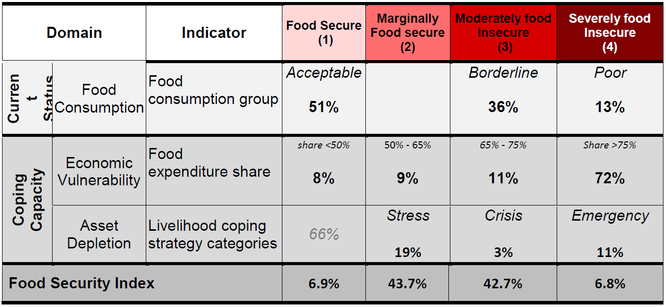
Consolidated Approach to Reporting Indicators of Food Security (CARI)

Slide 4
Prevalence of food insecurity among refugees and IDPs in Sudan (CARI)
61 percent of IDP households and 51 percent of refugee households in Sudan are food insecure.
An increase compared to the previous round conducted in Q1 2021 (52 percent of IDP and 45 percent of refugees food insecure).
Darfur region had higher prevalence of food insecurity among both IDP and refugee households compared to Southern and Eastern Sudan.

Slide 5
Prevalence of food insecurity among refugees and IDPs in Sudan (CARI)

Slide 6
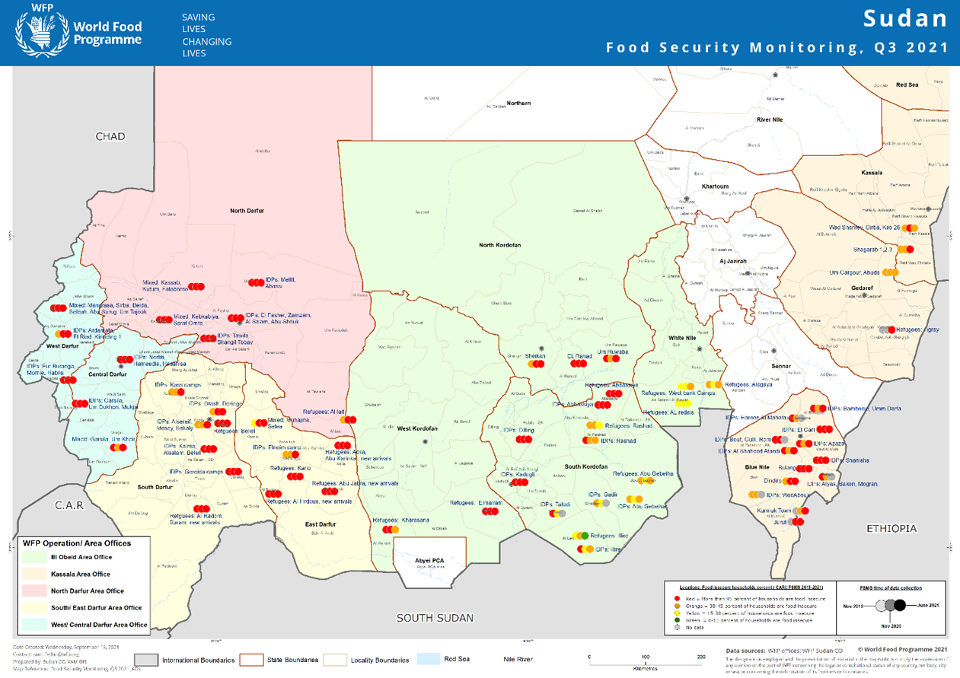

Slide 7
Percentage of food insecurity by state in Q1 2021 and Q3 2021
State | Percentage of food insecure households |  | Change compared to the previous round (%)
 | Q1 2021 | Q3 2021
North Darfur | 75% | 71% | ↓ -4%
South Darfur | 62% | 64% | ↑2%
West Darfur | 64% | 68% | ↑4%
Central Darfur | 67% | 71% | ↑4%
East Darfur | 49% | 69% | ↑20%
Kassala | 41% | 46% | ↑6%
Blue Nile | 46% | 62% | ↑15%
White Nile | 23% | 27% | ↑4%
North Kordofan | 46% | 68% | ↑22%
West Kordofan | 64% | 50% | ↓-14%
South Kordofan | 35% | 43% | ↑8%
EL Gadarif | Not assessed | 59% | NA

Slide 8
Clusters with highest food insecurity levels

Slide 9
Profile of food insecure households
60 percent of female-headed households are food insecure while 56 percent of their counterparts are.
Households with elderly head of household / many elderly members / high dependency ratio are more likely to be food insecure.
Household heads with a lower level of education were more food insecure. 61 percent of those with no education and 55 percent of those with only primary education were food insecure.
Households with begging and informal transfers such as remittances as main income source were the most food insecure group. 93 percent of households with begging and 67 percent of households with transfers as main income source were food insecure. Households with crops and agricultural wage labour as main income source were also more food insecure due to current lean season.

Slide 10
Prevalence of food insecurity by primary income source

Slide 11
Prevalence of poor food consumption
18 percent of IDP and 11 percent of refugee HHs in Sudan have poor food consumption.
Darfur region had a higher prevalence of poor food consumption among both IDP and refugee households compared to Southern and Eastern Sudan.

Slide 12
Negative food-based coping strategies
52 percent of IDP and refugee households resort to negative food-based coping strategies.
Food-based coping strategies | IDPs (%) | Refugees (%)
RELY ON LESS PREFERRED AND LESS EXPENSIVE FOOD | 43 % | 44 %
LIMIT PORTION SIZE OF MEALS | 25 % | 28 %
REDUCE NUMBER OF MEALS PER DAY | 24 % | 35 %
EAT BORROWED FOOD OR BORROW MONEY TO BUY FOOD | 22 % | 22 %
RELY ON HELP FROM FRIENDS AND RELATIVES (MUSAADA) | 20 % | 16 %
RESTRICT CONSUMPTION OF ADULTS TO FEED CHILDREN | 12 % | 12 %

Slide 13
Negative food-based coping strategies

Slide 14
Negative livelihood-based copings strategies
55 percent of IDP and 40 percent of refugee HHs resort to negative livelihood-based coping strategies.
Livelihood-BASED coping STRATEGIES | idps (%) | refugees (%)
Reduced non-food expenses on health | 21 % | 18 %
Spent savings | 18 % | 10 %
Withdrew children from school | 15 % | 6 %
Sold household assets/goods | 10 % | 7 %
Borrowed money / food from a formal lender / bank | 7 % | 3 %
Sold more animals (non-productive) than usual | 6 % | 1 %
Sold last female animals | 5 % | 1 %
Sold productive assets or means of transport | 5 % | 2 %
Sold house or land | 3 % | 0 %
Begging | 3 % | 2 %
Notes:
Increase from the previous

Slide 15
Negative livelihood-based copings strategies

Slide 16
Economic vulnerability: prevalence of HHs that spend more than 65 percent on food
More than 90 percent of IDP and refugee population is spending more than 65 percent of their total expenditure on food.
Households are forced to prioritize immediate short-term food needs over longer-terms investments in such as health care or education and other basic needs.

Slide 17
Drivers of transitioning out of food insecurity for refugees
The livelihoods with less probabilities of transiting out are those living out of donations and casual workers (non-agricultural).
Refugees involved in small businesses, selling crops or salaried worker are more likely to be in a better food security status.
Owning a camel is strongly correlated with being in a better food security status.
GFD, cash assistance, FFA, and other types of assistance is correlated with being in a better food security status.

Slide 18
Outlook
Key drivers of food insecurity include macroeconomic crisis, protracted political instability and environmental hazards.
With the ongoing economic downturn and high inflation, food prices are likely to remain high.
According to WFP market monitor, the national average cost of local food basket was SDG270.85, which is an increase by 3 percent compared to the previous month and 124 percent compared to a year before.
This will further erode the purchasing power of households, especially with high market reliance.
Also with the lean season approaching, the prevalence of food insecurity will likely remain high.

