Slide 1


Pemba,
14 April 2021

Slide 2
Pemba FSL Cluster Meeting – 14 April 2021
AGENDA
Emergency – Update
  Palma
  Emergency Tracking Tool (ETT), Mohamed Bakr
  Government Plan
Nampula: Food Security and Nutrition Assessment, SPAE / DPAP
FSC Updates
  FSC in Numbers, FSC Information Manager
  Food Assistance - Partners
  Agriculture WG Update, FAO
Inter-Cluster
  CERF
  Mueda Multi-Sectoral Mission
Trainings
  Protection
  FTS
AOB

Slide 3
Pemba FSL Cluster Meeting – 14 April 2021
ACTION & FOLLOW–UP POINTS
ACTION POINTS
1. Arco Iris: To adjust the food basket to a one-month ration by increasing the quantities of the food commodities. DONE! Revised food basket: 25Kg arroz, 25K farinha, 10Kg feijão, 5Lt Oleo, 1Kg sal, 1 item de roupa, 1 plastic NOTE: For Metuge, specifically for Bandar, Tratara, Ngalane and Natugo (Ntocota).
2. Arco Iris: To contact Helga and Ketty on challenges related to the disaggregated beneficiary data by age and gender in the 5W. DONE!
3. Caritas, jointly with government, to identified two areas of assistance in Palma. CANCELLED!
Follow-Up
1. NAMPULA: Follow up on the results of the meeting the HCT and a COE. PENDING.
2. Request from government to assist people in 280 new IDP arrivals who did not make it to the list.

Slide 4
Pemba FSL Cluster Meeting – 14 April 2021
Situation Update
Emergency – Update
  Palma
  Emergency Tracking Tool (ETT), Mohamed Bakr

Slide 5
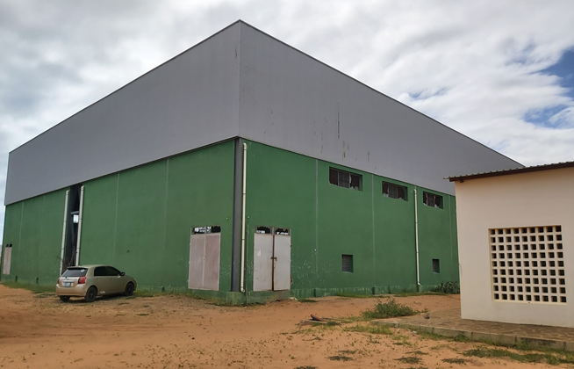
Pemba FSL Cluster Meeting – 14 April 2021
Situation Update
Emergency – Update
  Pemba Response, Centro Esportivo
  Arco-Iris, Caritas, WFP, Local Organizations

Slide 6
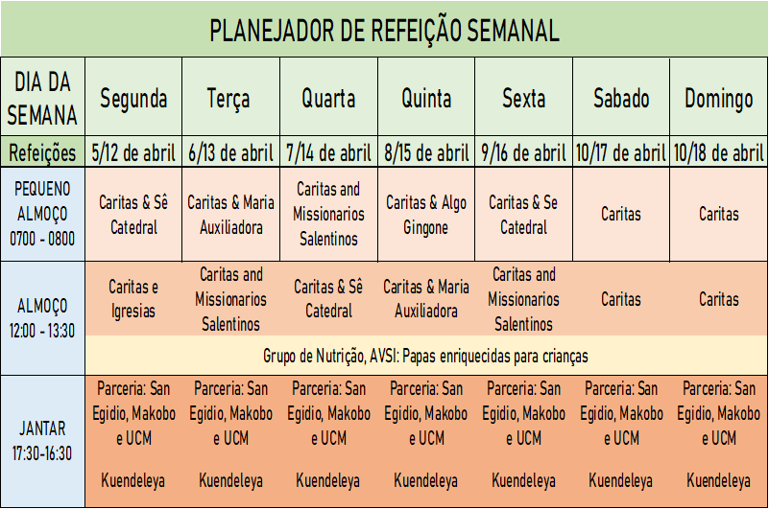
Pemba FSL Cluster Meeting – 14 April 2021
Situation Update
Emergency – Update
  Meals Calendar
  Stocks
5,350 food kits (WFP & Caritas) (2, 350) allocated Mueda, Montepuez, Ibo & Pemba. 3,000 BALANCE 30,000 FFR (5 pessoas) for 30 days by WFP

Slide 7
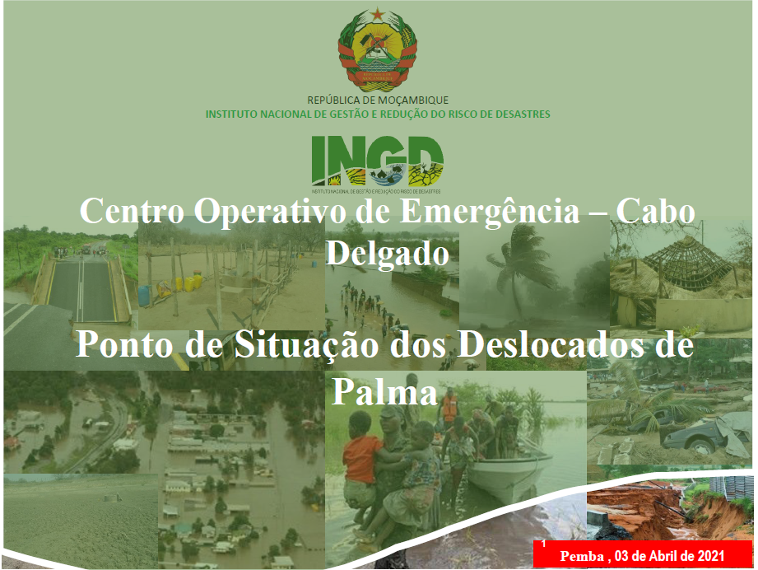
Pemba FSL Cluster Meeting – 14 April 2021
Situation Update
Emergency Update: Government Response Plan

Slide 8
Pemba FSL Cluster Meeting – 14 April 2021
Nampula Assessment
2. Nampula: Food Security and Nutrition Assessment, SPAE / DPAP

Slide 9
Pemba FSL Cluster Meeting – 14 April 2021
FSC Updates
  FSC in Numbers, FSC Information Manager
  Food Assistance - Partners
  Agriculture WG Update, FAO
Inter-Cluster
  CERF
  Mueda Multi-Sectoral Mission
Trainings
  Protection
  FTS
AOB

Slide 10

Pemba,
FSC response update
April 14th, 2021
Data month: March2021 , Last update: 14th April 2021
Data source: The information that will presented is reported by FSC partners all month in the 5W matrix
IMO contacts: joao.muianga@wfp.org, ketankumar.trivedi@wfp.org

Slide 11



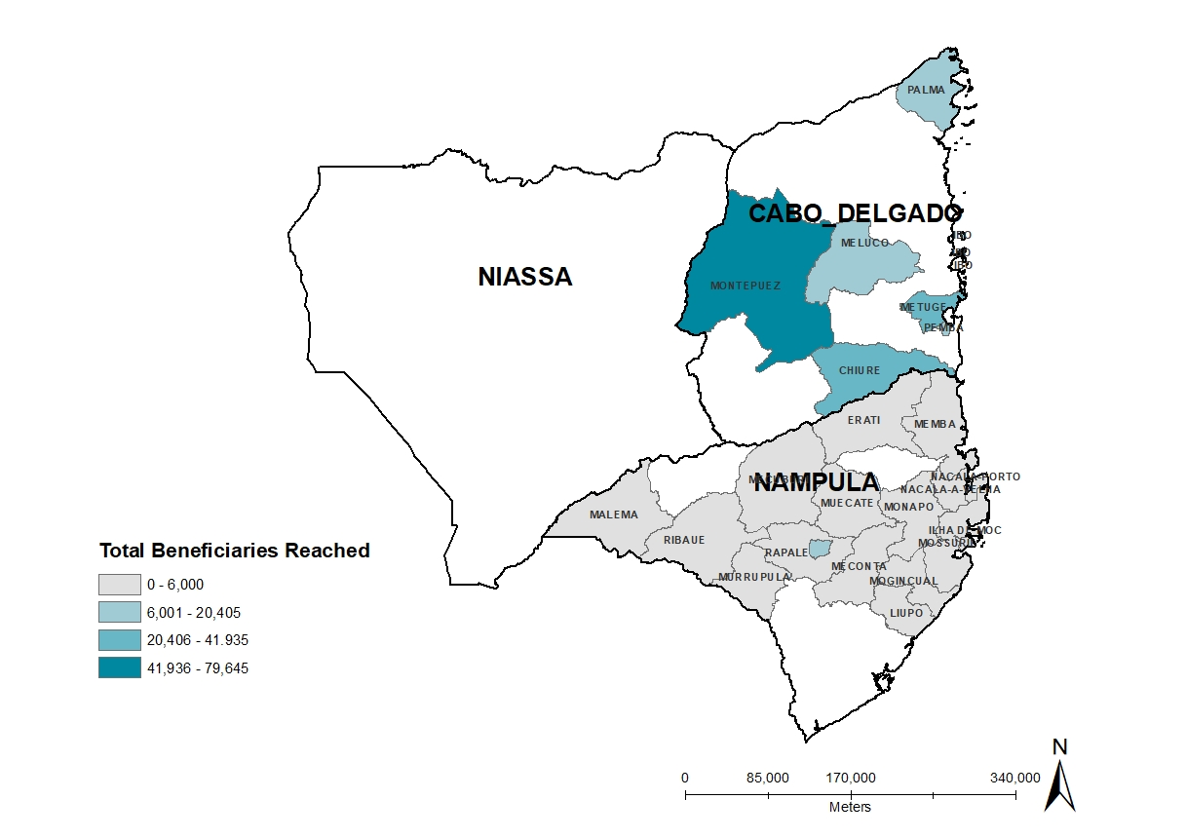


S01: Food Assistance Response in the North of Mozambique
As of March 31st , 2021
PIN (HRP 2021)
MAPPING: BENEFICIARIES REACHED BY DISTRICT BY PARTNERS
In the month of March 2021, the FSC partners provided assistance to food insecurity population in Cabo Delgado, Nampula and Niassa provinces.
950,000
PEOPLE TARGETED (HRP 2021)
Montepuez
34%
Ibo
9%
WFP – SEPPA
JAM
WFP-SEPPA
750,000
#BENEFICIARIES BY LEAD
PEOPLE REACHED (MONTH)
WFP is the lead organization with 78. % of coverage (18 districts in Nampula and 5 districts in Cabo Delgado) followed by JAM (12% of coverage and 1 district), Caritas ( 5% of coverage and 1 district) and Ministerio Arco-Iris (5% of coverage and 1 district).
232,000
Chiure
13%
TOTAL OF BENEFICIARIES REACHED BY DISTRICT
WFP – SEPPA
25
RESPONSE BY MODALITY
Metuge
18%
WFP – SEPPA
Ministerio Arco-Iris
Caritas
RESPONSE BY EVENT
LEAD ORGANIZATION
IMPLEMENTING PARTNER
World Food Programme
Ministerio Arco Iris
Caritas
JAM
SEPPA, CCM, AMA
Caritas Pemba
Ministerio Arco Iris
UNHCR / INAR
4
6

Slide 12

S01: Food Assistance Response by Cabo Delgado
As of March 31st , 2021
.
PEOPLE TARGETED
TOTAL OF BENEFICIARIES REACHED BY INDICATOR
675,000
Number of targeted people
receiving regular food assistance per modality
(minimum 10 months covered).
PEOPLE REACHED
202,000
TOTAL OF BENEFICIARIES REACHED BY DISTRICT
Number of IDPs/returnees
assisted disaggregated by age
and gender; MT/value of food provided.
7
TOTAL OF BENEFICIARIES REACHED BY LOCATION TYPE
LEAD ORGANIZATION
IMPLEMENTING PARTNER
4
World Food Programme
Ministerio Arco Iris
Caritas
JAM
4
Caritas Pemba
SEPPA, AMA
Ministerio Arco-Iris

Slide 13
S01: Food Assistance Response In Nampula
As of March 31st , 2021
.
PEOPLE TARGETED
TOTAL OF BENEFICIARIES REACHED BY INDICATOR
52,000
PEOPLE REACHED
30,000
TOTAL OF BENEFICIARIES REACHED BY DISTRICT
18
TOTAL OF BENEFICIARIES REACHED BY LOCATION TYPE
LEAD ORGANIZATION
IMPLEMENTING PARTNER
1
2
World Food Programme
UNHCR/INAR
CCM

Slide 14
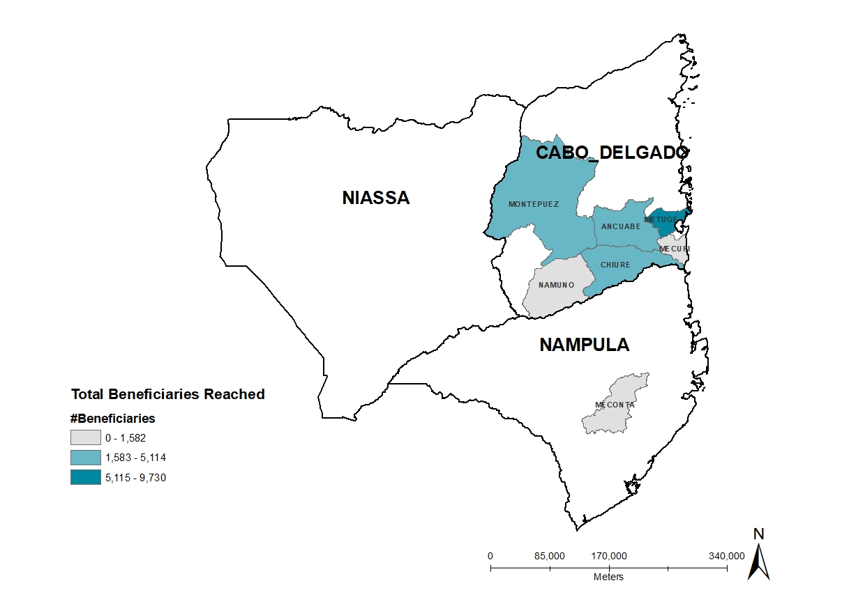
S01: Livelihoods Response in the North of Mozambique
As of March 31st , 2021
In the month of March 2021, the FSC partners did support rebuilding of the livelihoods of the affected population in the resettlement sites and host communities in Cabo Delgado province.
PIN (HRP 2021)
MAPPING: BENEFICIARIES REACHED BY DISTRICT BY PARTNERS
950,000
Montepuez
14%
Metuge
PEOPLE TARGETED (HRP 2021)
36%
550,000
FAO – AVSI
FAO – ADEL-CD,
Caritas
#BENEFICIARIES BY LEAD
PEOPLE REACHED (MONTH)
FAO is the lead organization with 86. % of coverage (6 districts in Cabo Delgado) followed by Livaningo(6% of coverage and 1 district in Nampula), Ministerio Arco Iris ( 5% of coverage and 1 district in Cabo Delgado) and Caritas (3% of coverage and 3 districts in Cabo Delgado).
27,000
TOTAL OF BENEFICIARIES REACHED BY DISTRICT
Chiure
19%
08
FAO– SDAE
RESPONSE BY MODALITY
Chiure
13%
FAO– ADEL-CD, Caritas
RESPONSE BY EVENT
LEAD ORGANIZATION
IMPLEMENTING PARTNER
Food And Agriculture Organization
Ministerio Arco Iris
Livaningo
Caritas
4
Caritas Pemba
SDAE, ADEL-CD, AVIS
4

Slide 15
S01: Livelihoods Response In Cabo Delgado
As of March 31st , 2021
.
PEOPLE TARGETED
TOTAL OF BENEFICIARIES REACHED BY INDICATOR
440,000
PEOPLE REACHED
25,000
TOTAL OF BENEFICIARIES REACHED BY DISTRICT
7
TOTAL OF BENEFICIARIES REACHED BY LOCATION TYPE
LEAD ORGANIZATION
IMPLEMENTING PARTNER
3
Food and Agriculture Organization
Ministerio Arco Iris
Caritas
4
Caritas Pemba
SDAE, ADEL, AVSI

Slide 16
S01: Livelihoods Response in Nampula
As of March 31st , 2021
.
PEOPLE TARGETED
TOTAL OF BENEFICIARIES REACHED BY INDICATOR
60,000
PEOPLE REACHED
1,500
TOTAL OF BENEFICIARIES REACHED BY DISTRICT
1
TOTAL OF BENEFICIARIES REACHED BY LOCATION TYPE
LEAD ORGANIZATION
IMPLEMENTING PARTNER
1
0
Livaningo

Slide 17
IM Update
FSC Information
Kindly share to us the 5W focal point information fill the form:
FSC create a google driver, partner can upload and download relevant information, the link below: FSC Driver
Food Security Cluster Website: https://fscluster.org/mozambique/documents
Interactive Dashboard of Partner Presence for Cabo Delgado

Slide 18
Pemba FSL Cluster Meeting – 14 April 2021
Obrigada!!!

