Slide 1

Food Security & Agriculture Sector
National Working Group Meeting
May 10th, 2022

Slide 2
Agenda
Food security and market situation analysis – WFP/RAM updates
Activity-info updates (LCRP, ERP…)
Protection/gender/SGBV mainstreaming priorities and focal points (UNDP-UNHCR)
Core Group nominations update
BASATINE Consortium Programme presentation
ERP 2022 light revision process update
Partners key updates
LHF 1st allocation 2022: field coordination update and Q&A session (only for interested Partners, please see note below)
AOB

Slide 3
Activity Info Update
May 10, 2022
  Food Security and Agriculture Sector

Slide 4
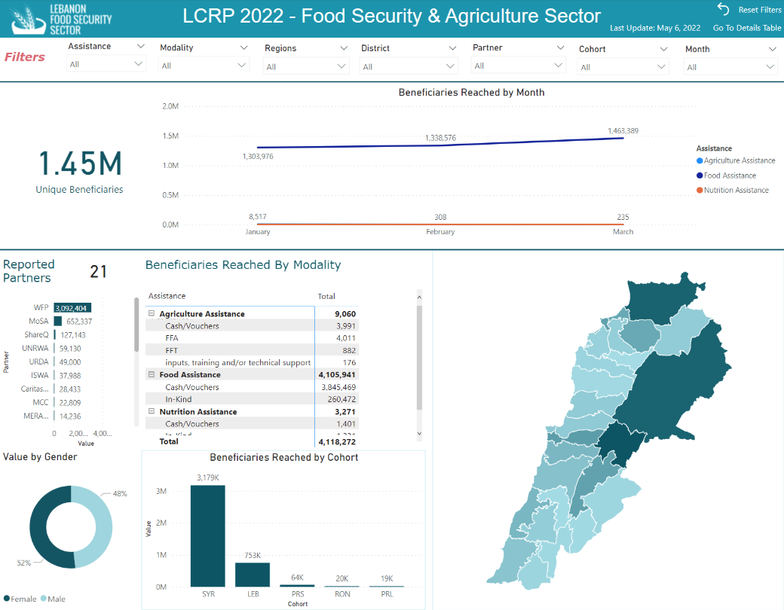

Slide 5
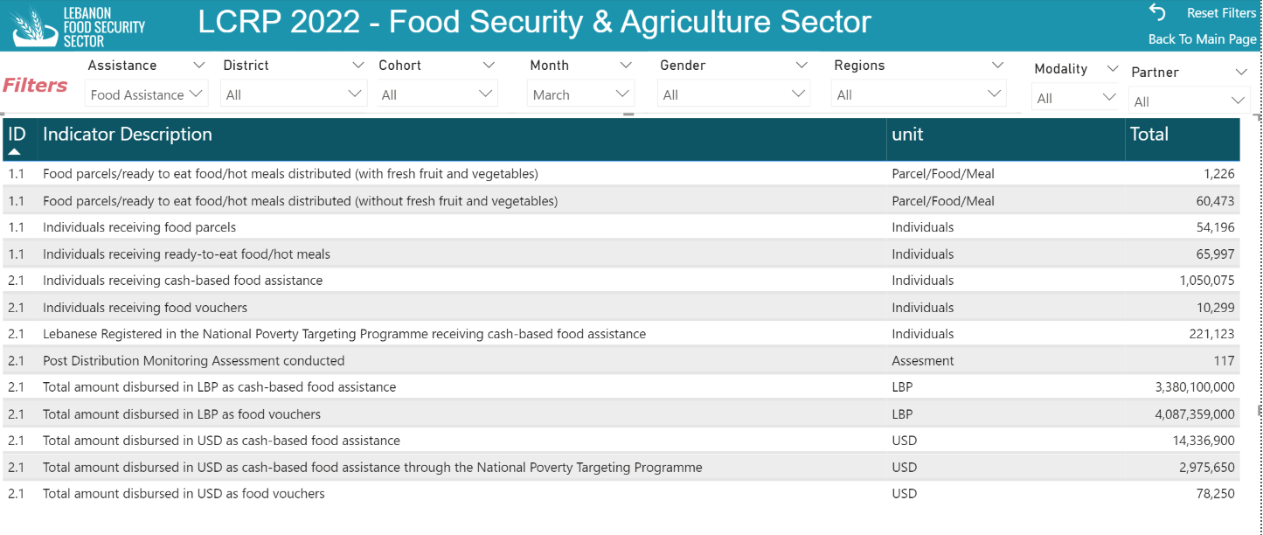

Slide 6
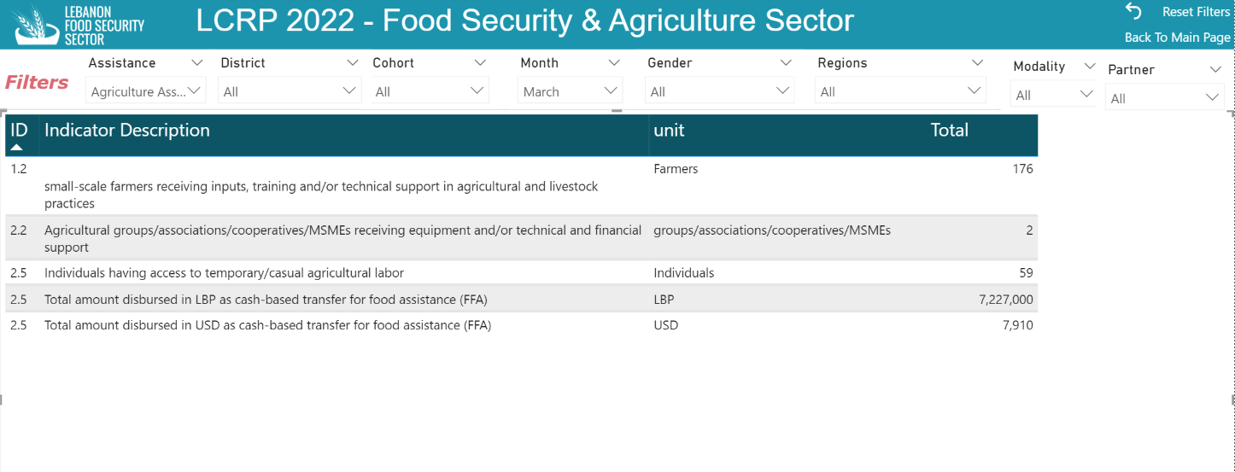

Slide 7
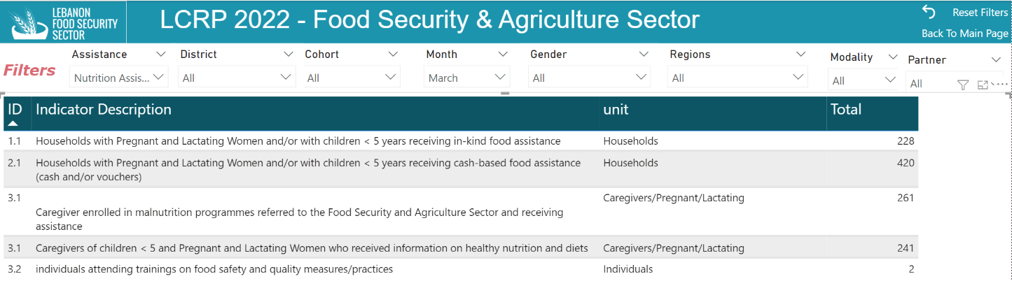

Slide 8
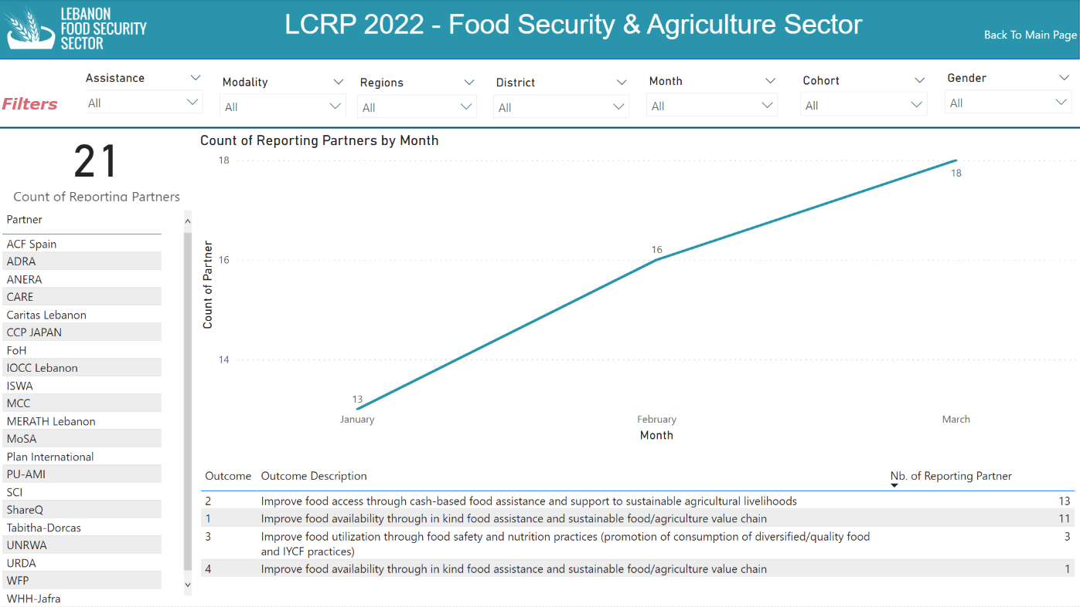

Slide 9
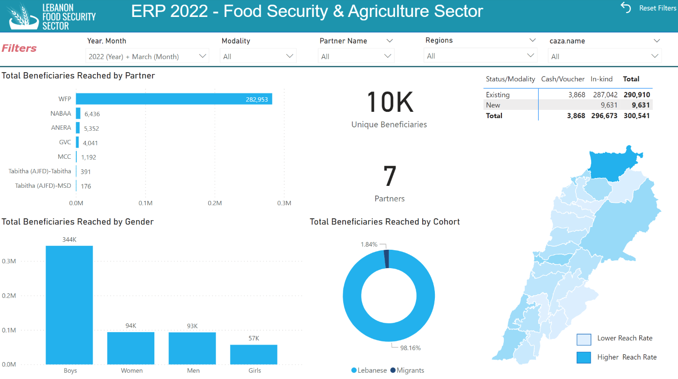

Slide 10
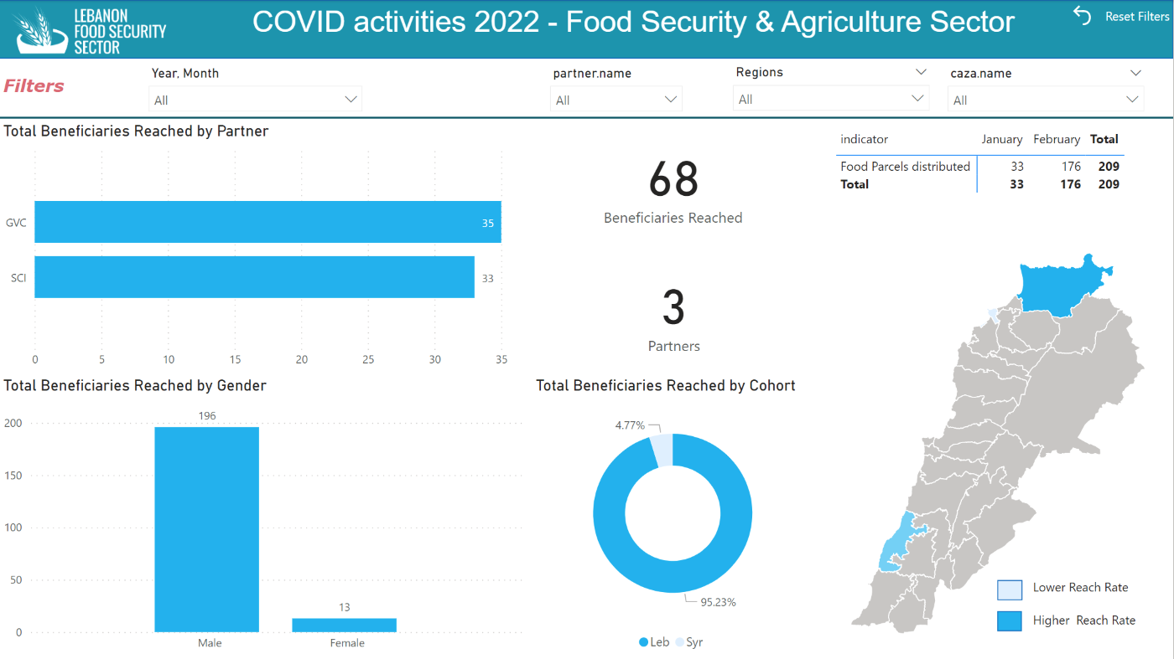

Slide 11
  Reminder
Activity Info reporting Deadline is on Friday May 13th COB
Sector’s online dashboard link

Slide 12
  ERP 2022 light revision time line – Projects revision
The ERP is being extended until December 2022
 | May |  |  |  |  |  |  |  |  |  |  |  |  |  |  |  |  |  |  |  |  |  |  | June
 | 9 | 10 | 11 | 12 | 13 | 14 | 15 | 16 | 17 | 18 | 19 | 20 | 21 | 22 | 23 | 24 | 25 | 26 | 27 | 28 | 29 | 30 | 31 | 1 | 2 | 3 | 4 | 5 | 6 | 7 | 8 | 9 | 10 | 11 | 12 | 13
Guidance note shared with EOC and Partners
Partners upload projects
Training Partners on Project module |  |  |  |  | 12:00
Sectors review projects
Partners revise projects
Sectors enforse projects
Project approval by HC

Slide 13
  ERP 2022 light revision time line – Projects revision
Projects can be extended until December 2022 if they are still justified by needs. This applies to any level of funding received.
Extended projects on the online platform will be re-submitted in two parts (OCHA will provide guidance):
  August-December 2021
  January-December 2022
Projects reported in the Financial Tracking System (FTS) but not part of the ERP, could also be included, if relevant to ERP objectives and activities.

Slide 14
  LHF 1st allocation 2022 - update
Deadline for project submission: 13th May
Project revision process: by 27th of May
Financial revision: by 8th June
Final approval: from 13th June onwards
District level direct coordination is working well, and resulted in some plans’ modifications and joint work.
Q&A session through Jamboard.

Slide 15
  LHF 1st allocation 2022 - update
Households verification: the FSAS Team is working with WFP to have a standard questionnaire, including WFP system for the analysis of data.
Beneficiaries selection: working with WFP to make available Lebanese assessed HHs who cannot be served by WFP due to financial constraint.
Vetting panel: 1 INGO and 1 LNGO needed to be part of the panel

