Slide 1
Damascus Hub achievements (Jan-Dec, 2020)

Slide 2
Strategic Objective | # of Beneficiaries
SO1 | 4,138,807
SO2 | 1,552,499
SO3 | 318,193
6,009,499
Beneficiaries Assisted from Jan to Dec 2020

Slide 3
Type of Assistance for SO1

Slide 4
Type of Assistance for SO2&SO3

Slide 6
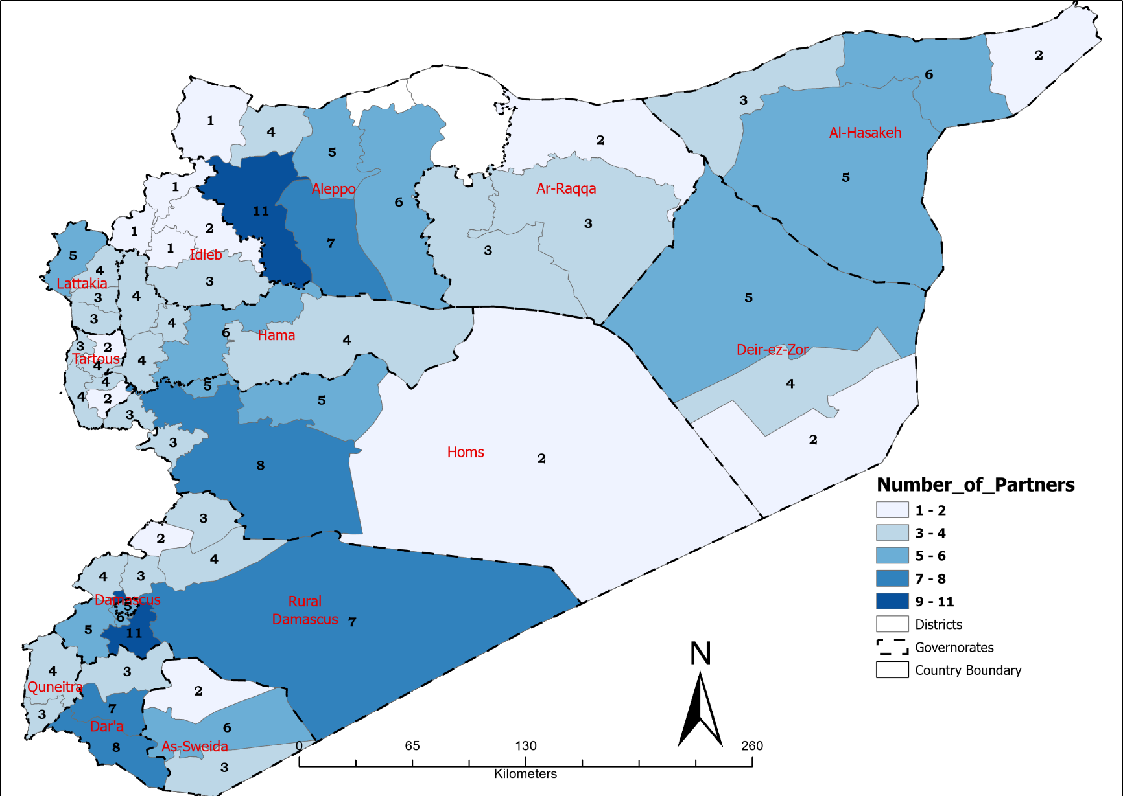
Syria-DAM-Hub: Partners’ Presence (Leading Agencies) Map
Jan-Dec-2020
This map indicates the areas where FSC partners’ projects are being implemented at the moment. It is based on the FSC 5Ws matrix, hence it reflects only the activities of the organizations that have agreed to share their 5W info with the cluster. For those actors who are not listed and who are currently conducting food security activities, we encourage them to share the matrix with the FSC. Since projects can finish or start at any time during the year, this mapping will be shared every month in order to have a realistic and up-to-date version of the current situation.
Total number of Partners
17
Total number of Partners
Oxfam | WFP | AAH
EU | ICRC | IFRC
ADRA | UNRWA | TdH
DRC | FAO | COOPI
UNHCR | PARCIC | Dorcas
OCHA | Aga Khan Foundation
http://fscluster.org/syria
Contact: moteb.marei@wfp.org
The boundaries and names shown and the designations used on this map do not imply official endorsement or acceptance by the UN.
Production date: 10/Jan/21 Data sources: FSLC/FSLC Partners

Slide 7
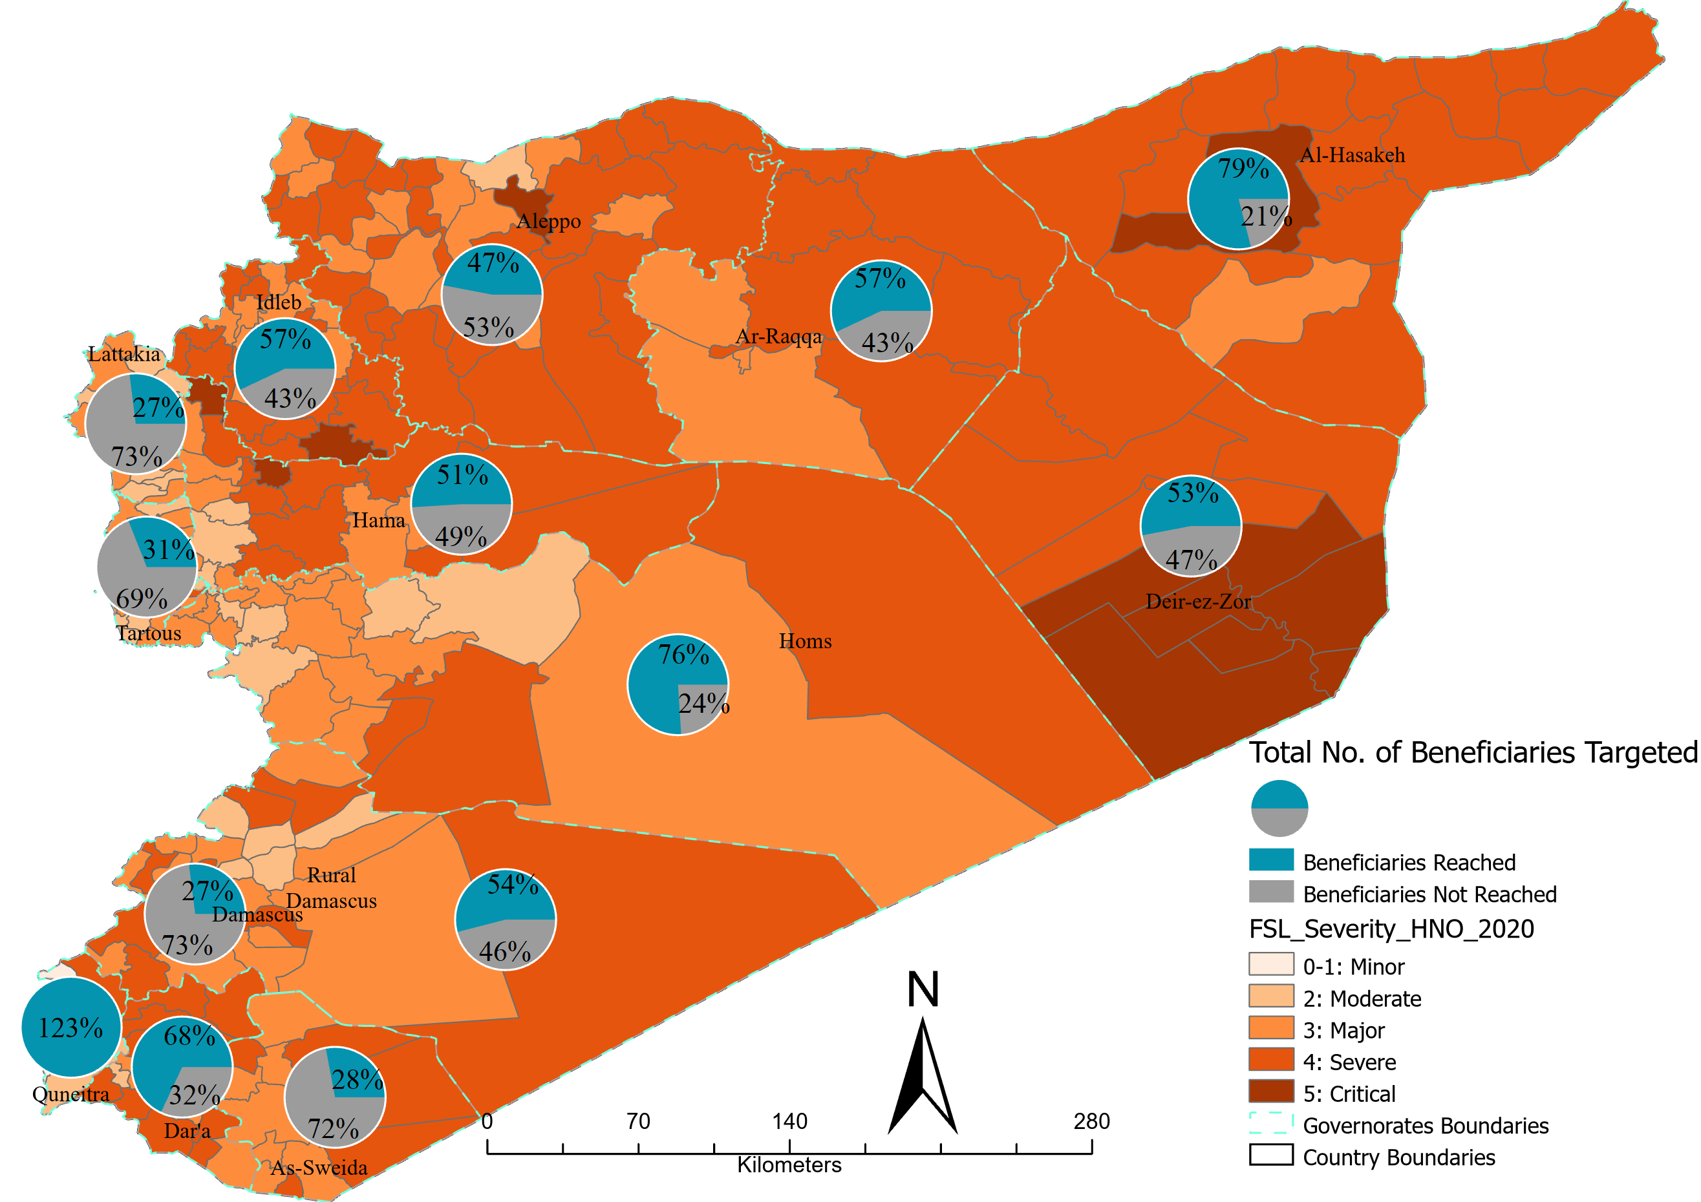
Country: FS Gap Analysis – SO1 Food Assistance
Jan-Dec- 2020
http://fscluster.org/Syria
The boundaries and names shown and the designations used on this map do not imply official endorsement or acceptance by the UN.
Production date: 11-Jan-21
Data sources: FSLC/FSLC Partners
Contact: moteb.marei@wfp.org
http://fscluster.org/

Slide 8
Country: FS Gap Analysis – SO1
Jan-Dec- 2020
Target vs Reach for ‘Governorate’
http://fscluster.org/Syria
The boundaries and names shown and the designations used on this map do not imply official endorsement or acceptance by the UN.
Production date: 11-Jan-21
Data sources: FSLC/FSLC Partners
Contact: moteb.marei@wfp.org
http://fscluster.org/

Slide 9
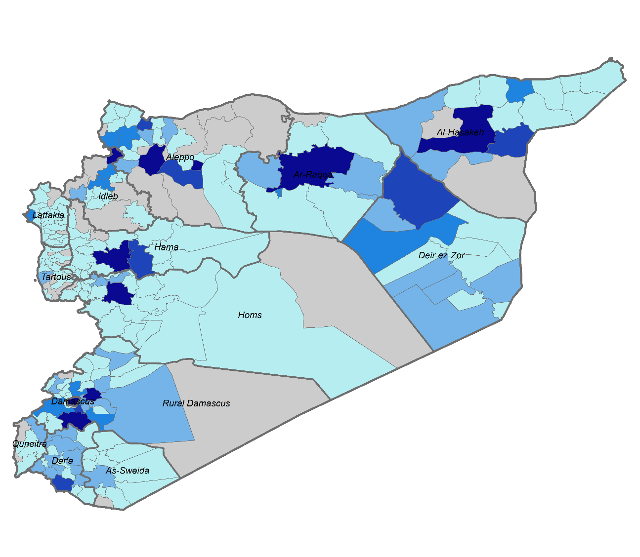
Damascus Hub achievements (Jan-Dec, 2020) Per Sub-District For SO1

Slide 10
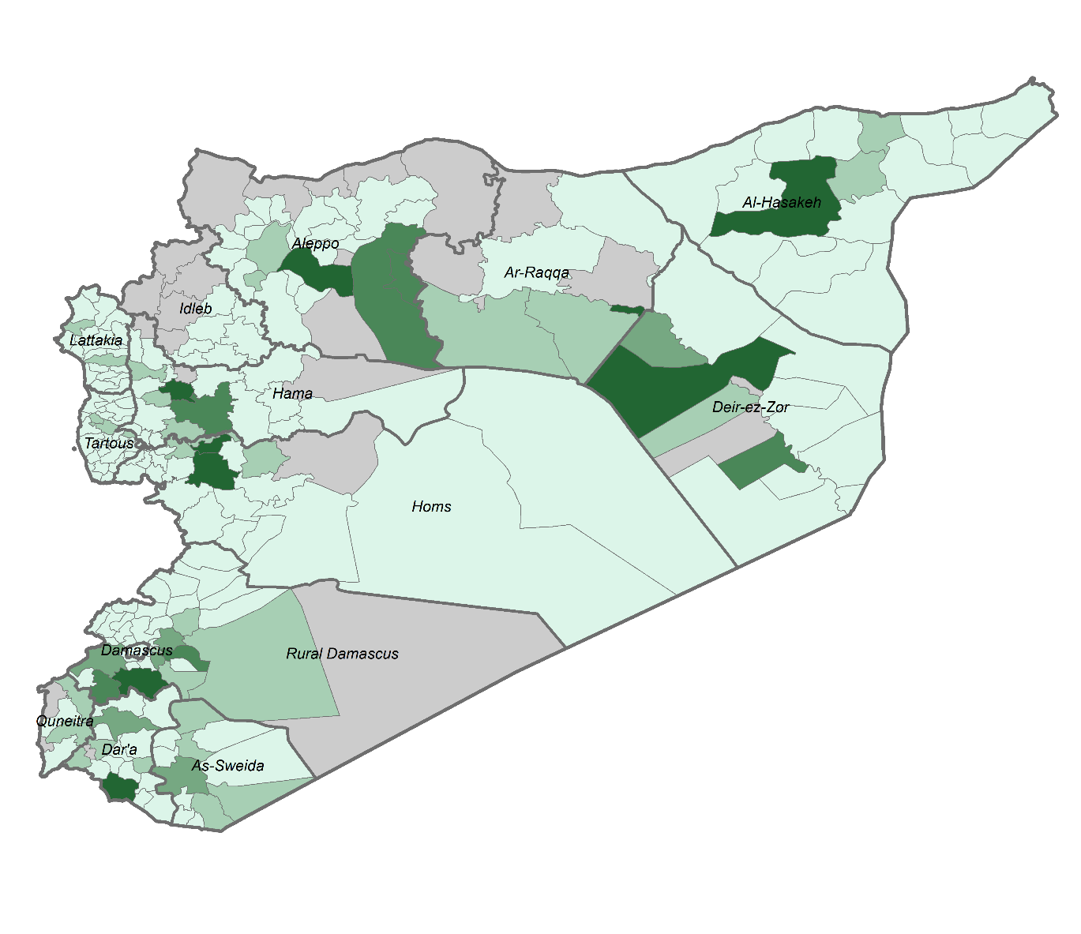
Damascus Hub achievements (Jan-Dec, 2020) Per Sub-District For SO2&SO3

