Slide 1
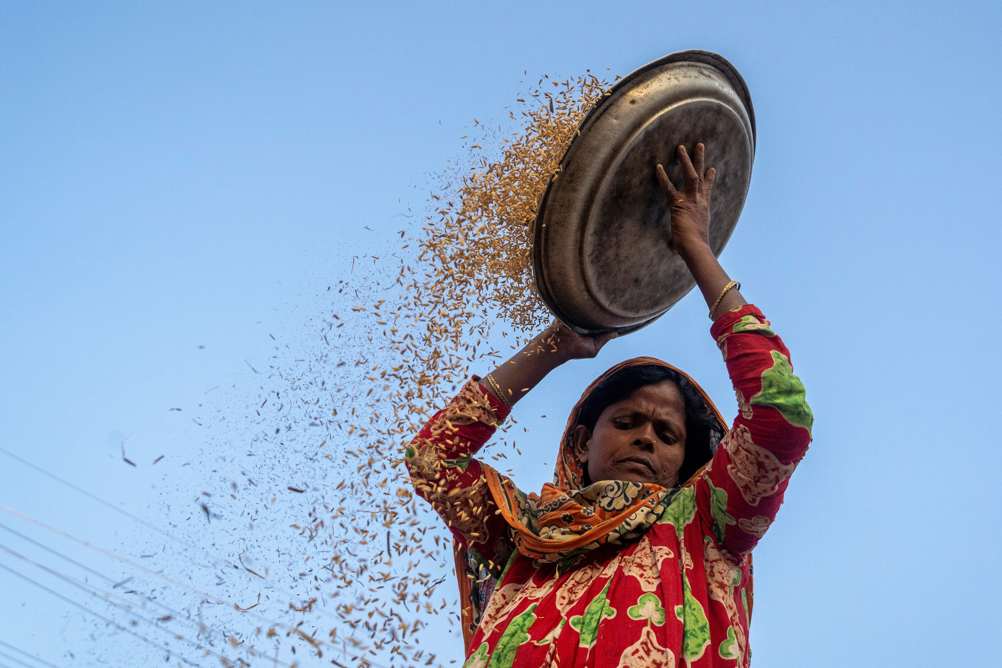
Meeting with Livestock Partners
29 December 2021
Cox’s Bazar, Bangladesh
Photo: ISCG / Saikat Mojumdur

Slide 2
Agenda
Preview of last meeting minutes and action points
Livestock Focal Point Input Update
Livestock mapping: Update on 5W reporting for the livestock partners
Partner's presentation on Livestock by WORLD VISION & BRAC
AoB

Slide 3
Preview of the last meeting minutes and action points
Who | Action | When
FSS | A criteria has set to nominate and identifying livestock partner’s focal point. A survey link has generated and circulated with partners to input. FSS will organize a two hours webinar for livestock focal points for livestock activities monthly reporting in existing 5W template. To enrich and strengthening partners coordination, Department of Livestock Services (DLS) officials will included from upcoming meetings. Will develop a common pool for the livestock service providers. Will generate livestock partner’s activity tracker and dashboard. Will compile related documents in google drive for all partner’s access. Livestock distribution guidelines. | 9th December By December Ongoing Ongoing Ongoing Ongoing Ongoing
Livestock Meeting Action Points
FSS Partners | Will attend livestock focal points for the 2 hours session on 5W template for monthly livestock activity progress update reporting | By December 2021
FSS Partners | Nominate livestock Focal Point from each partner | 09 December 2021
FSS | Create and share a Livestock folder with existing documents on Google Drive | By December 2021

Slide 4
Livestock Focal Point Input Update

Slide 5
Livestock Focal Point Input Update
Livestock Focal (Organization)
ACDI/VOCA
Action Against Hunger (ACF)
BRAC
CEHRDF
Concern Worldwide
FAO
HELVETAS Bangladesh
ICCO Part of Cordaid
IOM
NONGOR
Oxfam
Practical Action
Resource Integration CENTRE(RIC)
Shushilan
Solidarites International
VSO Bangladesh
World Food Programme
World Vision Bangladesh
20 Focal from 18 organizations

Slide 6
Livestock focal point selection
The proposed criteria for the livestock focal are (recommended):
- Experienced in livestock intervention.
- Academic qualification in livestock background e.g., Veterinary science, Animal Husbandry or Agriculture.
- Working in Cox’s Bazar for the livestock program for a minimum 3 years.
- Experience in coordinating the livestock activities with relevant stakeholders including government e.g., Department of Livestock Services.
Registration: link
Deadline: 28 November 2021

Slide 7
Livestock mapping: Update on 5W reporting for the livestock partners

Slide 8
Livestock mapping: Update on 5W reporting for the livestock partners
FSS 5W orientations for FSS partners: 23 December 2021
Participant status: 36 participants from 19 organizations
FSS 5W guidance note how to report your organization’s activities on our online tracker and Excel template.

Slide 9
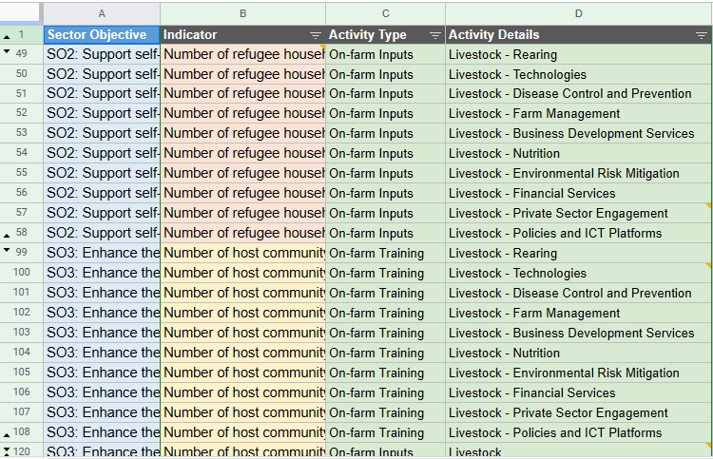
Livestock mapping: 5W reporting for the livestock partners

Slide 10
Partner's presentation on Livestock by WORLD VISION

Slide 11
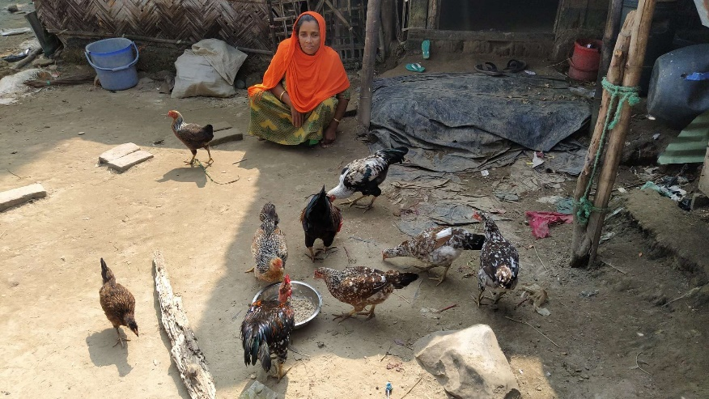
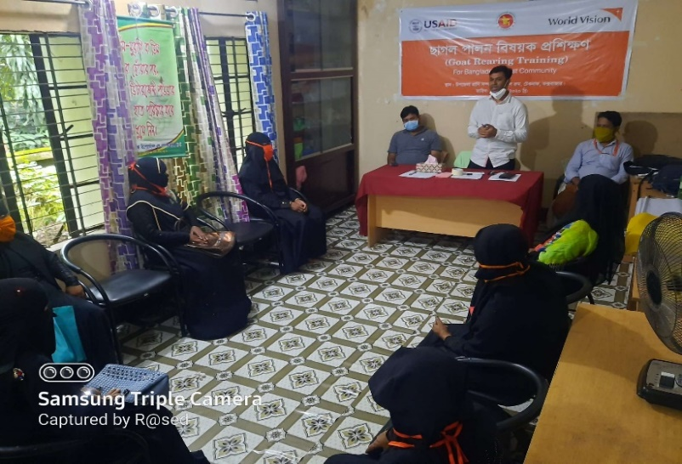
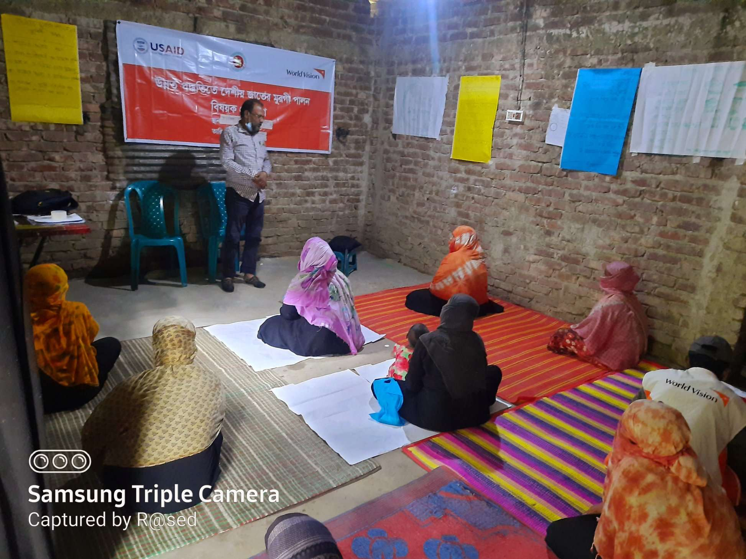
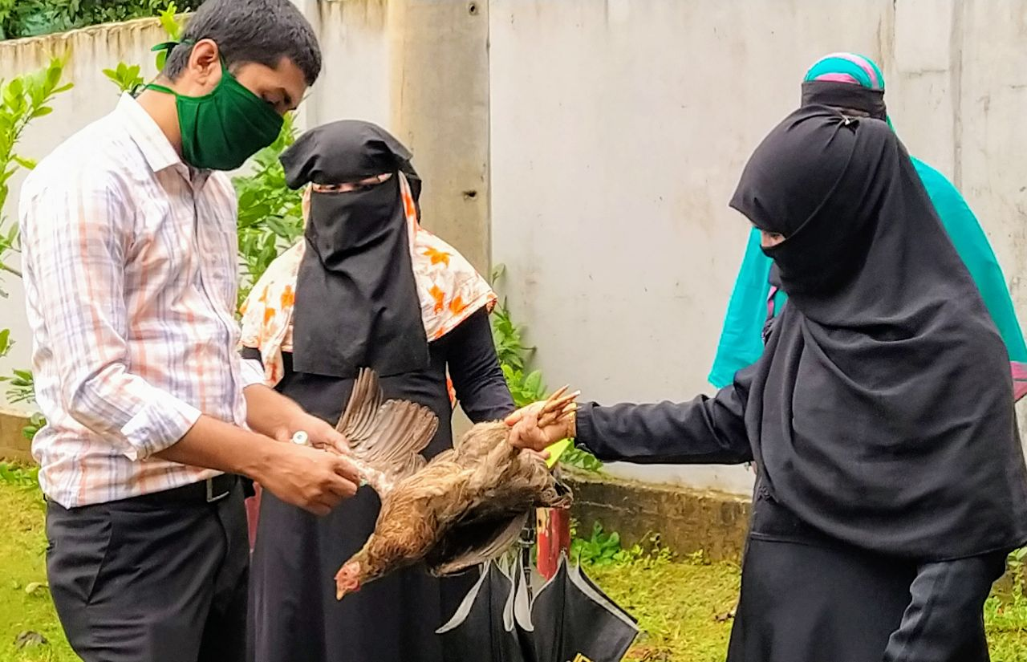
Livestock Partner Meeting
WELCOME
Dr. Jnanottor Chakma
Focal – Livestock Intervention
World Vision Bangladesh
December 29 , 2021

Slide 12
Livestock Interventions at a glance
WVB has Livestock interventions under two (2) projects:
Emergency Food Security Program (EFSP): To improve food security and nutrition status of vulnerable host community members in Cox’s Bazar District, Bangladesh, Funded by USAID
2. Gender Inclusive Pathways out of Poverty (GPoP) Project: To ‘graduate’ ultra-poor households in Ukhiya and Teknaf sub-Districts in Cox’s Bazar out of poverty, Funded by Australian Government through ANCP

Slide 13
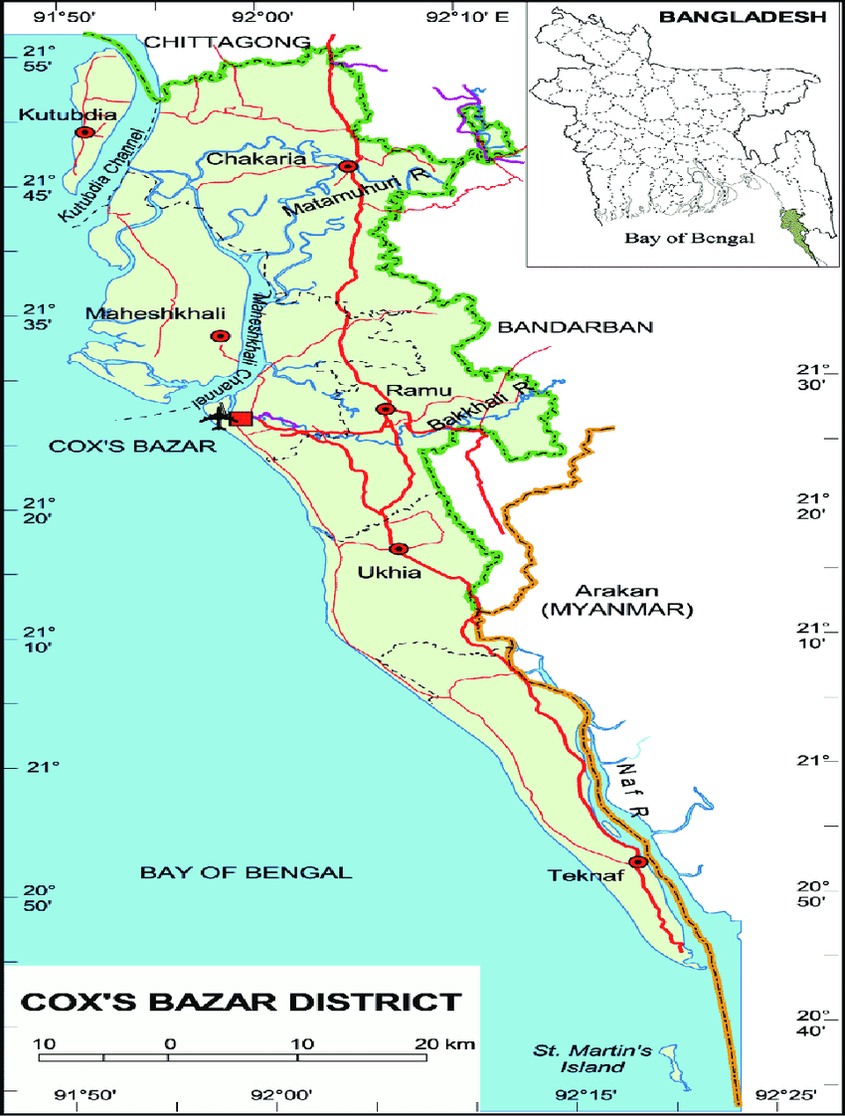
Working Area
GPoP:
Ukhiya & Teknaf sub-districts (148 Villages)
(4 unions each)
EFSP:
Sub-districts Ukhia & Teknaf
( 233 villages (Teknaf -57 Ukhia-178)
Ukhiya: 3 Union ( Jaliapalong , Palonkhali and Razapalong )
Teknaf : 2 Union ( Baharchora and Hinla )

Slide 14
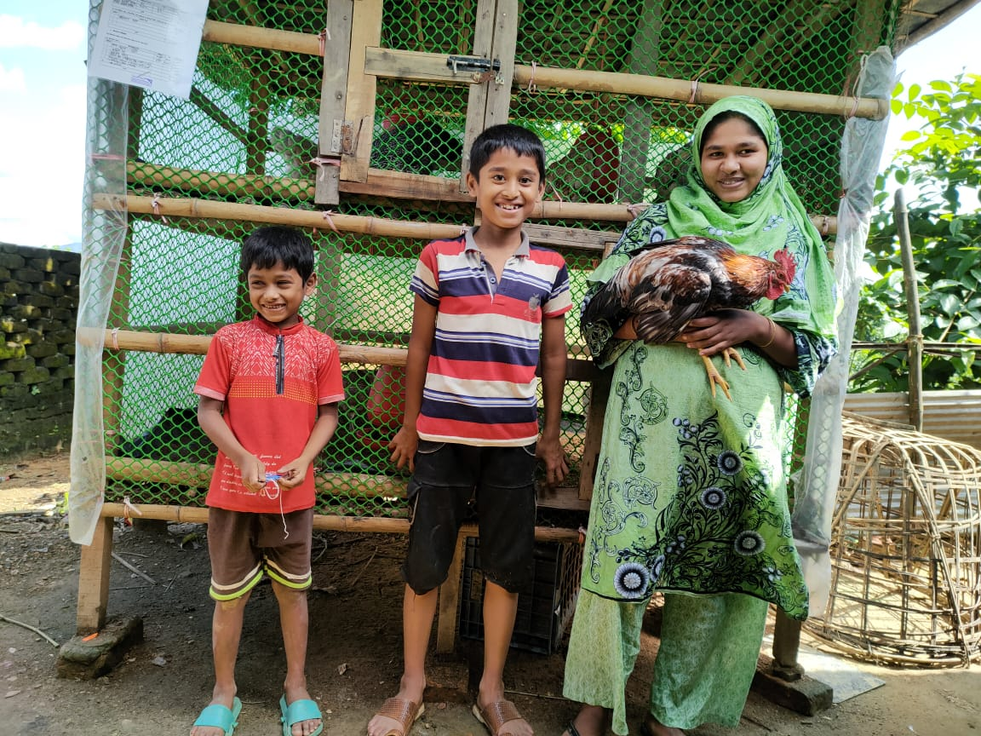
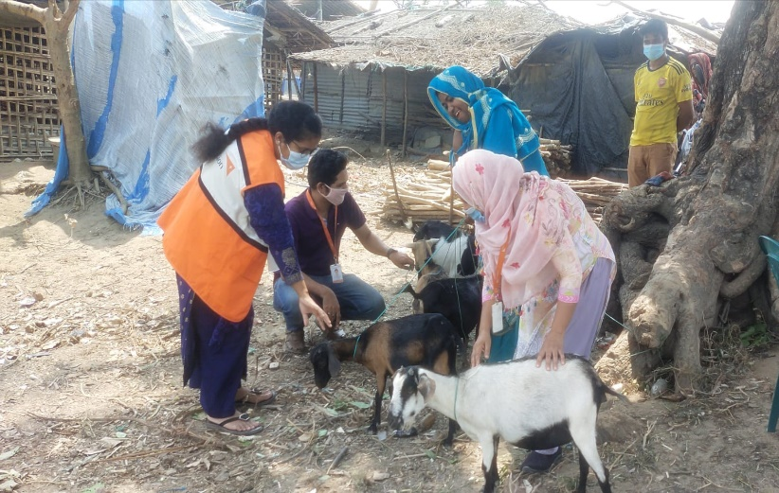
Livestock Activity
Indigenous Chechen Rearing
345 Groups
Total participants : 3460 ( M-64 F-3396)
Goat rearing
90 Groups
Participants : 906 ( M-163, F 743)
Total Goat : 1925

Slide 15
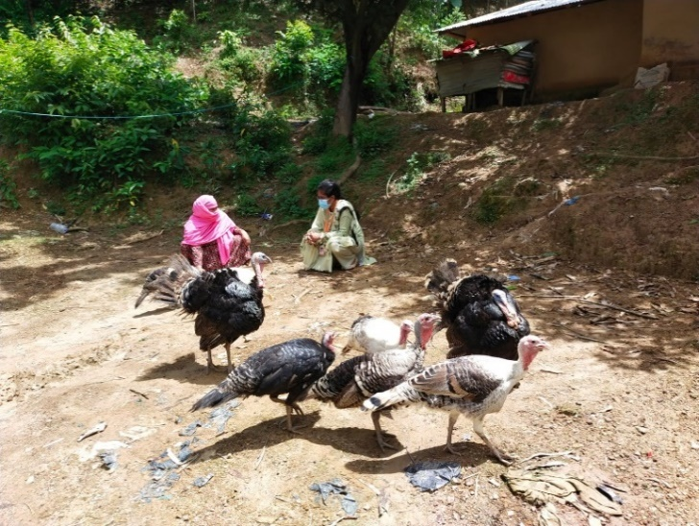
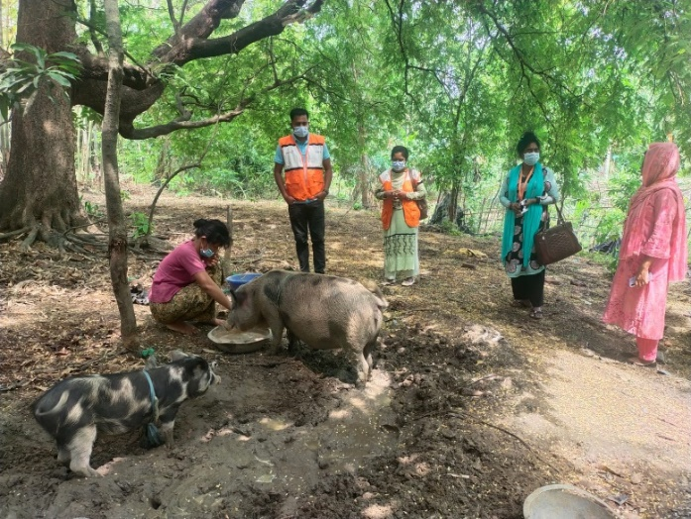
Livestock Activity
Terkey Rearing
8 Groups
Participants – 86 ( M-04 F- 82)
Total Terkey : 543
Pig rearing
6 Groups
Participants 64 ( M 07 F57)
Total Pig : 129

Slide 16
Our Approaches
1. Ultra-Poor Graduation (UPG) Model – An integrated model that targets chronically food insecure families living well below poverty line, ensuring that the most vulnerable graduate out of extreme poverty towards self-reliance
2. Community Led Monitoring (CLM) – Programme monitoring by engaging communities.
3. Inclusive Market System Development (iMSD) – An approach to improve the effectiveness of market systems and the participation of poor and marginalized groups.

Slide 17
Good Practices of Livestock Intervention
1. Training – including internal/external training partner: Government engagement for technical skill training program for partner staff and Ultra poor household before asset transfer.
2. Suitability analysis of selected livestock for ultra-poor household: The Nadine Chicken and Goat are most suitable for UP HH
3. Engagement of Community Working and Monitoring Group (CWMG) - During Asset distribution, all CWMG are engaged and monitoring the assets directly to how nursing the productive assets, provocation increasing the asset, no damage/ destroy or sell and overall monitoring with advising.

Slide 18
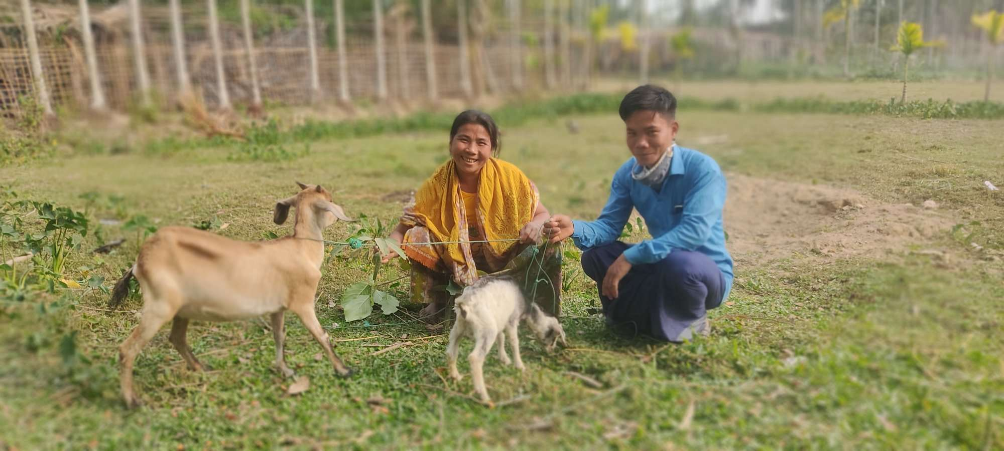
Success in livestock Intervention
* 1,355 ultra-poor Households have been graduated

Slide 19
Challenges:
1 Properly selection of laying hens and doe
2. Mass vaccination program for Native Chicken.
Recommendation of livestock intervention :
Training program for targeted participants with engagement of the .DLS personnel
Campaign of Mass vaccination program at community level
Engagement local private sector( Feed and medicine company )

Slide 21
Partner's presentation on Livestock by BRAC

Slide 22
Update on Livestock interventions
in Cox’s Bazar
Humanitarian Crisis Management Programme (HCMP)
BRAC
Date: 29.12.2021

Slide 23
Area Coverage 2021
Project Name | Beneficiary Coverage (HH) | Program/Sector | Areas/ Location | Donor
Livelihoods Support and Women Empowerment Project in Cox’s Bazar | 1800 | Ultra-poor Graduation Program (UPGP) | 8 Unions of Ukhiya and Teknaf sub-districts | Global Affairs Canada
Multi-sectoral emergency assistance to Rohingya in Cox’s Bazar | 2000 | UPGP | 5 Unions of Ukhiya and Teknaf sub-districts | UNHCR
Livelihoods Support and Women Empowerment Project in Cox’s Bazar | 2500 | Agriculture & Environment | 8 Unions of Ukhiya and Teknaf sub-districts | Global Affairs Canada

Slide 24
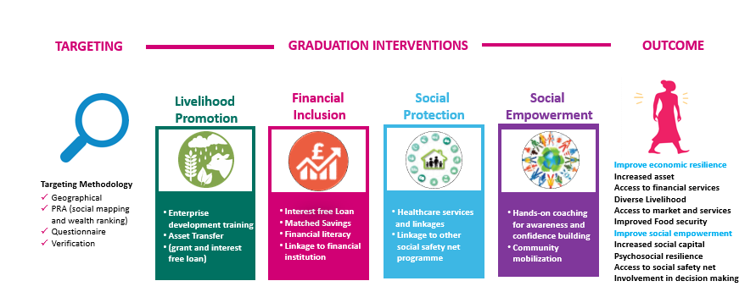
Key interventions, Components & Outcome, UPGP
Programme Components
Key interventions
Enterprise Development Training
Asset transfer
Hands on coaching
Matched savings
Health care
Community mobilisation

Slide 25
Implementation mechanism
Targeting/Selection of HHs
Social Mapping &
Wealth ranking
Questionnaire/format dev.
Verification and Group formation
Training & Inputs packages/Asset Transfer
Training and refreshers
Asset transfer
Feed and medicine
Cash support for poultry rearing cage
Adult chicken aged 75-80 days (10 chicken/HHs
Technical Support
Households visit by Technical assistant & resource person
Community Vaccination
Fortnightly/Monthly meeting by the group

Slide 26
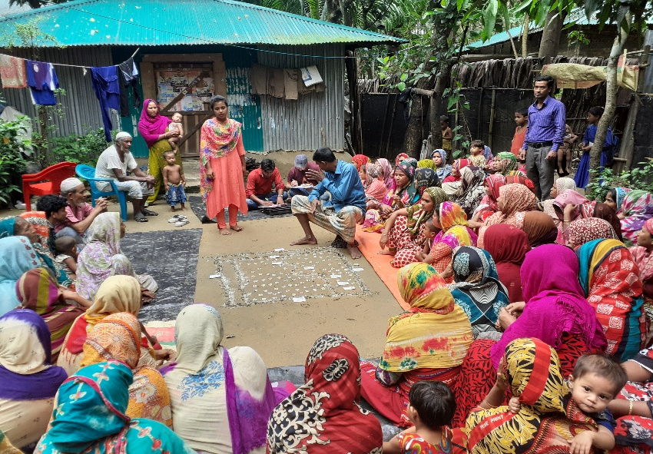
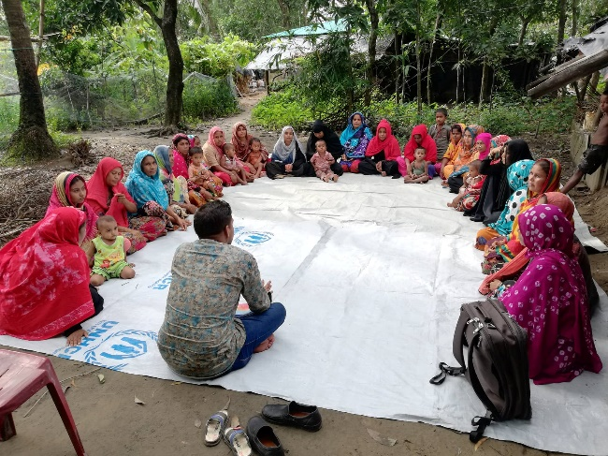
Targeting/Beneficiary selection
Participatory Rural Appraisal (PRA)
Wealth ranking and social mapping
Questionnaire and format develop
Households visit for verification
Group formation
PRA for beneficiary selection
Group formation meeting

Slide 27
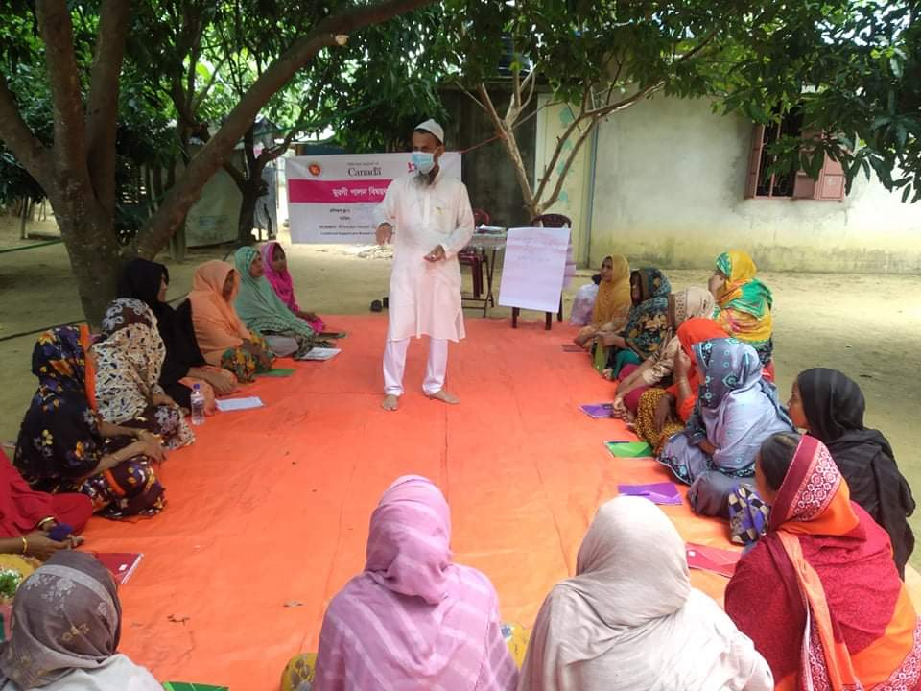
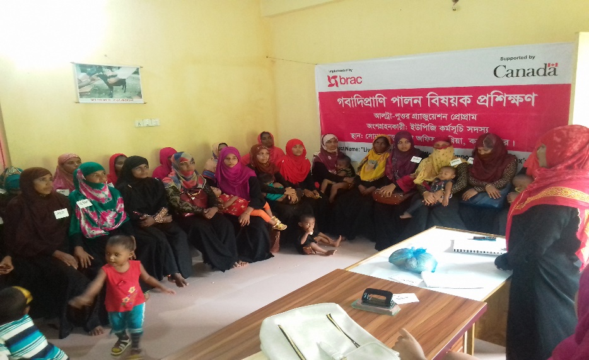
Technical Training & Refreshers
Training on improved poultry
and livestock Management
Use of training materials (flip chart)
Participation of resource person from
livestock department.
Fort-nightly/monthly meeting by the community
Group on livestock Management
Upazila Livestock Officer Conducting training on poultry rearing
Training on livestock rearing

Slide 28
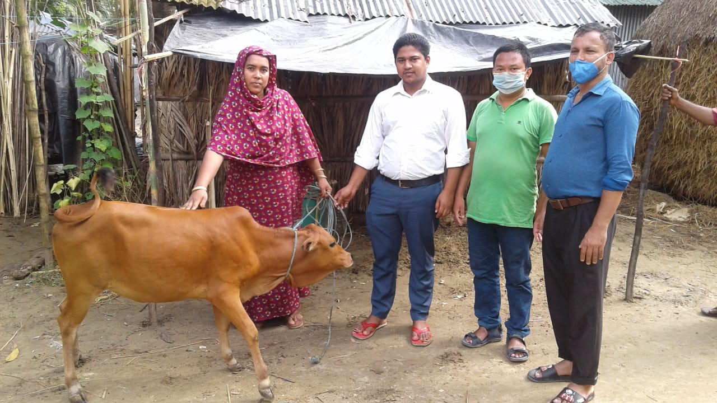
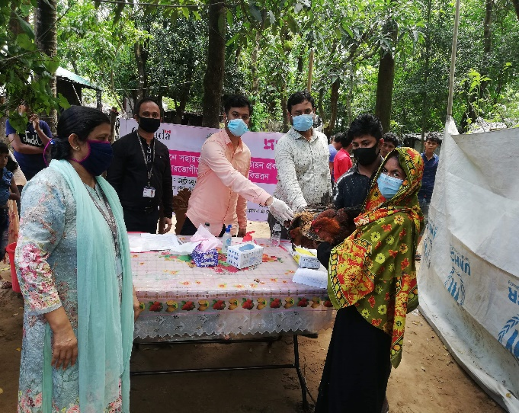
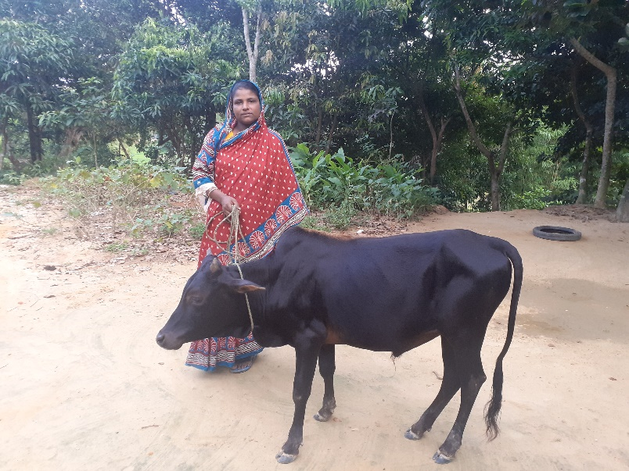
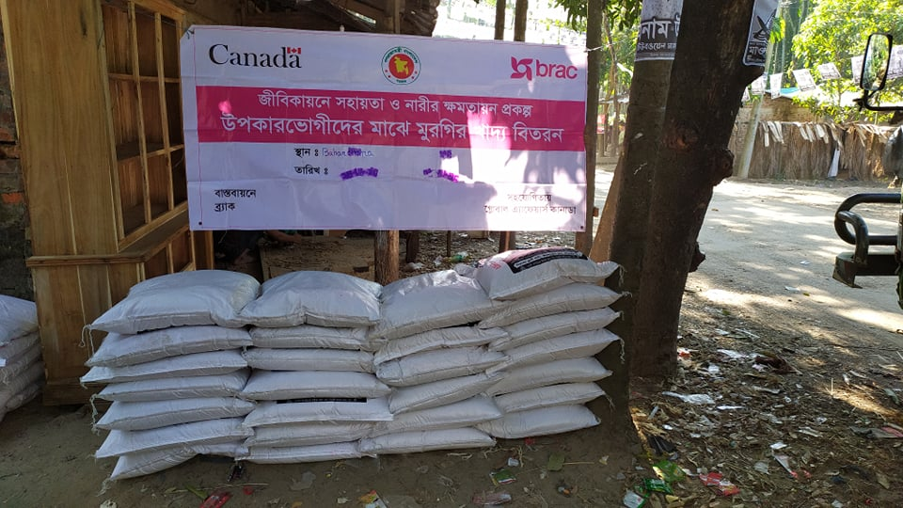
Asset Transfer and inputs packages
Asset transfer ( Beef, heifer etc.)
75-80 days old vaccinated adult poultry chicken
distribution among beneficiaries
Cash to prepare poultry rearing house
Poultry feed and cattle feed distribution
Medicine distribution for disease
management.
Asset transfer ( heifer rearing)
UNO, Teknaf distributing 75-80 days (vaccinated)old chicken
Asset Transfer (beef fattening)
Poultry feed distribution

Slide 29
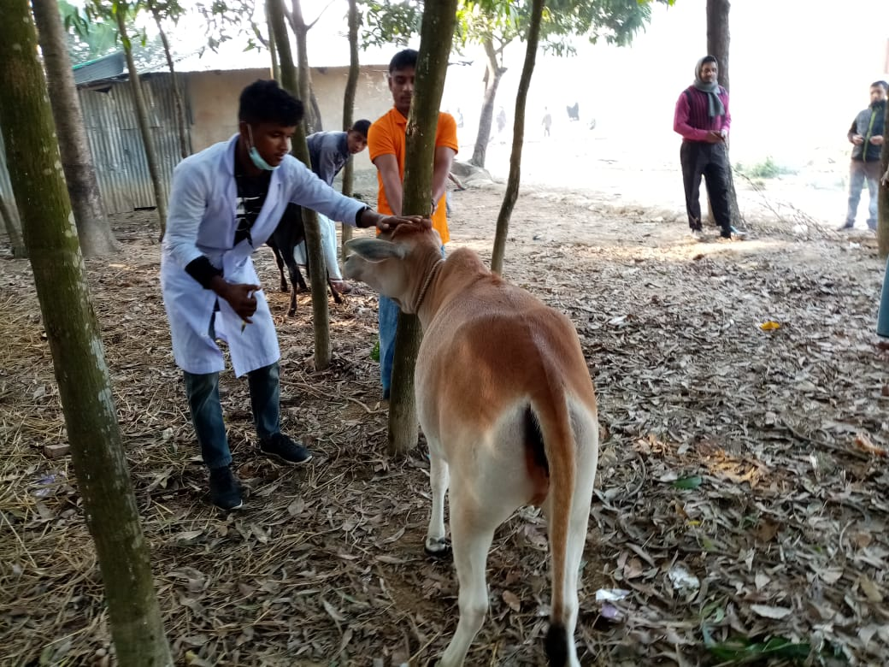
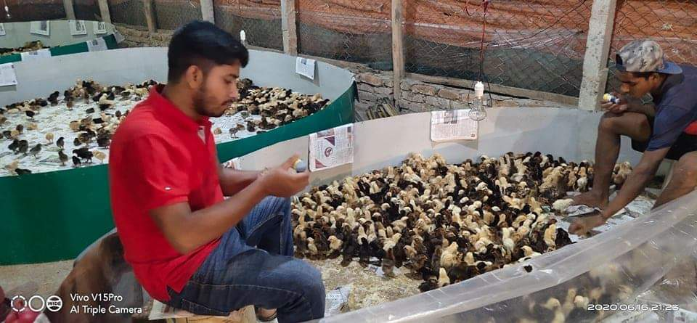
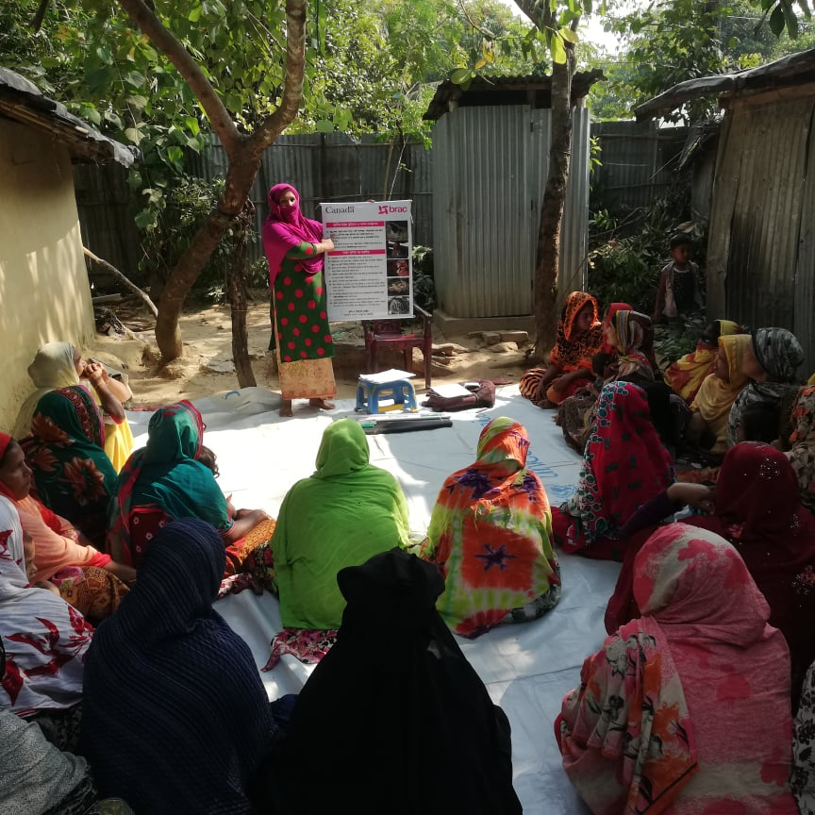
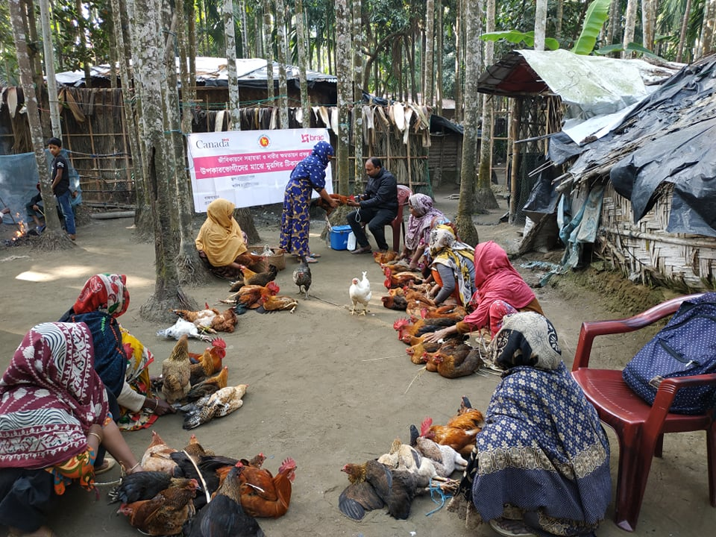
Technical Support and Vaccination
Vaccination at the community level
both cattle, goat and poultry.
Ensuring vaccination of poultry at
farm level before distribution
among beneficiaries.
Ensuring group meeting and hands-on
coaching at household level by the
Technical Assistant.
Livestock(cattle) vaccination
Ensuring vaccination at the farm level before distribution
Group meeting by the beneficiary on poultry rearing/management
Poultry vaccination at the community level

Slide 30
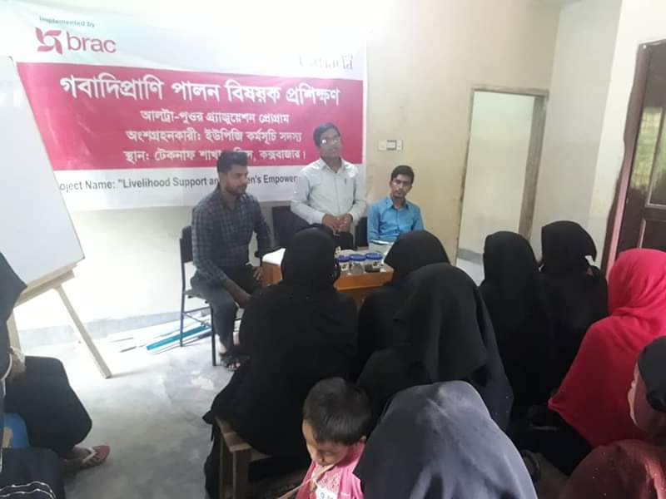
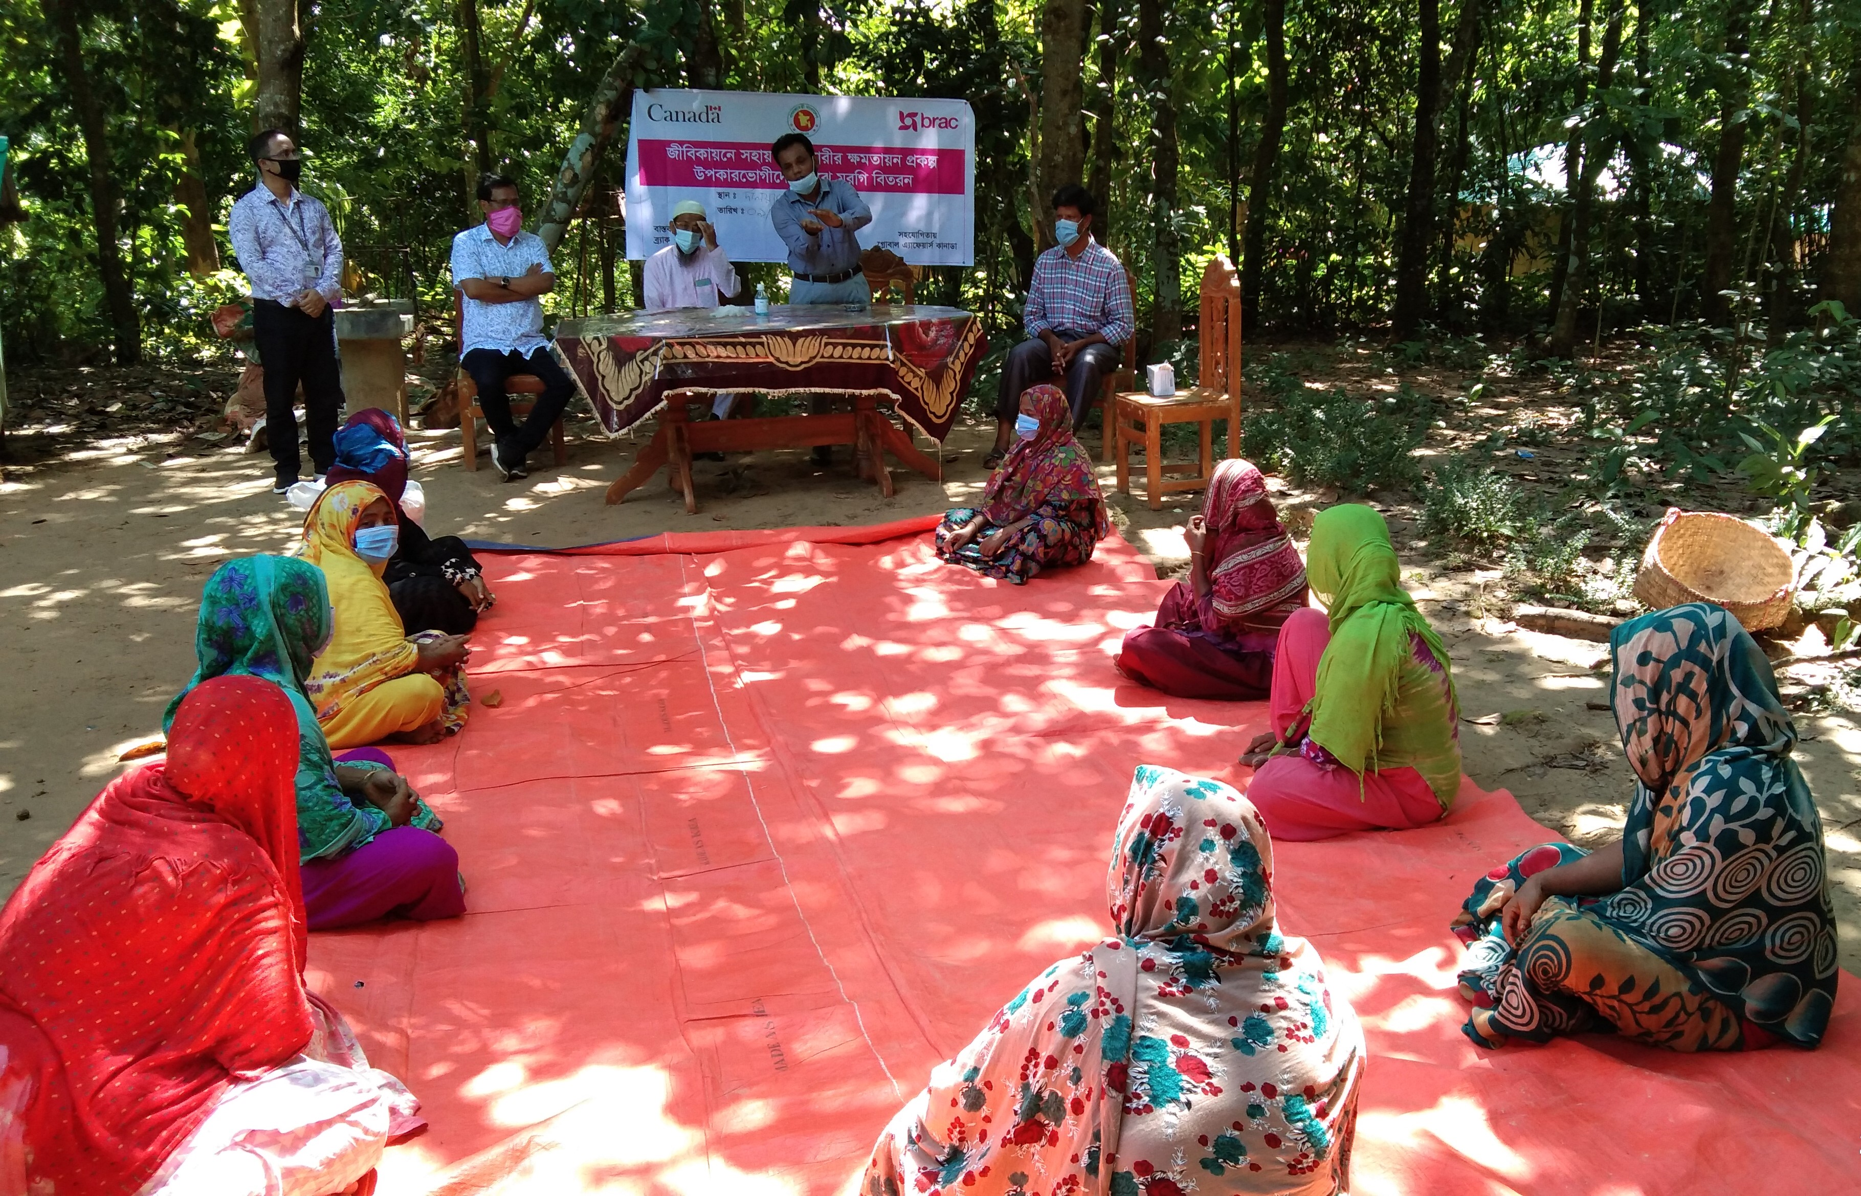
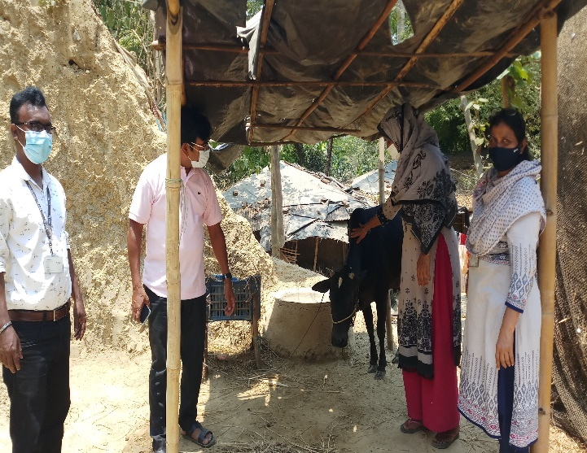
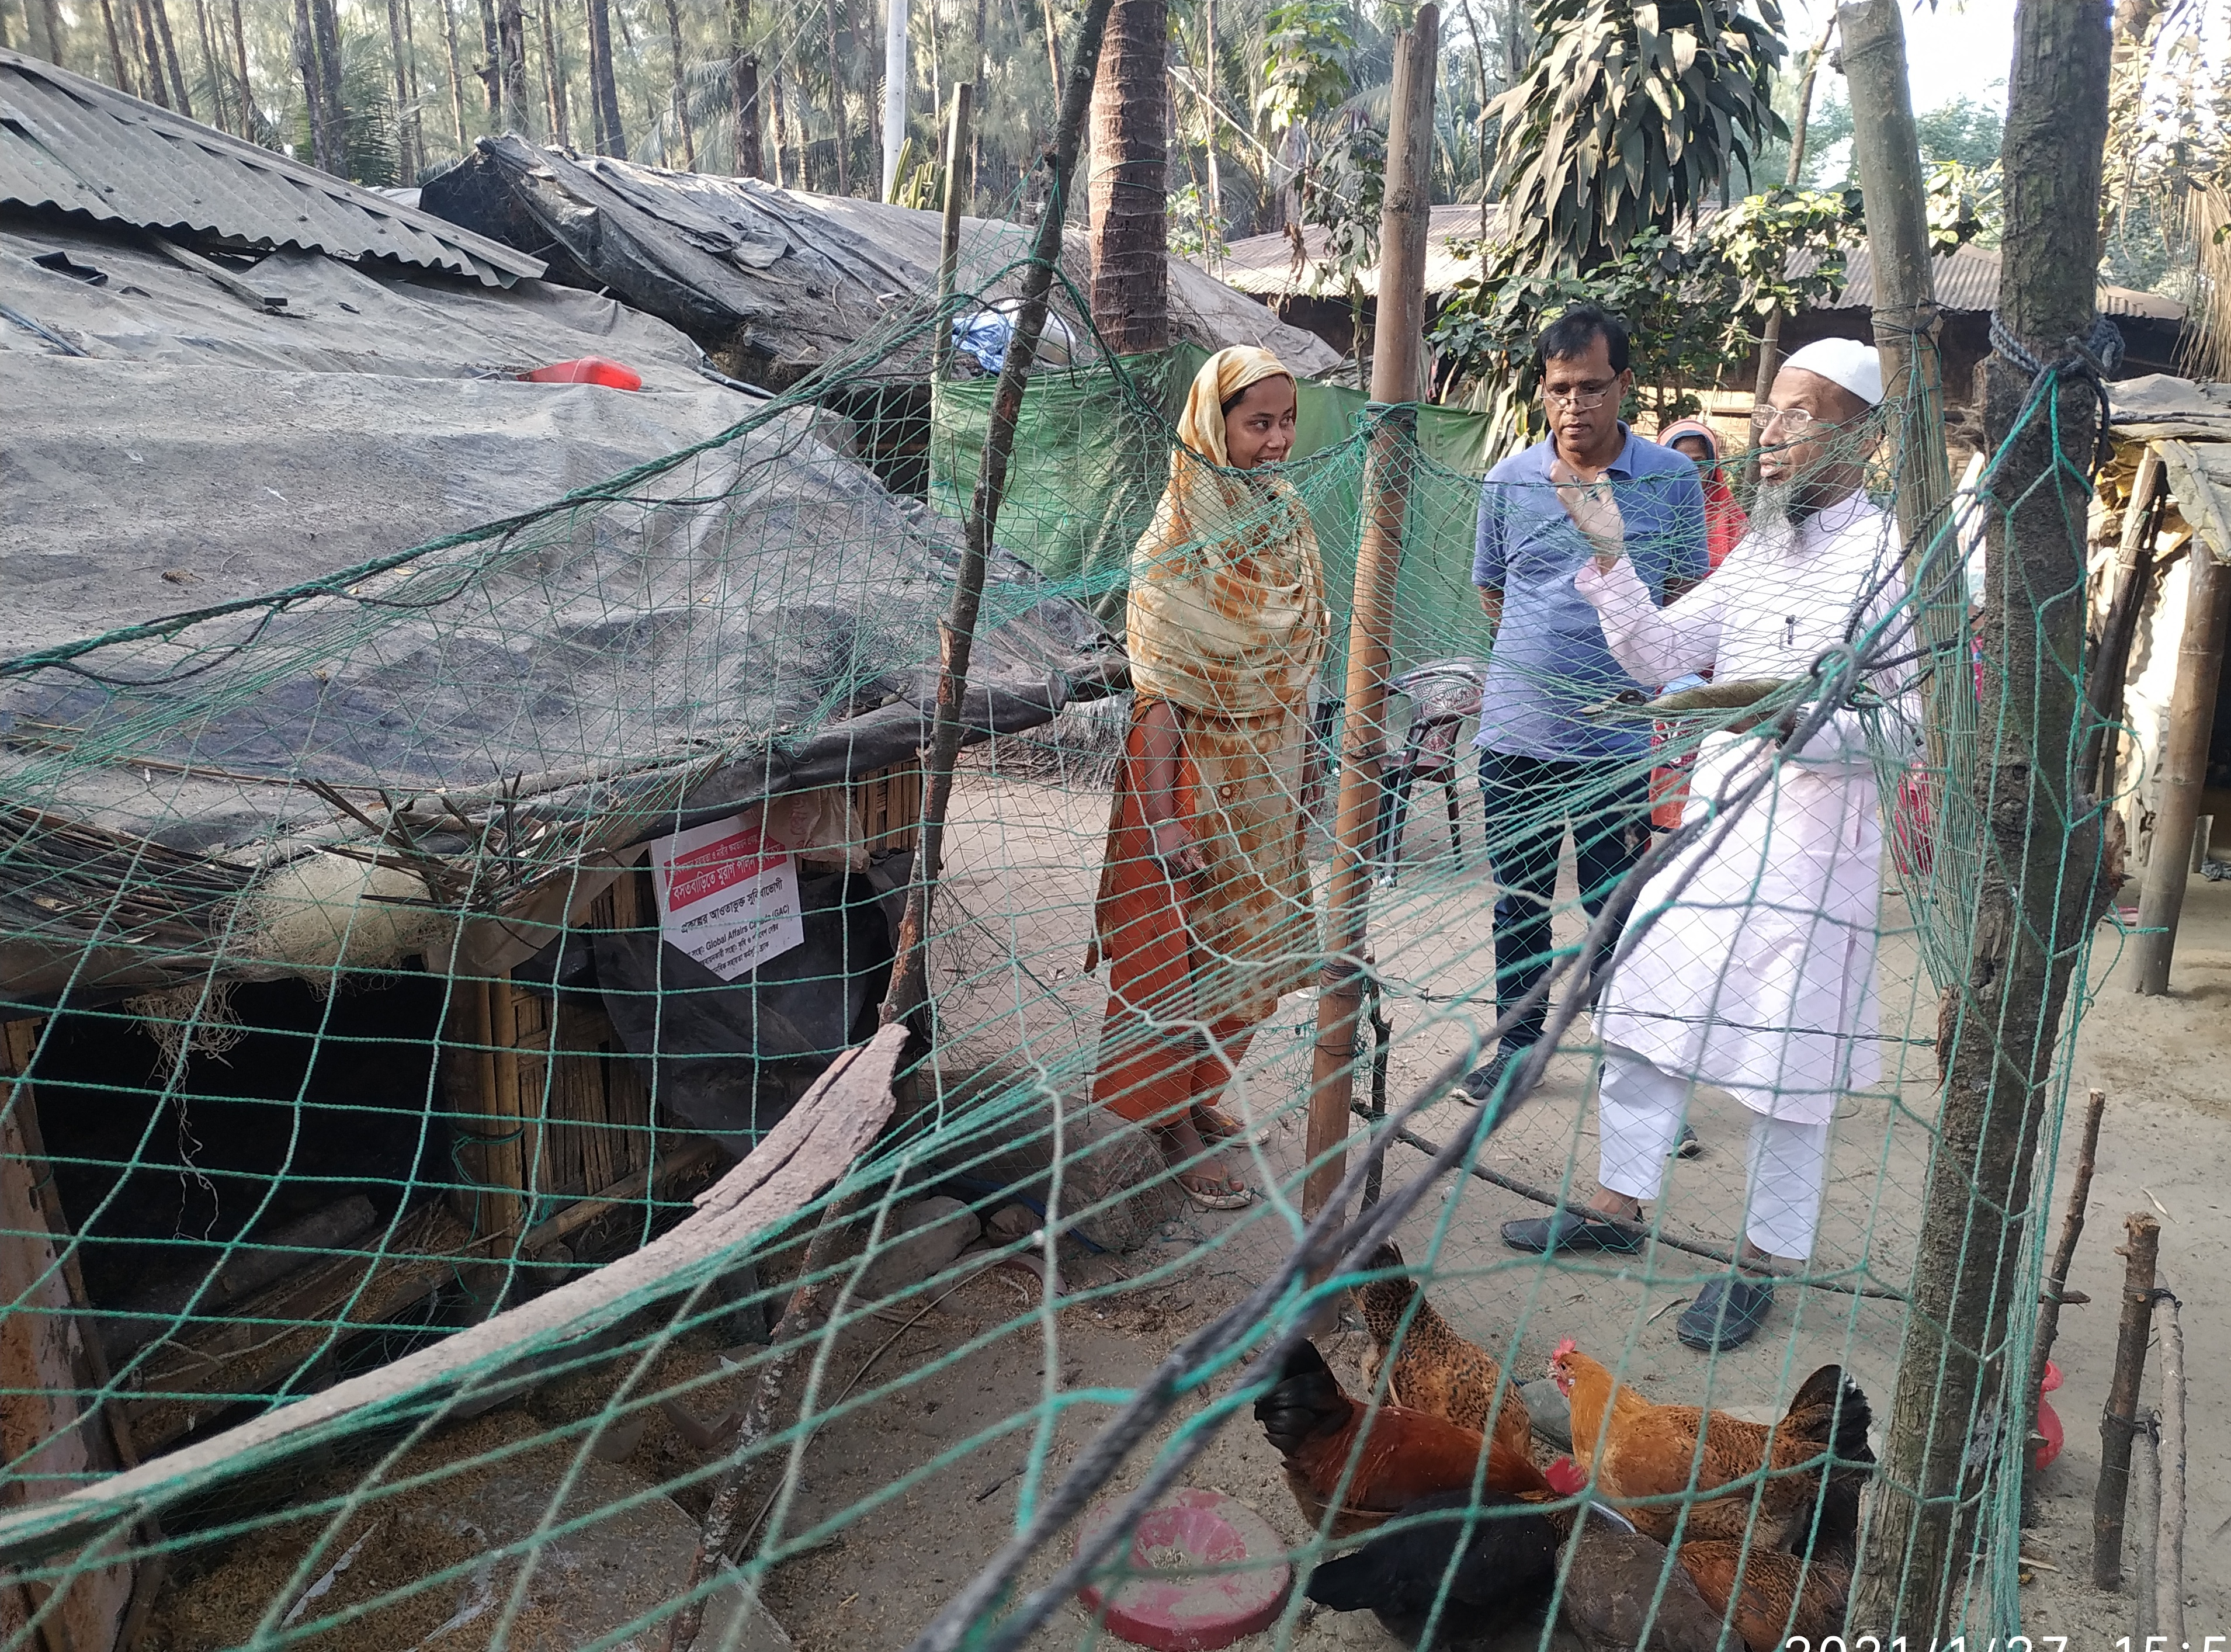
Coordination and linkage
Linkage being ensured with the local govt. dept.
for sustainability of project results.
Upazila Livestock Officer from Teknaf Upazila
delivered training on livestock management
District Livestock Officer(DLO), Cox’s Bazar visited
Ukhiya to observe poultry rearing activities.
Upazila Livestock Officer (ULO), Ukhiya visited
poultry rearing activities in Ukhiya.
ULO , Teknaf delivering lecture on livestock training
DLO, cox’s bazar visited poultry activities in Ukhiya
UNO representative visiting UPGP activities
ULO, Ukhiya Providing technical support for poultry beneficiary

Slide 31
Good practices
Coordination and linkage with government department and Local Union Parshad services.
Asset diversification of beneficiaries are important to enhance resilience.
Because of vaccination campaign, nowadays beneficiaries are much interested and willingly bringing their chickens for vaccination.
Parallel to project direct beneficiaries, secondary beneficiaries/ community people also bring their chickens for vaccination which reduces the chance of spreading the diseases, especially Newcastle/
Ranikhet disease.
Use of Antiseptic is gradually increasing and tendency to bury the dead chickens increases.
Participants are diversifying assets from income generation.

Slide 32
Challenges
Protection from diseases esp., Newcastle (Ranikhet) and worm infestation because poor knowledge of poultry management.
Ensuring Vaccination
-Lack of awareness and Superstition (Poultry dies because of vaccination )
-Availability of vaccine
Unavailability of local livestock services provider and Artificial Insemination (AI) worker.
Ultra-poor participants have no access to backward and forward markets in term of access to information, access to quality and affordability.
Heavy rainy weather and natural disaster damaged partially or fully cattle and poultry house
Project Beneficiaries are slow learners in nature.
It is a common occurrence to steal chickens from a shed kept outside the house; sometimes injured by predator like Rat etc. (Teknaf areas).
Ensuring quality cattle and poultry feed.
The expectation of receiving more from the project sometimes hinders the pace of the project.
Tendency to cling to old ideas rather than the new friendly technology/technologies.

Slide 33
Recommendation
Training with video clips/short video documentation of best/improved practices through a portable projector.
Video documentation in local language with the example of a successful livestock farmers at their nearby Upazila/Union.
Fortnightly short meeting by the beneficiaries focusing on disease & livestock management topics with video clips.
Livelihood projects with market development initiative considering the backward and forward market linkages for ultra-poor people and make them ready for the market.
Cultivation of fodder to ensure availability of cattle feed at the community level
Hatching box made of cement will increase hatching rate as well as egg production.
Customized multilayered hygienic poultry shed inside or outside the house.
Develop vaccinator at the community level among the community to support individual HHs with vaccine kits support and cold storage facilities.

Slide 34
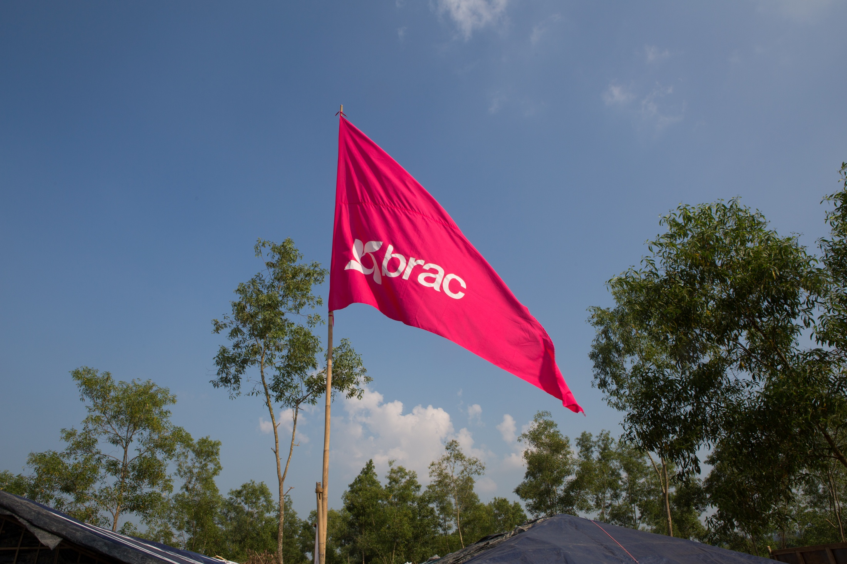
Thank You

Slide 35
AOB

Slide 36
Livestock Partner's Meeting Frequency
- Monthly Meeting | the last Wednesday of every month
- Next meeting 26th January 2022

