Slide 1
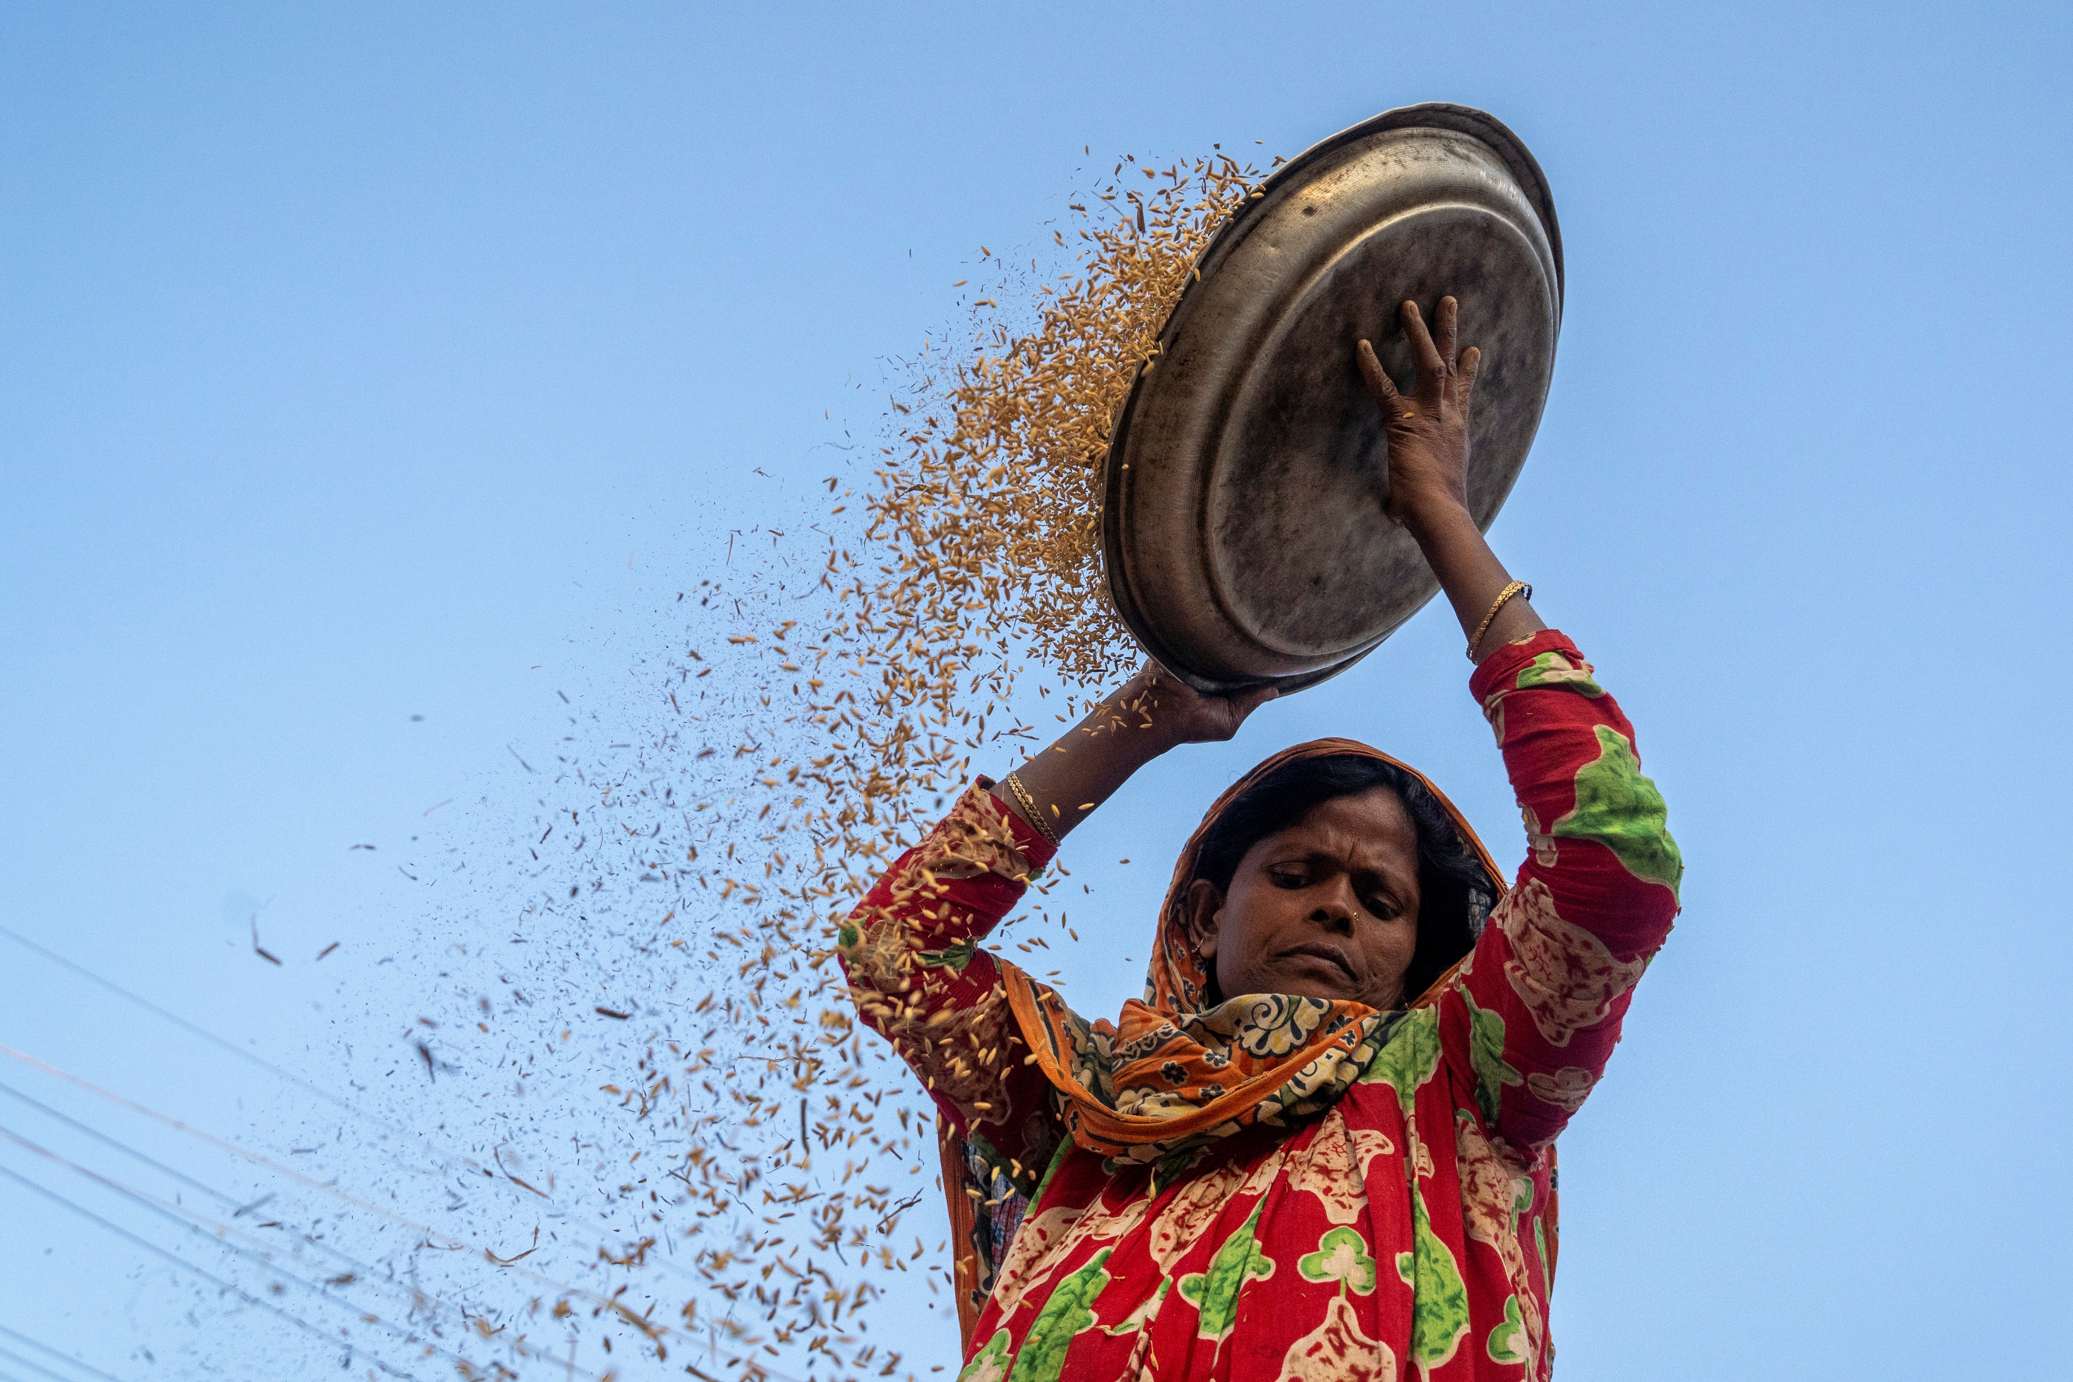
Food Security & Livelihoods Coordination Meeting
16th November 2021
Cox’s Bazar, Bangladesh
Photo: ISCG / Saikat Mojumdur

Slide 2
Agenda
Meeting agenda
FSS Updates
JRP Updates
IMO Updates
Livelihoods/Self Reliance Updates
EETWG Updates
Partner presentations
FAO – Impact Assessment on Pond Fish Culture in the Camps
Partner Updates
AOB

Slide 3
FSS updates

Slide 4
FSS updates
Bhasar Char
Media release 9 October 2021 - MoU for Rohingya humanitarian response
The Government of Bangladesh and the United Nations, signed by UNHCR
Focal points:
UNHCR Assistant Representative for Operations in Dhaka, Fumiko Kashiwa kashiwaf@unhcr.org, +95 9450067170
UNHCR Senior Field Officer in Cox’s Bazar, Galiya Gubaeva gubaeva@unhcr.org, +880 1847327266

Slide 5
FSS updates
Winter Market
Objectives:
Promote off-farm livelihoods and self-reliance projects
Create market linkages
Date: 11 December 2021
Products for sale: Off-farm production
Location: to be confirmed
Stalls: expression of interest: link
Deadline for partners: 21 November
Stall confirmation FSS: 23 November

Slide 6
FSS updates
Winter Market
Theme:
From my home to your home
আমার ঘর থেকে আপনার ঘরে।
Graphic: template will be shared with partners to insert a picture and a short description (see draft)

Slide 7
FSS updates
2nd batch of Protection Mainstreaming training
3 – 4 November
Presentations (link)
3rd batch of Protection Mainstreaming | CANCELLED due to technical circumstances
Rescheduled for the first quarter of 2022

Slide 8
JRP updates

Slide 9
JRP 2022
The total allocation across the sectors is USD 775 million (2021: USD 943 million)
17.8 percent reduction has been proposed across the sectors
Pledge the FSS to review their proposals with view of the reduction of the budget
Upon this reduction, the FSS estimated funding envelope is at USD 203 million (2021: 247.2 million)
Agreed to realistically review the proposals on need-based approach. In any case, FSS funding envelope will not exceed the last year's level.

Slide 10
JRP 2022
Strict deadline for partner submission of projects in excel to Sector Coordinators – COB 16 NOV
Submit the proposals to coxsbazar.fss@wfp.org | info.coxsbazar@fscluster.org
PRT within each Sector review all uploaded projects, facilitate revisions as required, and recommend project portfolios – 17,18 NOV 9am – 4pm (*21 NOV if required – in WFP)
PRT feedback incorporation and send to FSS | 24 NOV
FSS to give final clearance to partners | 28 NOV
Strict deadline for partners to upload approved projects to the HPC module – 29-30 NOV

Slide 11
JRP 2022
Keep in mind as you submit your projects:
Include GAM reference number
Please submit one excel file for all your projects
Note: Projects that meet all criteria with a positive (Yes) assessment are included in the sector portfolio. If a proposed project does not meet one or more of the criteria, the PRT can seek more inputs or explanations from the proposing agency.

Slide 12
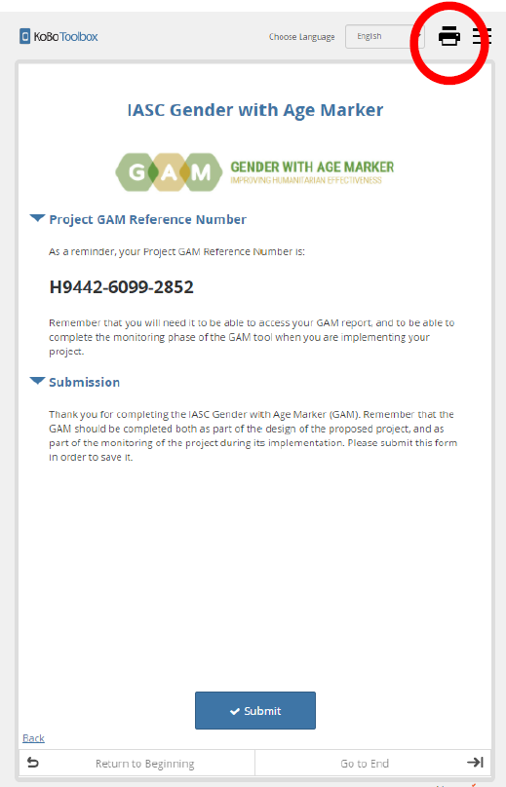
JRP 2022
Technical Issues for generating GAM, from ISCG:
Once you reach the final step of the online GAM tool where the GAM reference number is generated, please save a PDF version of the form before clicking submit. This is done by clicking on the print icon at the top right of the page. From the drop-down printer menu, you can select ‘save as PDF’ and save a copy of the form to your computer. Please remember to click submit after you have saved the PDF version of the form.

Slide 13
JRP 2022
Peer Review Team
Thank you to all the partners participating in the PRT!
Please ensure your full availability on 17,18 NOV from 9am-4pm (Long Beach)
*21 Nov if required – in WFP
Org Type | Name and type of Organization
NNGO | Shushilan
 | Humanitarian Assistance Program
 | BRAC
INGO | Concern Worldwide
 | Plan International Bangladesh
 | HelpAge International
 | HELVETAS Swiss Intercooperation
UN | IOM
 | UNHCR
 | FAO
 | UN Women
 | WFP
Reserve | 8
FSS | 5
ISCG | 1 Observer
Peer Review Teams should be chaired by the Sector Coordinator and include a minimum of 1 UN, 1 NGO, 1 NNGO member. ISCG Secretariat will join peer reviews as observer.

Slide 14
FSS updates
Sector Objective 1: Ensure and sustain the timely provision of life-saving food assistance for Rohingya refugees.
Number of refugees receiving regular food assistance through the primary sources of e-voucher outlets and fresh food corners
Percentage of refugee households reached with timely food assistance in case of a disaster
Percentage of refugee households with acceptable Food Consumption Score
Percentage of refugee households using consumption-based coping strategy

Slide 15
FSS updates
Sector Objective 2: Support capacity building of Rohingya refugees that can support their sustainable reintegration in Myanmar, while ensuring climate resilient practices to address the impacts of climate change.
Number of households receiving capacity building support through skills development and self-reliance activities
Number of refugees participating in food for assets/cash-for-work activities.
Percentage of refugee households using a crisis coping strategy (reduced coping strategy index)
Hectares of land reforested and maintained within the camps
Number of households implementing climate smart homestead gardening practices and climate sensitive self-reliance interventions

Slide 16
FSS updates
Sector Objective 3: Enhance livelihoods and resilience of vulnerable host communities in cooperation with the Government of Bangladesh, while ensuring climate resilient practices to address the impacts of climate change.
Number of host community households reached with agricultural and non-agricultural livelihoods support
Number of host community households reached with food or cash support
Number of host community individuals participating in food for assets/cash-for-work activities
Hectares of land reforested and maintained in surrounding host communities
Number of households implementing climate smart agricultural practices and sustainable off-farm livelihood interventions

Slide 17
GFA updates
Food assistance
100% beneficiaries receiving GFA support through 22 e-voucher outlets
All beneficiaries received BDT 1024.31 through their e-voucher to purchase up to 25 food items in a total of 22 e-voucher outlets operational across the camps. (November 2021)
19 Fresh Food Corners operational to provide fresh food items (20) to all except Registered beneficiaries, including live chicken and fish at 18 locations.
Continuing Fresh Food Voucher ($3 = 256.08 BDT) support (top up for most vulnerable individuals, November)
To reduce the risk of Covid-19 transmission, beneficiaries visit e-voucher outlets and FFCs once per month regardless of family size or top-up for most vulnerable individuals,
GFA is planning to resume normal transaction and started Piloting- in 20 Ext outlet. Therefore Families will be allowed for multiple visit to this outlet.

Slide 18
FSS updates (Information management)

Slide 19
Information management:
Thank you everyone for your 5W and CfW reporting for October 2021!
IM team now updating Static and Interactive Dashboards
Some preliminary overview:
882,460 refugee individuals reached
145,115 host community individuals reached
Skills Development TWG - producing IM report of past and current activities (upcoming)
EETWG Planting Mapping - (upcoming)

Slide 20
Livelihoods and Self-Reliance

Slide 21
FSS updates
Livelihoods and Self-Reliance | Livestock:
* Input for 5W template updating on livestock reporting - Request for review and feedback by using this link
* Livestock Partners Focal Point Nomination Criteria – Request for review and feedback by using this link
Scheduled Next Monthly Meeting: Wednesday, 24 November, 2021.

Slide 22
EETWG updates

Slide 23
Energy & Environment Technical Working Group updates
About: The EETWG is a multi-sectoral technical working group which aims to build synergies amongst stakeholder efforts and initiatives across all sectors with a special focus on identified linkages between the Food Security, Site Management and Shelter/NFI Sectors.
Example of activities: Plantation, Natural resource and human-elephant management, nature-based DRR*, cleaner energy*, solar lighting*, lightning arrestors*
* Under Shelter/NFI & SMSD Sectors
Resources:
EETWG google drive: https://drive.google.com/drive/u/2/folders/1RC6UPbss3tYTZ1etWbqZwRhU6iItNcap
Old EETWG google drive (pre-2021): https://drive.google.com/drive/u/0/folders/1c3tSPMk8cEl-F_OOOy7oo9EnxcLZEuON
Meetings: First Tuesday of every month from 16:00-17:00 (next meeting: Tuesday, 7 December)
Contact person: Fenella Henderson-Howat, Interim Coordinator, Fenella.Hendersonhowat@wfp.org

Slide 24
Energy & Environment Technical Working Group updates
UPDATES
CiC Staff orientations on Energy & Environment on 2 & 3 November
Successful learning field visit took place on 9 November
Final reminder (deadline TOMORROW – 17 Nov 2021!) for all 2021 plantation partners to report on activities ahead of 2021 Plantation Lessons Learned Workshop on 23 November
REPORT PLANTATION ACTIVITIES: Tracker
UPLOAD SHAPEFILES: File to upload shapefiles
UPLOAD PHOTOS: File to upload photos

Slide 25
IMPACT ASSESSMENT OF POND FISH CULTURE IN THE CAMPS (FAO)

Slide 26
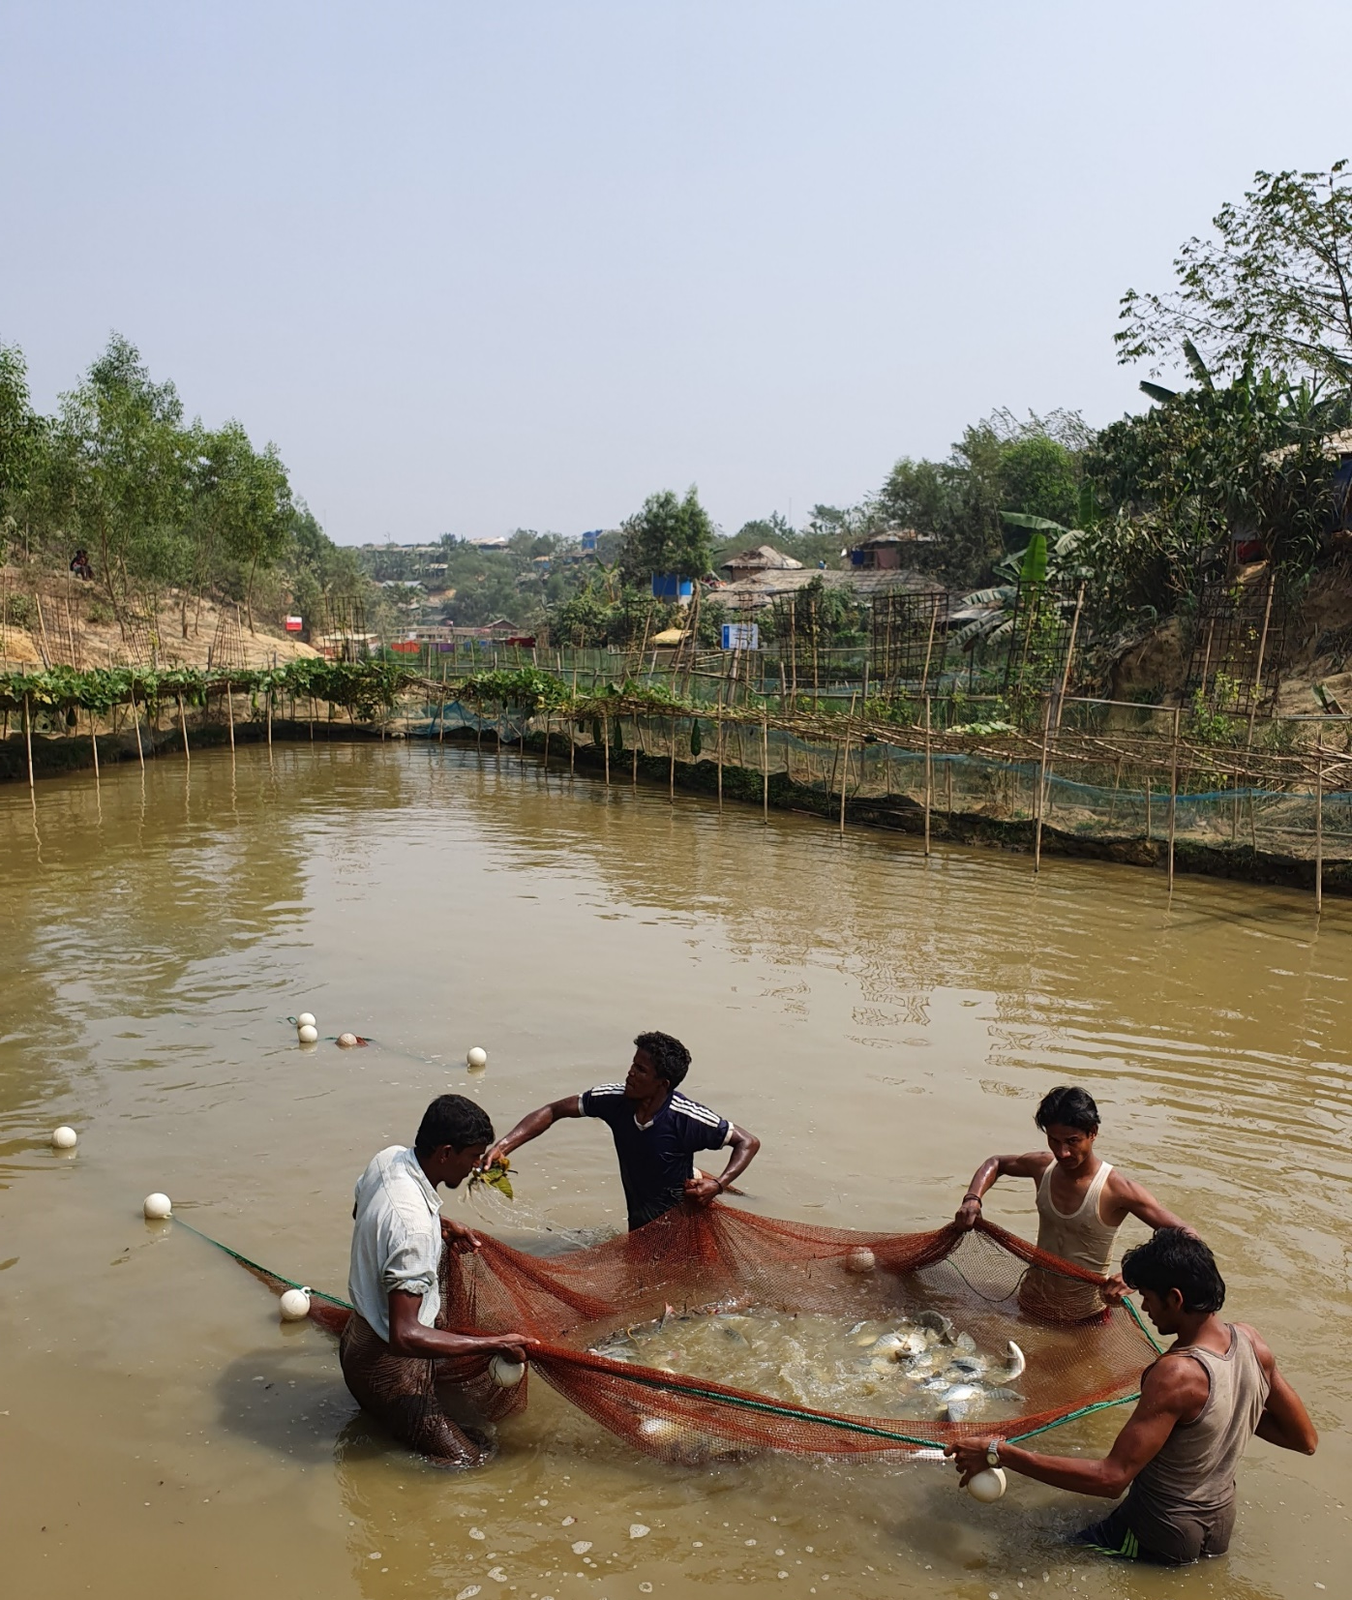
IMPACT ASSESSMENT OF POND FISH CULTURE IN THE CAMPS
FAO WFP UN-UN Agreement Component 1.2
Notes:
WFP has been working to ensure food security for the vulnerable communities in the camps. As part of these initiatives, for 1 year, the WFP has been operating 12 fishponds located in three Rohingya refugee camps, with the aim objective to support household nutrition. Considering the status of the natural and built environment, population density, climate change and extreme weathers, and landscape and land-use-changes in the area, the possible environmental and social impacts of the ponds and aquaculture where highlighted and this environmental and social assessment that I’m going to present to you today was needed, to make sure no harm was done.
The objectives of the assessment is to evaluate the environmental and social impact of the fishponds, and suggest monitoring and mitigation activities to reduce any negative impacts, and also identify opportunities to create added environmental or social values.
Nipul, Ensure we do no harm but instead of safety and security of
Assess and evaluate the environmental and social impact of fishponds located in the Rohingya Camps.
Suggest monitoring and mitigation activities reduce environmental and social impact.
Nipul, Ensure we do no harm but instead of safety and security of

Slide 27
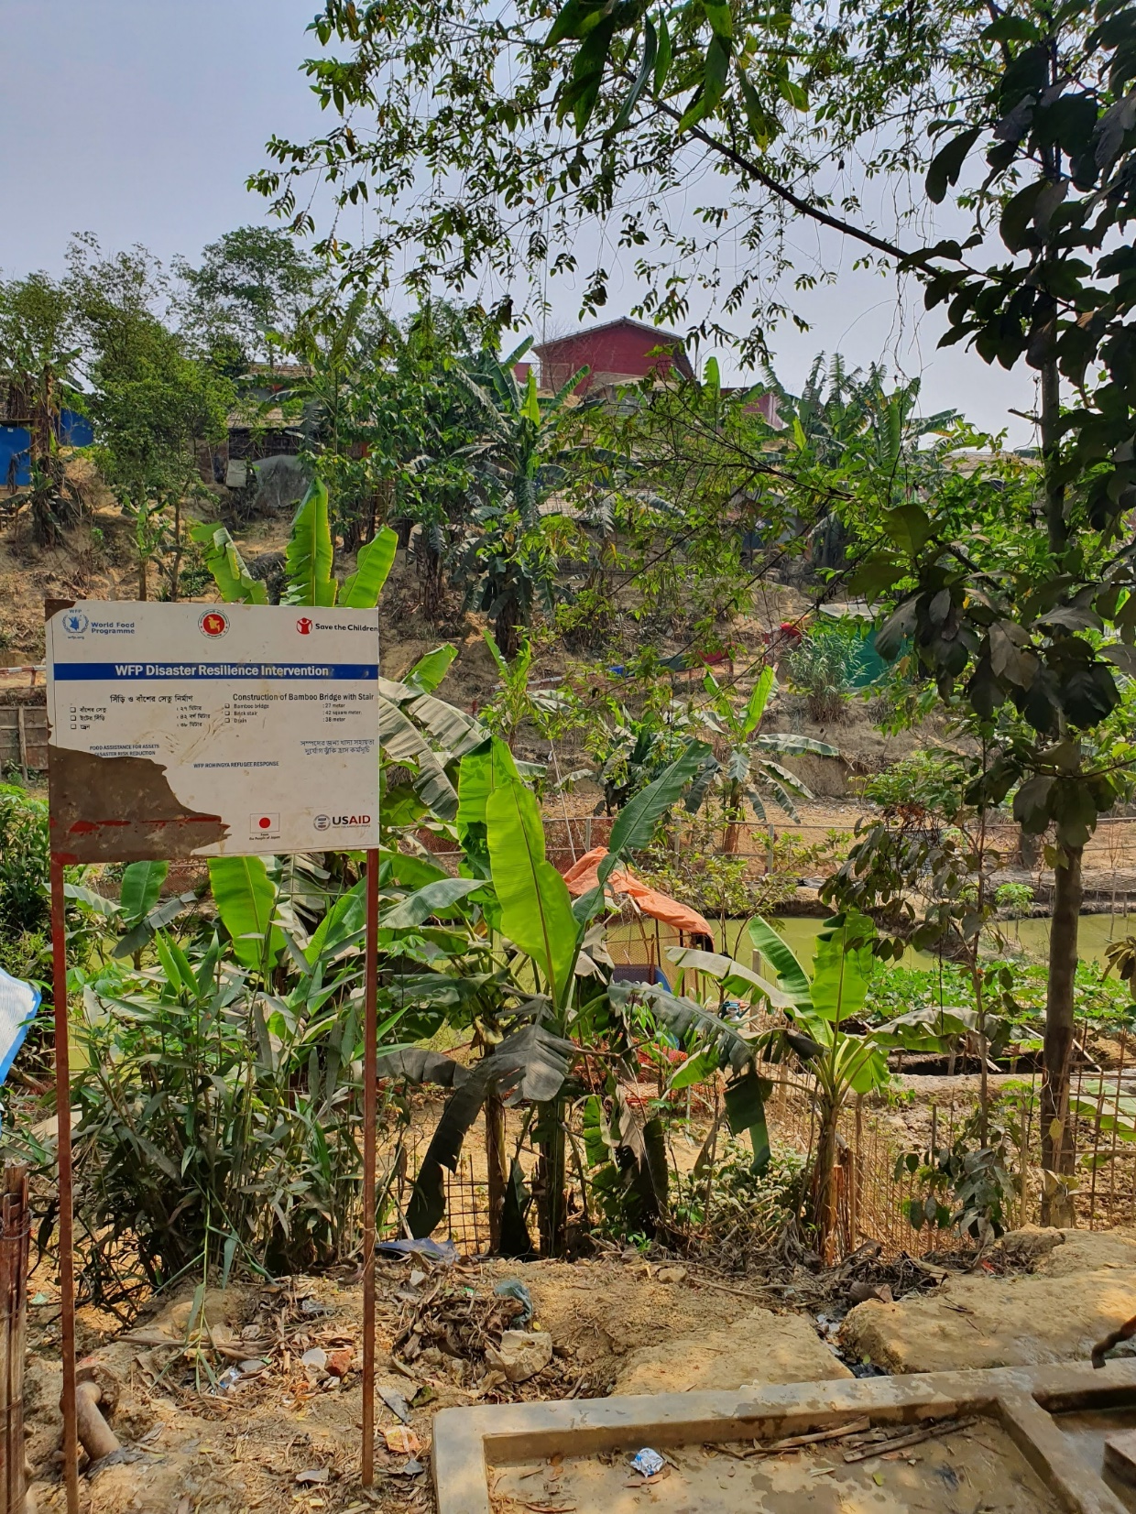
AGENDA
Environmental and Social assessment
Method
Results
Monitoring
Recommendations
Questions and discussion
Next steps
Notes:
The whole assessment and the report is about 60 pages long, and last time we presenteted the results it took about 45 minutes, but I will keep to my little time today, and I have just

Slide 28
METHOD
Notes:
The methodology is based on EIA method, but adjusted to fit the assessment, which in practice ment making the method more practical.
An iterative approach – exploring a wide range of issues initially and narrowing the focus steadily through risk analysis was undertaken.
In addition to the assessment of the environmental and social impact, a technical report on the current pond practice was written, and finally, a site-specific guideline for recommended pond management was produced

Slide 29
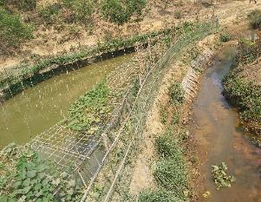
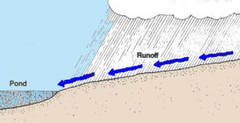
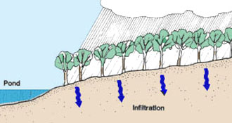
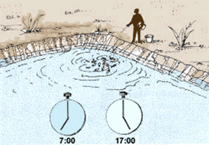
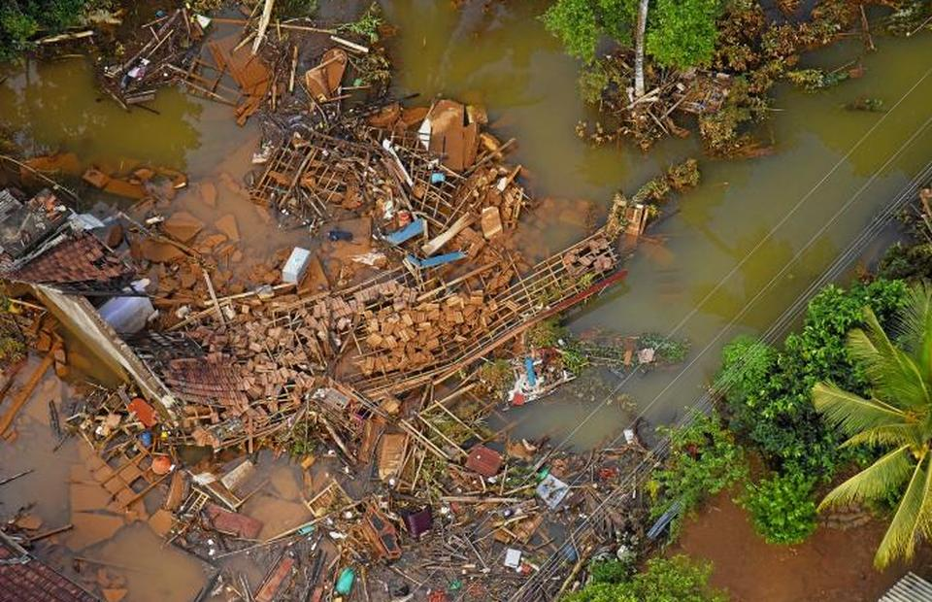
BASELINE
Potential future issues and opportunities
Environmental and Social
Disturbance or damage to ecosystems and biodiversity, including:
Water quality and supply
Animal health and welfare
Human health
Climate change
Notes:
The baseline studies explored the typical impacts from aquaculture, such as water use, nutrition loads to surrounding water bodies, spread of animal desis etc. that can disturb local ecosystems and biodiversity. Then we also look at the current status of for example surface and ground waters in the area, the status of resilience of ecosystems etc. It was found that the area is very degraded and for example the status of both water quality and quantity is low, creeks running dry and groundwater levels sinking etc.
With climate change and increased storms and extreme weathers.
So from the baseline both the current status in the camps and the possible impacts from the ponds, risks where identified, prioritized and evaluated.

Slide 30
IDENTIFYED RISK AND OPPROTUNITIES
Risk 1 The fish ponds negatively affect the water quality in the surrounding area. | Risk 2 The fish ponds negatively affect the water availability in the surrounding area, reduced flows and hydrological changes in natural habitats. | Risk 3 Negative impact on protected area and natural habitat. | Risk 4 Pond excavation and land-use for the fishponds can increase erosion and landslides.
Risk 5 The land use practice of the project area contradicts with national forest protection and restoration policy vision. | Risk 6 Residents falling in the ponds. | Opportunity 1 Increased nutrition for the residents. | Opportunity 2 Recreational value for resident

Slide 31
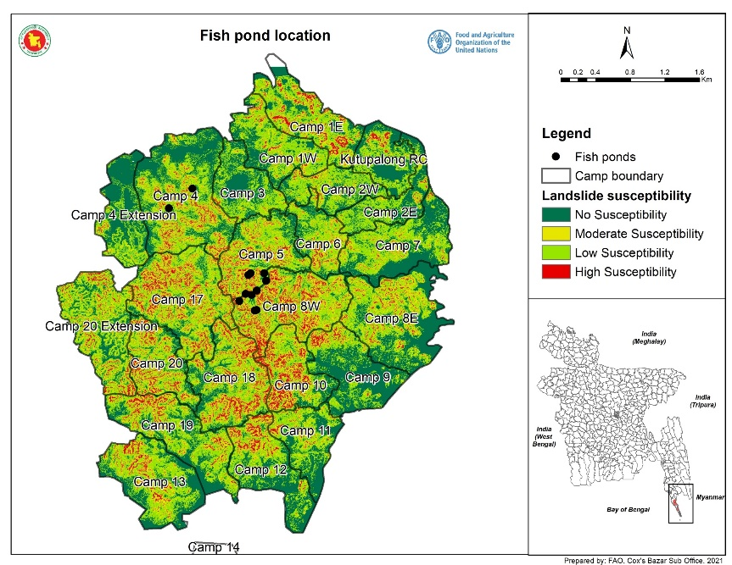
FURTHER ASSESSMENT OF RISKS
Risk 1: The fish ponds negatively affect the water quality in the surrounding area.
State of the receiving water bodies
Pond production systems
Extreme weather events, erosion and stirring of the pond water
Risk 2: The fish ponds negatively affect the water availability in the surrounding area, reduced flows and hydrological changes in natural habitats.
Rainwater harvesting in small-scale ponds altered the water balance
Environmental flow requirements to estimate ecological carrying capacity and fishpond water usage
Risk 3: Negative impact on protected area and natural habitat

Slide 32
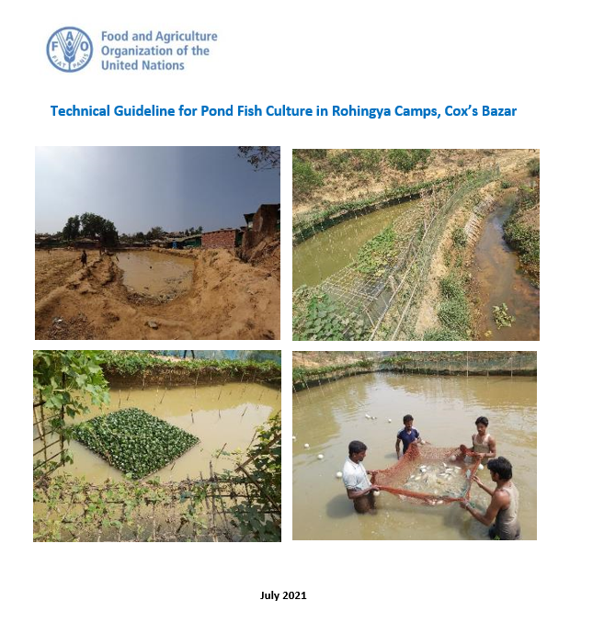
MITIGATION - Applicable recognized good management and/or pollution abatement practices
Location and design of ponds
Management of aquaculture production system
Indicators and monitoring
Notes:
So considering the risk identified mitigation actions are considered and proposed, so for example for both risk about water quality and quantity the location of the ponds are vital, both considering water harvesting possibilities and erosion control and climate and extreme weather resilience will affect the water quality.
Water Quality
Parameters: Temperature, pH, DO, BOD, Ammonia, Turbidity, Total alkalinity, hardness. Total coliform can be used as an indication of pathogen contamination.
Pond and watershed level
Sediment Quality
Determine the content of organic matter and nutrients to decide on proper management and possible usage areas.
Water availability
Hydrological modeling is recommended to estimate water components
Collaboration and data sharing
Occurrence of landslides and flashflood
Track occurrence of landslides and flashfloods in the area of ponds. Observation of visible signs of erosion in the pond area.
Safety
Percentage of pond guards trained in first-aid. Track the number of accident with residents falling into the ponds

Slide 33
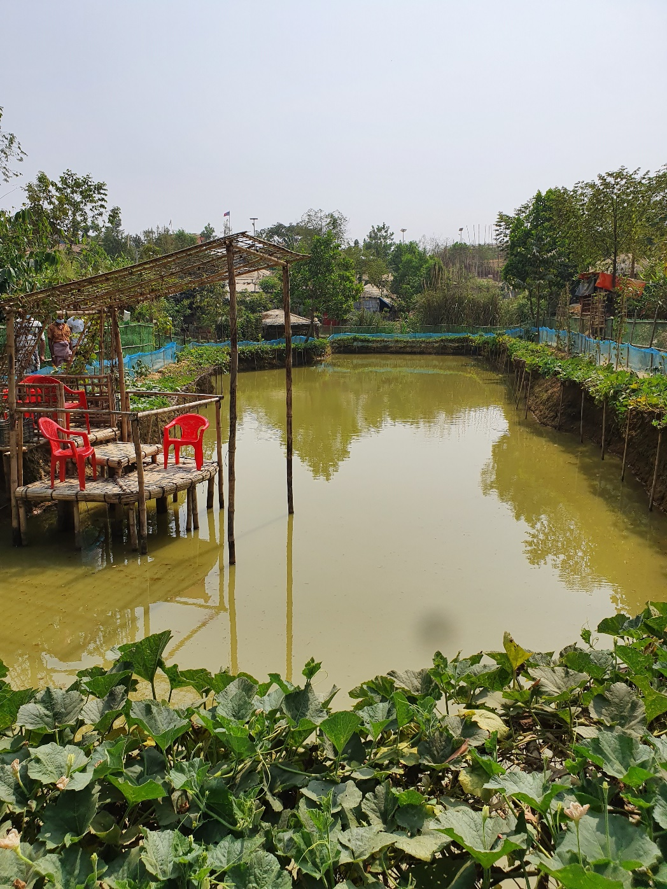
RECOMMENDATIONS
Integrate mitigation in management
Follow feeding and stocking methods guided by FAO
Adopt a landscape approach that takes into account the environment and social context at a larger scale
Stabilize the sites that are already affected by the excavation and avoid any further excavation, especially during rainy season.
Provide first aid training to all pond guards.
Increase recreational possibilities
Further study and careful monitoring

Slide 34
QUESTIONS AND DISCISSIONS

Slide 35
Partners Update

Slide 36
AOB

