Slide 1
9th June 2021

Slide 2
National & Provincial FSL Cluster Meeting – 09th June 2021
AGENDA
Cluster updates (Pablo Rodriguez - FSC) - 10 mins
SETSAN – Post-harvest assessement (Director Pacheco – SETSAN) – 10 min
Cabo Delgado humanitarian updates (Apolonia Morhaim - FSC) - 40 mins
FSC monthly response – Preliminary numbers May (FAO, WFP & FSC)- 15 mins
Non-HRP Interactive Dashboard presentation (Joao Muianga– FSC) -10 min
AoB (All)-5 mins

Slide 3
National & Provincial FSL Cluster Meeting – 09th June 2021
AGENDA
Cluster updates (Pablo Rodriguez - FSC) - 10 mins
SETSAN – Post-harvest assessment (Director Pacheco – SETSAN) – 10 min
Cabo Delgado humanitarian updates (Apolonia Morhaim - FSC) - 40 mins
FSC monthly responses update for February 2020 (FAO, WFP & FSC)- 15 mins
Non-HRP Interactive Dashboard presentation (Joao Muianga– FSC) -10 min
AoB (All)-5 mins

Slide 4
Ponto da situação da preparacao da Avaliação Pós-Colheita 2021
Junho de 2021

Slide 5
ESTRUTURA DA APRESENTAÇÃO
INTRODUÇÃO
OBJECTIVOS DA AVALIAÇÃO
METODOLOGIA
ORÇAMENTO
RESULTADOS ESPERADOS
____________
REPÚBLICA DE MOÇAMBIQUE | CONSELHO NACIONAL DE SEGURANÇA ALIMENTAR E NUTRICIONAL

Slide 6
1. INTRODUÇÃO
O SETSAN, através do Serviço de Informação de Segurança Alimentar e Nutricional (SISAN), tem a função de Avaliar e Monitorar a situação de SAN no País.
Neste contexto, o SETSAN através do SISAN e com apoio tecnico e financeiro do PMA, FAO, FEWSNET e COSACA, pretende realizar entre os dias 26 de junho a 10 de Julho de 2021, uma avaliação pós-colheita da situação de Segurança Alimentar Aguda no País.
____________
REPÚBLICA DE MOÇAMBIQUE | CONSELHO NACIONAL DE SEGURANÇA ALIMENTAR E NUTRICIONAL

Slide 7
2. OBJECTIVOS DA AVALIAÇÃO 2.1 OBJECTIVO GERAL
Avaliar o ponto de situação da Segurança Alimentar Aguda no país, principalmente nos Distritos mais afectados pelos choques.
2.2. OBJECTIVOS ESPECÍFICOS
Avaliar a situação de indicadores de segurança alimentar no que concerne ao acesso e consumo de alimentos pelos Agregados Familiares (AFs);
Medir os níveis de segurança alimentar aguda ao nível dos AFs;
Estimar a população actual e projectada na situação de insegurança alimentar aguda.
____________
REPÚBLICA DE MOÇAMBIQUE | CONSELHO NACIONAL DE SEGURANÇA ALIMENTAR E NUTRICIONAL

Slide 8
3. METODOLOGIA
3.1 Coordenação e Organização
A nível Central – será da responsabilidade do Director do Serviço de Informação de Segurança Alimentar e Nutricional (SISAN), com o acompanhamento da Secretária Executiva (SE) e assistência técnica do Chefe do Departamento da Administração e Finanças (DAF) e Chefe da Unidade de Gestão Executora das Aquisições (UGEA) para as questões logísticas do exercício.
A assistência técnica para a formação dos Supervisores, Controle diário da qualidade de dados recolhidos nos AFs, comprometimento das equipas e processamento de dados será da responsabilidade dos técnicos do SISAN e Parceiros.
____________
REPÚBLICA DE MOÇAMBIQUE | CONSELHO NACIONAL DE SEGURANÇA ALIMENTAR E NUTRICIONAL

Slide 9
3. METODOLOGIA
3.1 Coordenação e Organização
A nível provincial – a coordenação deste exercício será do Director dos Serviços Provinciais de Actividades Económicas (SPAE), no concerne ao apoio logístico necessário, disponibilização de pelo menos uma viatura e indicação de dois técnicos para a equipa do trabalho de campo, para o treinamento das equipa dos quais, um será permanentemente o responsável pelos Estudos de SAN ao nível Provincial e elo de ligação entre o SPAE e o SISAN a nível Central.
Este técnico, prestará contas do desenvolvimento das actividades deste Exercício ao Ponto Focal do SETSAN na Província, que por sua vez apresentará informe ao Director do SPAE. Esta informação será apresentada em fórum próprio ao Secretário do Estado da Província.
____________
REPÚBLICA DE MOÇAMBIQUE | CONSELHO NACIONAL DE SEGURANÇA ALIMENTAR E NUTRICIONAL

Slide 10
3. METODOLOGIA
3.2 Coordenação e Organização
A nível Distrital – a coordenação do exercício será da responsabilidade do Director dos Serviços Distritais de Actividades Económicas (SDAE) em coordenação com o SPAE e apoio de um técnico do SDAE, no que concerne a recepção das equipas de recolha de dados, direcionamento às comunidades selecionadas e sua apresentação às Autoridades Locais (Chefes de Postos Administrativos, Líderes Comunitários e outras), o qual prestará contas do desenvolvimento das actividades ao Administrador do Distrito.
____________
REPÚBLICA DE MOÇAMBIQUE | CONSELHO NACIONAL DE SEGURANÇA ALIMENTAR E NUTRICIONAL

Slide 11
3. METODOLOGIA
3.3 Equipas de Recolha de Dados
Serão constituídas e treinadas 10 equipas de trabalho para recolha de dados nas 10 Províncias, 10 Inquiridores, 10 Controladores e 10 Supervisores do nível central, acompanhados por 40 Técnicos dos SDAEs, 240 Guias Locais e 10 Motoristas.
Os Supervisores serão funcionários das instituições do Estado membros do CONSAN que fazem parte do MOZVAC e técnicos dos Parceiros.
____________
REPÚBLICA DE MOÇAMBIQUE | CONSELHO NACIONAL DE SEGURANÇA ALIMENTAR E NUTRICIONAL

Slide 12
4. ORÇaMENTO
As despesas deste exercício, serão suportadas pelos Parceiros, estimadas em aproximadamente
6,776,601.20 (Seis Milhões, Setecentos Setenta e Seis Mil, Seiscentos e Um Meticais e 20 Centavos).
Nr. | Actividades | Valor (MTs) | Valor (USD) | %
1 | Formação de Formadores a nível Central | 39,750.00 | 662.50 | 0.6
2 | Formação de Inquiridores a nível Provincial | 1,779,900.00 | 29,665.00 | 26.3
3 | Trabalho de Campo | 4,726,800.00 | 78,780.00 | 69.8
 | Despesas de Coordenação Central | 230,151.20 | 3,835.85 | 3.4
TOTAL |  | 6,776,601.20 | 112,943.35 | 100
Para o efeito, foi prometido pelos parceiros um total de 5.736.000,00 Mts o equivalente a 85.000 USD, dos quais 75.000USD do PMA, 10.000USD da FAO e COSAC/Oxfam viaturas para a zona norte, com um défice de 1.040.601,20 Mts.
____________
REPÚBLICA DE MOÇAMBIQUE | CONSELHO NACIONAL DE SEGURANÇA ALIMENTAR E NUTRICIONAL

Slide 13
5. RESULTADOS ESPERADOS
Avaliada a situação de indicadores de segurança alimentar no que concerne ao acesso e consumo de alimentos pelos Agregados Familiares;
Medidos os níveis de segurança alimentar aguda ao nível dos agregados familiares;
Estimada a população actual e projectada na situação de insegurança alimentar aguda.
____________
REPÚBLICA DE MOÇAMBIQUE | CONSELHO NACIONAL DE SEGURANÇA ALIMENTAR E NUTRICIONAL

Slide 14
____________
REPÚBLICA DE MOÇAMBIQUE | CONSELHO NACIONAL DE SEGURANÇA ALIMENTAR E NUTRICIONAL

Slide 15
National & Provincial FSL Cluster Meeting – 09th June 2021
AGENDA
Cluster updates (Pablo Rodriguez - FSC) - 10 mins
SETSAN – Post-harvest assessment (Director Pacheco – SETSAN) – 10 min
Cabo Delgado humanitarian updates (Apolonia Morhaim - FSC) - 40 mins
FSC monthly responses update for February 2020 (FAO, WFP & FSC)- 15 mins
Non-HRP Interactive Dashboard presentation (Joao Muianga– FSC) -10 min
AoB (All)-5 mins

Slide 16
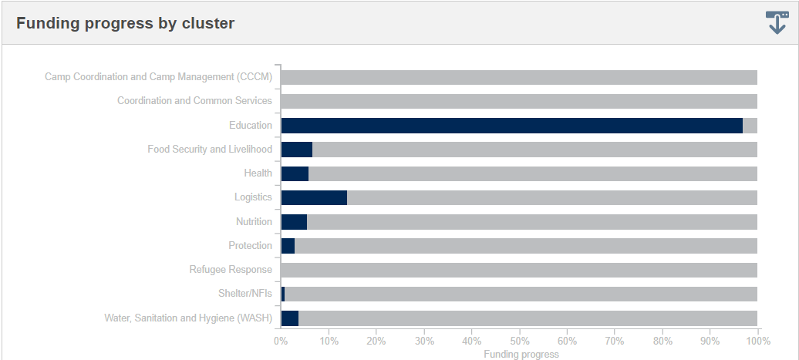
General updates
Funding status of 2021 HRP
USD 254,400,000 / 135,800,000 FSL Cluster -
Received 9,000,000 (Only 6.6% of the total).
CERF applications for Palma Crisis
Training on the FTS (Financial tracking system)
Notes:
Agriculture and Rural Development minister Celso Correia who signed the deal on behalf of government

Slide 17
General updates
Regional Food Security Update - SADC Food Security Quarterly Update 2020/2021 Agricultural Season – Released June 2021
Near normal agricultural production expected this season despite floods in parts of the country and irregular rainfall patterns.
Seasonal rainfall in Mozambique was above normal in the south, near normal to above normal in the central areas, and below normal in the north-eastern provinces of Cabo Delgado and Nampula, while above normal rainfall was received in the north-west of the country.
Chalane /Eloise - Preliminary crop production estimate data indicates that approximately 7% of various crops in the field were affected in the provinces of Maputo, Gaza, Inhambane, Sofala, Manica, Tete, Zambézia and Niassa.
Despite the floods, irregular rains in the provinces of Nampula and Cabo Delgado, and incidences of pests and diseases, near normal agricultural production is expected this season
Notes:
Agriculture and Rural Development minister Celso Correia who signed the deal on behalf of government

Slide 18
General updates
Preliminary results of the 2020 agricultural survey, (Sept 2020 and May 2021).
The survey covered 873 large commercial farms and plantations, 93,183 medium sized farms and 4.17 million small farms, in 141 districts.
Mozambique: Agricultural growth of eight per cent forecast
The survey found that
Only 6.9 per cent of farms have access to the services of rural extensionists.
9.7 per cent use certified seeds,
0.6 per cent have access to agricultural credit.
9.1 per cent of the farms use irrigation,
7.8 per cent use chemical fertilisers, and 5.5 per cent use pesticides.
39.9 per cent have information about the prices of agricultural products.
post-harvest losses at 13.5 per cent, which is much the same as in 2017.
Production of at least two million tonnes of grain this year was already guaranteed.
Final results from the survey should be published on 15 June.
Notes:
Agriculture and Rural Development minister Celso Correia who signed the deal on behalf of government

Slide 19
WFP Continuation of assistance - Sofala & Manica
District | HHs | Beneficiaries | Modality
Búzi | 2,710 | 13,550 | Value voucher
Machanga | 900 | 4,500 | Commodity Vouchers
Muanza | 1,000 | 5,000 | Commodity Vouchers
Sussundenga | 542 | 2,710 | Commodity Vouchers
Machaze | 620 | 3,100 | Commodity Vouchers
Total | 5,772 | 28,860
From May 2021 for a period of 4 months
Seeds to be distributed in the first cycle
Remote sensing Crops ready soon

Slide 20
National & Provincial FSL Cluster Meeting – 09th June 2021
AGENDA
Cluster updates (Pablo Rodriguez - FSC) - 10 mins
SETSAN – Post-harvest assessment (Director Pacheco – SETSAN) – 10 min
Cabo Delgado humanitarian updates (Apolonia Morhaim - FSC) - 40 mins
FSC monthly responses update for February 2020 (FAO, WFP & FSC)- 15 mins
Non-HRP Interactive Dashboard presentation (Joao Muianga– FSC) -10 min
AoB (All)-5 mins

Slide 21
National & Provincial FSL Cluster Meeting – 09th June 2021
AGENDA
Cabo Delgado humanitarian updates (Apolonia Morhaim - FSC) - 40 mins
Situation Update Palma Crisis – Response
Distribution Plans
FSC Livelihoods Strategy
Inter-Cluster
CERF
Multi-Sectoral Missions – Updates
Food Assistance by Partner
Agriculture WG Update – Gaudencio (FAO)
FSC – Preliminary numbers -MAY, Ketan Trivedi, IMO

Slide 22
Situation Update - Palma Crisis / Response
Movements: A/O 3 June, 67,147 people displaced from Palma.
Nangade: 18,202
Mueda: 18,061
Cidade Pemba: 15,905
In Pemba, the Centro Desportivo
Food assistance: Hot meals for breakfast, lunch and dinner,
Partners: Kuendeleya, San Egidio, Makobo and Catholic University and Arco-Iris.
Population A/O 8 June: 42 families / 145 people.
Palma Response and Preparation of Survival Kits
Composition: critical loose items from various clusters (food, WASH, health, shelter, NFI and nutrition).
Purpose: to improve people’s ability to survive in deep field locations
SOP under discussion
Notes:
Agriculture and Rural Development minister Celso Correia who signed the deal on behalf of government

Slide 23
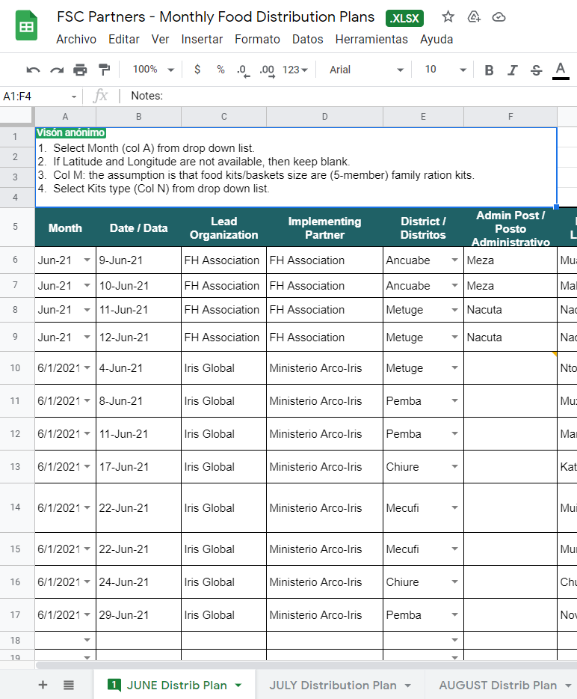
FSC Updates- Distribution Plans for Food Assistance
Notes:
Agriculture and Rural Development minister Celso Correia who signed the deal on behalf of government

Slide 24
FSC Updates- FSC Livelihoods Strategy
On 17 May, we shared with you the Draft Version of the Livelihoods Strategy for the IDP Response in Cabo Delgado.
It intends to cover a period of 12 months.
This strategy is intended to serve as a guidance to the FSL Cluster Partners
Shared with partner for your review, comments and recommendations aiming at an having improved version based on consensus among Cluster Partners before we make the official launch of the strategy.
ACTION POINT:
Notes:
Agriculture and Rural Development minister Celso Correia who signed the deal on behalf of government

Slide 25
Inter-Cluster- CERF
CERF Rapid Response Allocation for $5 Million
Objective: respond rapidly to the crisis caused by the attacks which began in Palma on 24 March 2021.
Of the $5 million, $1,475,000 is for Food Security.
To assist 26,867 beneficiaries
Districts: Montepuez, Mueda, Nangade, Palma and Pemba.
Activities include the provision of the following:
IRR for new arrivals (7 days).
A food basket for 2 months (50kg cereals, 10kg legumes and 5Lt of oil per family per month)
Provision of life-saving nutrition assistance -:
Notes:
Agriculture and Rural Development minister Celso Correia who signed the deal on behalf of government

Slide 26
Inter-Cluster
Multi-Sectoral Missions – Updates
Mueda and Negomano
Ibo & Matemo
Macomia
CCCM Cluster Updated Site List, as of May 2021
Total number of sites: 55
Total number of Relocation Sites: 29
Total number of sites under development: 8
Total number of IDPs in sites: 89,668 –90,000
Media Guidelines – Updates
Issue: government's recent instructions (...May) to avoid taking photos of their people.
Action Taken: shared Protection Cluster Media Guidelines and discussed with OCHA.
Next Steps: Share the FINAL media guidelines and OCHA will discuss further with the SoS
New Secretary of State
Designation as of 3 June
Antonio Njonje Taimo Sopela
New Deputy Humanitarian Coordinator (DHC) for Cabo Delgado, Mr. Jose Barahona.
Notes:
Agriculture and Rural Development minister Celso Correia who signed the deal on behalf of government

Slide 27
Inter-Cluster
Media Guidelines – Updates
Issue: government's recent instructions (...May) to avoid taking photos of their people.
Action Taken: shared Protection Cluster Media Guidelines and discussed with OCHA.
Next Steps: Share the FINAL media guidelines and OCHA will discuss further with the SoS
New Secretary of State
Designation as of 3 June
Antonio Njonje Taimo Sopela
New Deputy Humanitarian Coordinator (DHC) for Cabo Delgado, Mr. Jose Barahona.
Notes:
Agriculture and Rural Development minister Celso Correia who signed the deal on behalf of government

Slide 28
Pemba,
09 June 2021

Slide 29
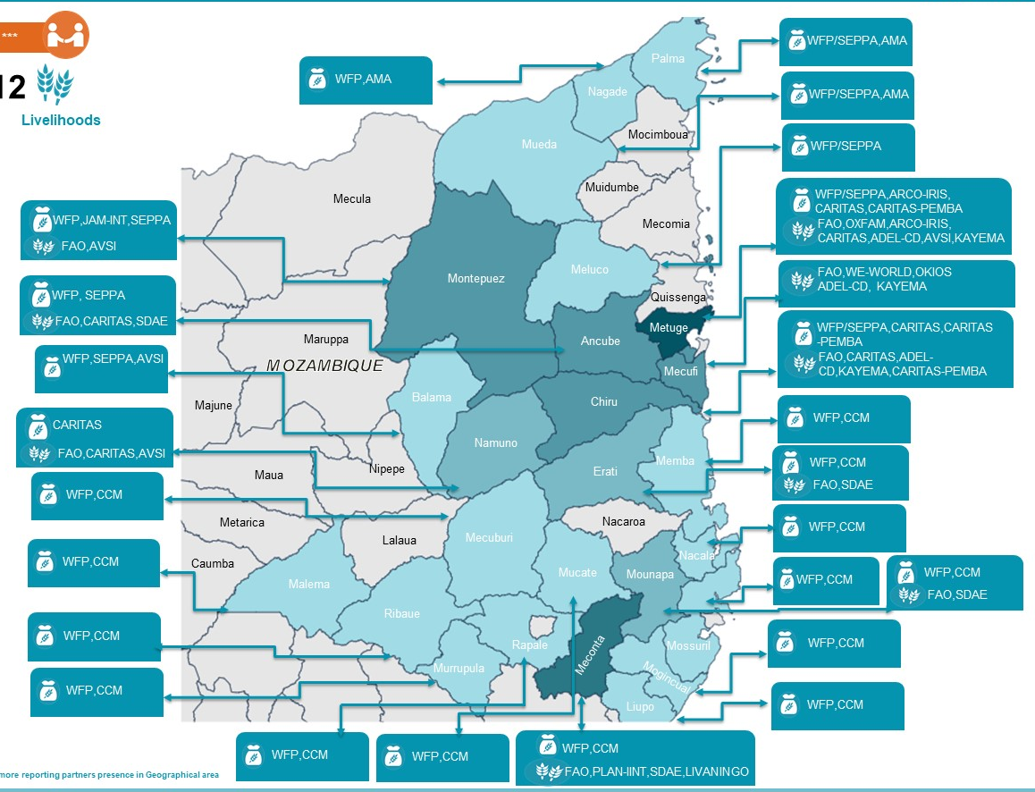
S01: Food Assistance Response in the North of Mozambique
As of May 31st , 2021
In the month of May 2021, the FSC partners provided assistance to food insecurity population in Cabo Delgado, Nampula and Niassa provinces.
PIN (HRP 2021)
MAPPING: No of Partners BY DISTRICT
950,000
PEOPLE TARGETED (HRP 2021)
750,000
#BENEFICIARIES BY LEAD
PEOPLE REACHED (MONTH)
WFP is the lead organization with 93 % of coverage (17 districts in Nampula and 9 districts in Cabo Delgado) followed by JAM (3% of coverage and 1 district), FH ( 1% of coverage and 2 district) and Iris-global (3% of coverage and 4 district).
640,000
TOTAL OF BENEFICIARIES REACHED BY DISTRICT
27
RESPONSE BY MODALITY
Voucher
RESPONSE BY EVENT
LEAD ORGANIZATION
IMPLEMENTING PARTNER
World Food Programme
Food for the Hungry - FH
JAM, Iris-Global
SEPPA, CCM, AMA, AVSI
UNHCR / INAR
4
5

Slide 30
S01: Food Assistance Response by Cabo Delgado
As of May 31st , 2021
.
PEOPLE TARGETED
TOTAL OF BENEFICIARIES REACHED BY INDICATOR
675,000
PEOPLE REACHED
573,000
TOTAL OF BENEFICIARIES REACHED BY DISTRICT
Number of IDPs/returnees
assisted disaggregated by age
and gender; MT/value of food provided.
10
TOTAL OF BENEFICIARIES REACHED BY LOCATION TYPE
LEAD ORGANIZATION
IMPLEMENTING PARTNER
4
World Food Programme
Iris-Global
Food for the Hungry-FH
JAM
3
,AVSI
,SEPPA, AMA

Slide 31
S01: Food Assistance Response In Nampula
As of May 31st , 2021
.
PEOPLE TARGETED
TOTAL OF BENEFICIARIES REACHED BY INDICATOR
52,000
PEOPLE REACHED
75,118
TOTAL OF BENEFICIARIES REACHED BY DISTRICT
17
TOTAL OF BENEFICIARIES REACHED BY LOCATION TYPE
LEAD ORGANIZATION
IMPLEMENTING PARTNER
1
2
World Food Programme
UNHCR/INAR
CCM

Slide 32
S01: Livelihoods Response in the North of Mozambique
As of May 31st , 2021
In the month of May 2021, the FSC partners did support rebuilding of the livelihoods of the affected population in the resettlement sites and host communities in Cabo Delgado province.
PIN (HRP 2021)
MAPPING: No. of Partners by Districts
950,000
PEOPLE TARGETED (HRP 2021)
550,000
#BENEFICIARIES BY LEAD
PEOPLE REACHED (Month-May)
FAO is the lead organization with 91. % of coverage (6 districts in Cabo Delgado) followed by Okios (1% of coverage and 1 district in Cabo delgado), We world GVC( 8% of coverage and 1 district in Cabo Delgado).
6,425
TOTAL OF BENEFICIARIES REACHED BY DISTRICT
6
RESPONSE BY MODALITY
RESPONSE BY EVENT
LEAD ORGANIZATION
IMPLEMENTING PARTNER
Food And Agriculture Organization
Ministerio Arco Iris
We World - GVC
3
FAO,We World – GVC, Okios
3

Slide 33
S01: Livelihoods Response In Cabo Delgado
As of May 31st , 2021
.
PEOPLE TARGETED
HOUSEHOLDS REACHED
TOTAL OF BENEFICIARIES REACHED BY ACTIVITY
440,000
1,290
PEOPLE REACHED
6,425
TOTAL OF BENEFICIARIES REACHED BY DISTRICT
6
TOTAL OF BENEFICIARIES REACHED BY LOCATION TYPE
LEAD ORGANIZATION
IMPLEMENTING PARTNER
3
Food and Agriculture Organization
OKIOS
We World - GVC
3
FAO,OKIOS
We World-GVC

Slide 34
Pemba FSL Cluster Meeting – 28 April 2021
Obrigado!!!

Slide 35
National & Provincial FSL Cluster Meeting – 09th June 2021
AGENDA
Cluster updates (Pablo Rodriguez - FSC) - 10 mins
SETSAN – Post-harvest assessment (Director Pacheco – SETSAN) – 10 min
Cabo Delgado humanitarian updates (Apolonia Morhaim - FSC) - 40 mins
FSC monthly responses update for February 2020 (FAO, WFP & FSC)- 15 mins
Non-HRP Interactive Dashboard presentation (Joao Muianga– FSC) -10 min
AoB (All)-5 mins

Slide 36
Province/Assistance Context | Apr-21 |  |  | May-21
 | Planned | Reached | Achievement rate | Planned | Reached | Achievement rate
Cabo Delgado | 669,472 | 491,804 | 73% | 705,692 | 576,047 | 82%
Conflict/IDPs | 667,500 | 489,485 | 73% | 659,050 | 529,405 | 80%
PRN | 1,972 | 2,319 | 118% | not available | not available | -
Global Partnership for Education |  |  |  | 38,627 | 38,627 | 100%
Home-grown national school feeding programme (PRONAE), |  |  |  | 8,015 | 8,015 | 100%
Nampula | 72,708 | 76,706 | 105% | 116,543 | 119,487 | 103%
Conflict/IDPs | 64,369 | 68,239 | 106% | 65,658 | 67,668 | 103%
PRN | 724 | 1,028 | 142% | not available | not available | -
Refugees | 7,615 | 7,439 | 98% | 7,615 | 7,450 | 98%
Home-grown national school feeding programme (PRONAE), |  |  |  | 43,270 | 44,369 | 103%
Niassa | 500 | 0 | 0% | 8,855 | 8,252 | 93%
Conflict/IDPs | 500 | 0 | 0% | 500 | 0 | 0%
Home-grown national school feeding programme (PRONAE), |  |  |  | 8,355 | 8,252 | 99%
Gaza |  |  |  | 8,260 | 5,240 | 63%
Home-grown national school feeding programme (PRONAE), |  |  |  | 8,260 | 5,240 | 63%
Inhambane |  |  |  | 4,851 | 4,149 | 86%
Home-grown national school feeding programme (PRONAE), |  |  |  | 4,851 | 4,149 | 86%
Manica | 8,736 | 8,372 | 96% | 14,104 | 45,045 | 319%
Eloise | 8,135 | 8,130 | 100% | 8,135 | 8,130 | 100%
lean season | - | - | - | 0 | 30,155 | -
PRN | 601 | 242 | 40% | not available | not available | -
Home-grown national school feeding programme (PRONAE), |  |  |  | 5,969 | 6,760 | 113%
Notes:
For April distribution, only in Cabo Deglado 44,725 IDPs have received Food assistance so far, 7% of the total 667,500 people planned.

Slide 37
Province/Assistance Context | Apr-21 |  |  | May-21
 | Planned | Reached | Achievement rate | Planned | Reached | Achievement rate
Sofala | 33808 | 24034 | 71% | 47991 | 53744 | 112%
Conflict/IDPs | 395 | 180 | 46% | 395 | 180 | 46%
Eloise | 30,250 | 1,455 | 5% | 30,250 | 30,195 | 100%
lean season | 0 | 15,650 | 0% | 0 | 5,070 | 0%
Central region IDPs | 0 | 3,135 | 0% | 0 | 3,135 | 0%
Social Protection - Idai |  |  | 0% | 0 | 1,455 | 0%
PRN | 3,163 | 3,614 | 114% |  |  | 0%
Global Partnership for Education |  |  | 0% | 10,360 | 5,297 | 51%
Home-grown national school feeding programme (PRONAE) |  |  | 0% | 6,986 | 8,412 | 120%
Tete | 87,157 | 15,902 | 18% | 170,155 | 94,194 | 55%
lean season | 0 | 2,070 | - | 0 | 3,360 | -
PRN | 377 | 417 | 111% | not available | not available | -
Social Protection - COVID | 86,780 | 13,415 | 15% | 86,780 | 7,520 | 9%
Home-grown national school feeding programme (PRONAE), |  |  |  | 83,375 | 83,314 | 100%
Zambezia | 138,901 | 2,872 | 2% | 159,905 | 22,132 | 14%
Conflict/IDPs | 1,151 | 1,240 | 108% | 1,173 |  | 0%
Home-grown national school feeding programme (PRONAE), |  |  |  | 22,132 | 22,132 | 100%
Social Protection - COVID | 136,600 |  | 0% | 136,600 | 0 | 0%
PRN | 1,150 | 1,632 | 142% | not available | not available | -
Maputo |  |  |  | 8,737 | 20,147 | 231%
Home-grown national school feeding programme (PRONAE), |  |  |  | 8,737 | 9,147 | 105%
lean season | - | - | - | 0 | 11,000 | -
Mozambique | 1,011,282 | 619,690 | 61% | 1,238,107 | 940,025 | 76%
Notes:
For April distribution, only in Cabo Deglado 44,725 IDPs have received Food assistance so far, 7% of the total 667,500 people planned.

Slide 38
Updates on FAO’s Intervention
National Food Security Cluster Meeting

Slide 39
National & Provincial FSL Cluster Meeting – 09th June 2021
AGENDA
Cluster updates (Pablo Rodriguez - FSC) - 10 mins
SETSAN – Post-harvest assessment (Director Pacheco – SETSAN) – 10 min
Cabo Delgado humanitarian updates (Apolonia Morhaim - FSC) - 40 mins
FSC monthly responses update for February 2020 (FAO, WFP & FSC)- 15 mins
Non-HRP Interactive Dashboard presentation (Joao Muianga– FSC) -10 min
AoB (All)-5 mins

Slide 40
National & Provincial FSL Cluster Meeting – 09th June 2021
AGENDA
Cluster updates (Pablo Rodriguez - FSC) - 10 mins
SETSAN – Post-harvest assessement (Director Pacheco – SETSAN) – 10 min
Cabo Delgado humanitarian updates (Apolonia Morhaim - FSC) - 40 mins
FSC monthly responses update for February 2020 (FAO, WFP & FSC)- 15 mins
Non-HRP Interactive Dashboard presentation (Joao Muianga– FSC) -10 min
AoB (All)-5 mins

Slide 41
AoB
FSC Coordination : Apolonia leaving ☹
Missing details? Information? -
CWG North
Energy and food security
Trainings needed? – Distributions
Next meeting – National / Cabo Delgado on the 23rd June?

