Slide 1


Pemba,
24 February 2021

Slide 2

Pemba FSL Cluster Meeting – 24 February 2021
AGENDA
Situation - Update
World Bank Project, Lizardo Narvaez Marulanda
FSC Updates
  Food Assistance - Partners Update
  Agriculture WG Update
  FSC in Numbers, Joao Muianga, FSC Information Manager
Linha Verde, Northern Region, Elda Deavelar
Inter-Cluster
  Rapid Response Mission to Mueda
  CCCM Cluster Site List
  HRP 2021 Cluster Projects
AOB

Slide 3
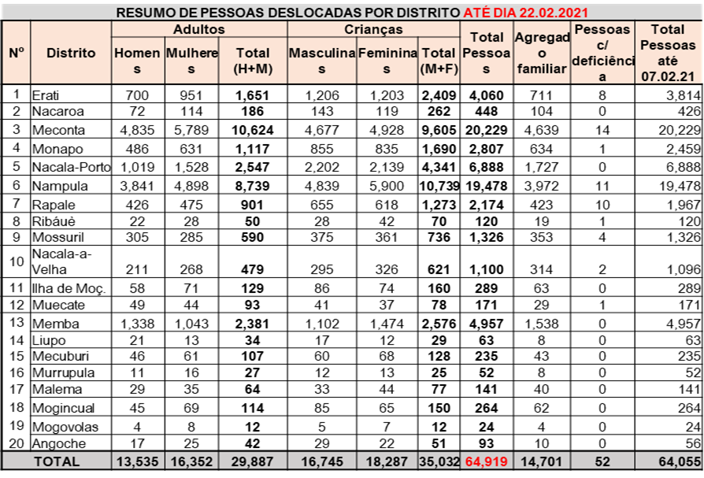
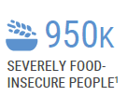

Pemba FSL Cluster Meeting – 24 February 2021
1. Situation Update
1.3 M People in urgent need of humanitarian assistance
Nampula
Niassa
Breakdown Estimates
CD = 605,000 IDPs
Source: OCHA Overview

Slide 4
Pemba FSL Cluster Meeting – 24 February 2021
2. World Bank Project
World Bank Project, Lizardo Narvaez Marulanda

Slide 5
Pemba FSL Cluster Meeting – 24 February 2021
3. FSC Updates
FSC Updates
  Food Assistance - Partners Update
      Arco Iris
      Caritas
      FH
      WFP
      OTHER NON-COORDINATED ASSISTANCE
  Agriculture WG Update
  FSC in Numbers, Joao Muianga, FSC Information Manager

Slide 6
Pemba FSL Cluster Meeting – 24 February 2021
4. Linha Verde Update
Linha Verde, Northern Region, Elda Deavelar

Slide 7
Pemba FSL Cluster Meeting – 24 February 2021
5. Inter-Cluster
Inter-Cluster
  Rapid Response Mission to Mueda
  CCCM Cluster Site List
  HRP 2021 Cluster Projects

Slide 8
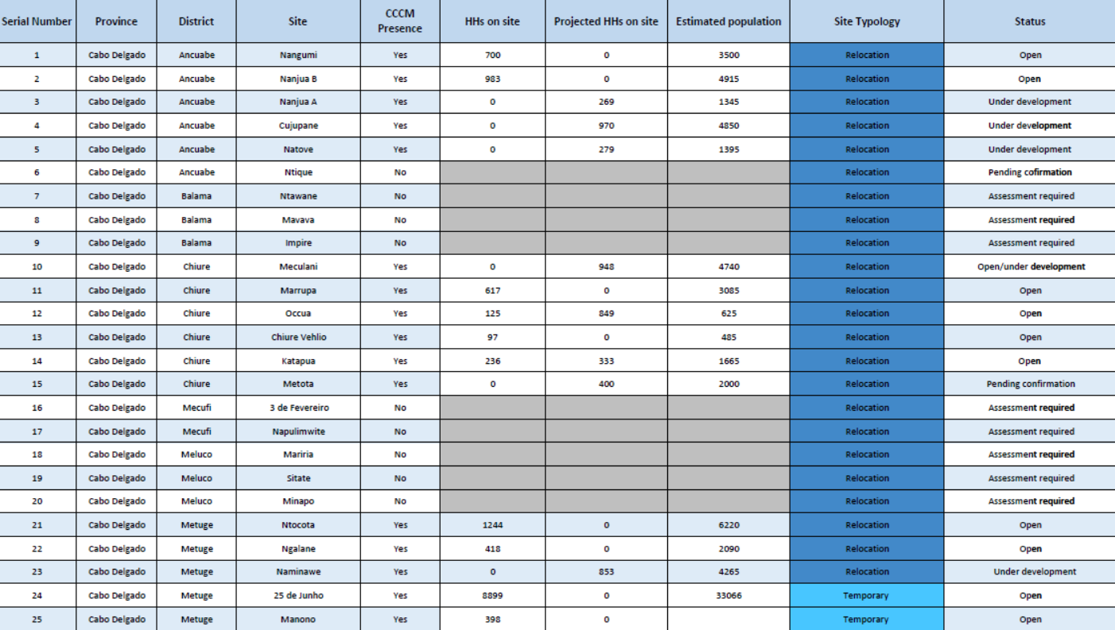
Pemba FSL Cluster Meeting – 24 February 2021
5. Inter-Cluster - CCCM Cluster Site List (17 Feb)

Slide 9
Pemba FSL Cluster Meeting – 24 February 2021
5. Inter-Cluster - CCCM Cluster Site List (17 Feb)

Slide 10
Pemba FSL Cluster Meeting – 24 February 2021
5. Inter-Cluster
  HRP 2021 Cluster Projects - US$136 M

Slide 11
Pemba FSL Cluster Meeting – 24 February 2021
6. AOB
AOB
?
?
?

Slide 12
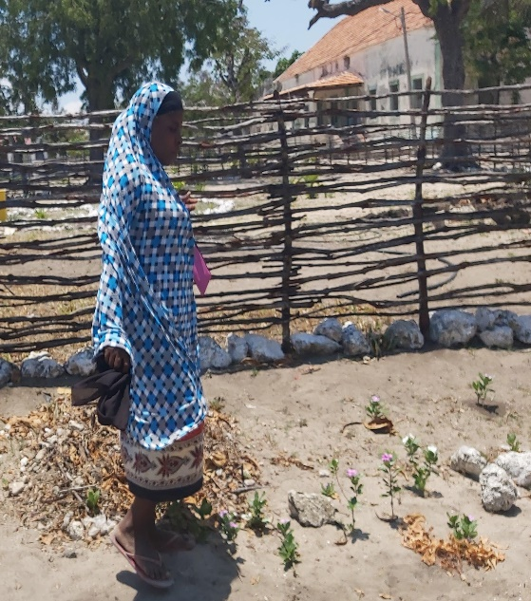
Pemba FSL Cluster Meeting – 24 February 2021
Thank you
Obrigada
Gracias

Slide 13
IM Update
Pemba,
24th January 2021

Slide 14

IMO Updates
The global FSC has introduced the new 5W Matrix template in which all FSC countries member must adopt.
Country-defined indicators for the 2021 HRP have been added to the 5W Matrix.
On the 17th and 18th February, the IMO of the FS Cluster met to:
  Have feedback on the challenges and success stories in submitting activities in the 5W matrix of 2020.
  Provided training on the use of the new 5W matrix for the year 2021.
A total of 20 people participated in the training with a total of 12 organizations (Ministerio Arco Iris, FAO, WFA, ADRA, JAM, Save the Children, Oikos- Cooperation and developments, FH Association, ActionAid, Agrimerc).
We had the participation of Elda Deavelar of the Linha verde, who spoke about the importance of partners in the dissemination of the Linha Verde and how to proceed when the assisted communities report cases of exploitation and sexual abuse.
A guide in Portuguese and English was shared with the partners for support and the DRAFT of the new 5W matrix.

Slide 15
IMO Updates
Upcoming
February 28th : IMO will send partners in Matrix 5W to submit February 2021 activities
March 5th : 5W Matrix submission deadline
IM products are produced using the 5W matrix which is reported by the partners, if your organization is not in any of the reports, please subscribe to the cluster contact list to receive important information;
For Support you can consult the:
Website: https: //www.fscluster.org/Mozambique
Contact: joao.muianga@wfp

Slide 16
Food Assistance & Livelihood Report, North of Mozambique
January 31st, 2021
During January 2021, FS partners assisted the provinces of Cabo Delgado, Nampula and Niassa. This assistance contributed to the two objectives of the cluster below.
  SO1 - Provision of life-saving food assistance to cutely food insecurity population including displaced population and immediate host communities;
  SO2 -Support rebuilding of the livelihoods of the affected population in resettlement sites and host communities

Slide 17

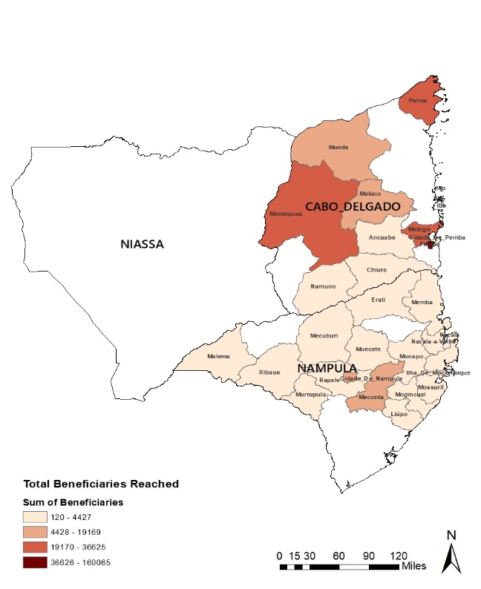





Food Assistance Dashboard For The North of Mozambique
As of January 31st 2021
FOOD ASSISTANCE BY ACTIVITY
FOOD ASSISTANCE MAP
321,901
Assistance by Lead
Total number of people reached in Cabo Delgado, Nampula by Food Assistance
0.6% Istituto OIKOS
2% Caritas Pemba
2,4% Iris Global
280,546
41,355
95% WFP
87%
13%
In-Kind
Voucher
FOOD ASSISTANCE: BENEFICIARIES REACHED BY DISTRICT
LEAD ORGANIZATION
IMPLEMENTING PARTNER
WFP, Caritas Pemba,
Iris Global, Istituto OIKOS
2
SEPPA, INAR
4
PARTNER BY PROVINCE
ASSISTANCE BY SHOCK
Cabo Delgado
WFP, Istituto OIKOS, Iris Global, Caritas Pemba,, SEPPA
2
Conflict affected
Refugees
Nampula
WFP
TOTAL OF DISTRICT REACHED
Niassa
NONE
20 District

Slide 18

# Beneficiaries reached monthly in the North of Mozambique In 2020 to January 2021

Slide 19
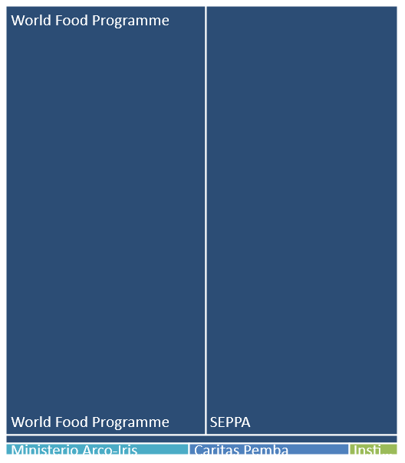
Beneficiaries Reached by Partners In The North Of Mozambique
Cabo Delgado
5
WFP, Iris Global, Caritas, SEPPA, Istituto OIKOS
NIASSA
Nampula
2
WFP, INAR

Slide 20
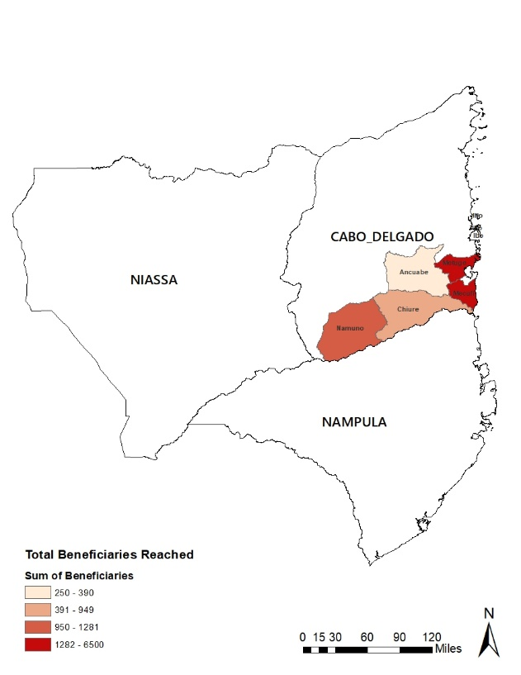

DRAFT_Livelihood Dashboard for the North of Mozambique
January 31st 2021
LIVELIHOOD BY ACTIVITY
LIVELIHOOD MAP
54,992
Assistance by Lead
Total cumulative number of people reached in Cabo Delgado by Livelihood
100% FAO
LIVELIHOOD BY ACTIVITY AND BENEFICIARIES
54,992
Seeds Distribution
54,992
Tools
LEAD ORGANIZATION
IMPLEMENTING PARTNER
1
FAO
4
SDAE, ADEL, AVSI,
Caritas Pemba, KAYEMA
LIVELIHOOD: BENEFICIARIES REACHED BY DISTRICT
PARTNER BY PROVINCE
ASSISTANCE BY SHOCK
Cabo Delgado
FAO
2
Conflict affected
Kenneth
Nampula
NONE
TOTAL OF DISTRICT REACHED
Niassa
NONE
6 District

Slide 21

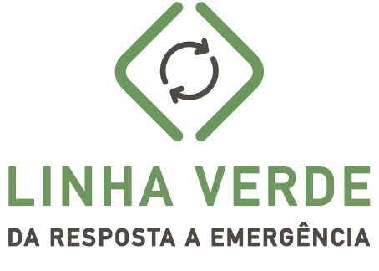
Inter-Agency Complaints and Feedback Mechanism in Mozambique
Joint commitments to Accountability to Affected Populations (AAP) and Protection against Sexual Exploitation and Abuse (PSEA)
February 2021

Slide 22

Linha Verde da Resposta a Emergencia (1458)
Launched in May 2019 as a result of IDAI, emanated from the Protection cluster as part of UN wide commitments to Protection, AAP and PSEA.
Is an interagency CFM and is available to clusters and cluster partners. Organizations working with UN agencies can obtain feedback regarding programs.
National reach:
  Scaled-up to cover Cabo Delgado in August 2019
  Further scaled up to cover drought affected areas in the south from November 2019
Operates from 6am to 9pm(8pm curfew). 6 agents per shift. 14 languages of communication. Always 50% women per shift.
Monthly dashboards intended to highlight gaps and challenges to facilitate joint decision-making by humanitarian coordination

Slide 23
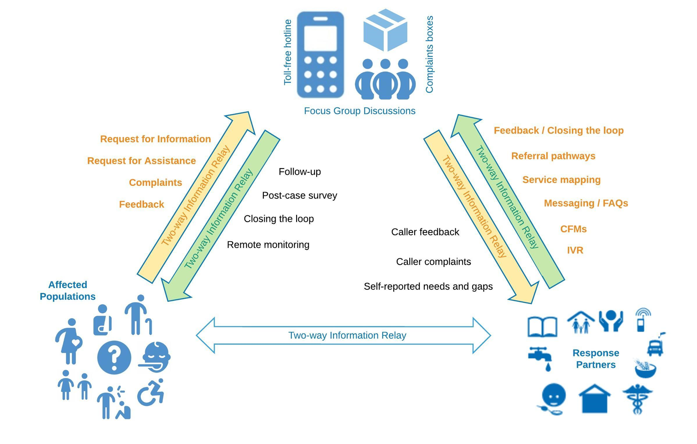
Linha Verde da Resposta a Emergência (1458)
Two-way information relay mechanism for the humanitarian response: cyclones, drought, IDP, Covid-19

Slide 24
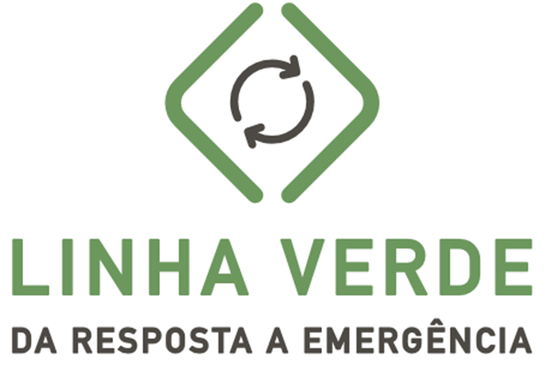
Humanitarian actors
Linha Verde call centre
Linha Verde manager (analysing and referring cases for action/ clarification by focal point and arrange feedback to users)
IMO (captures trends, analyses data and extracts programme adjustments based on feedback)
Joint advocacy to HCT on trends identified through Linha Verde, protection monitoring, DTM, CBCMs.
INGC
Food Security Cluster
Shelter Cluster
Camp Coordination and Camp Management
Water Sanitation and Hygiene cluster
Education cluster
Health cluster
Linha Fala Crianca
GBV sub-cluster
PSEA taskforce
Protection cluster
INGC – Provincial Focal Points
Food Assistance
Livelihoods
FAO/ 4W
4W
Resettlement Site managers
4W and Resettlement Site managers
MINED focal point
MISAU focal point
Focal point to link to MGCAS referral pathways
Focal point to link to MGCAS referral pathways
PSEA focal points
Procuradoria when cases relate to leaders
Cluster partners- directly or indirectly through Cluster focal point
Protection desk volunteers
Responding to the fact that the majority of complaints relate to abuses of power by leaders
Protection advisor
Every sub-office – CFM programme assistant to manage cases
CPs determine Protection/ AAP focal point
Linha Verde
PSEA Coordinator
Sexual exploitation and abuse
Charges for access to assistance
INGD
Maputo, Manica, Sofala
INGD
Maputo, Manica, Sofala
Procuradoria Sofala
PRM Sofala
(Buzi, Chibabava, Nhamatanda, Dondo
MCGAS
Gabinete de Combate Contra Corrupção (GCCC)
Maputo & Sofala

Slide 25
Case handling:
Linha Verde 1458 is only as good as the information provided by humanitarian partners.
Upon registering any case Linha Verde 1458 obtains consent to capture case details and to refer cases (with or without personal details) for action by partners.
First case resolution: [not referred] clarification is provided to callers on the call, removing doubt and opportunity for rumours or misunderstanding and managing expectations.
Referral to sector focal points for clarification or action. Humanitarian partners are responsible for addressing all cases and sharing a final update on actions taken for feedback loop closure by Linha Verde 1458
Linha Verde 1458 proposes the following referral timelines:
 |  | Role and responsibility
Case Type | Time | Linha Verde | Referral Focal Point (cluster, partner)
Urgent | 24 hours | to share the case with the relevant focal point | to acknowledge case and provide update* to Linha Verde
Urgent | 24 hours | to relay update to the CFM User / close the loop
Non-urgent | 7 days | to share the case with the relevant focal point | to acknowledge case and provide update* to Linha Verde
Non-urgent | 7 days | to relay update to the CFM User / close the loop
*Important Note: An update does not automatically indicate a resolution of a case, but ensures that Linha Verde is aware that action is being taken.

Slide 26
What does feedback mean?/Loop closure
Inform the caller/ beneficiary that the organisation has been notified of the issue and is taking steps to resolve it or put mechanisms in place to prevent it from happening again.
  (Humanitarian organisations have to verify the facts of the cases and use established internal measures to resolve issues and improve programming.
  Responses should be formulated as response to the hotline user
Where the humanitarian organisation cannot take action against perpetrator in cases of abuses of power/PSEA.
  Linha Verde 1458 informs caller regarding the role of the humanitarian organisation and local authorities who are in charge of taking action against local leadership
  Linha Verde 1458 informs caller the case has been referred to local authorities/encourage people to report to GPCC.
Notes:
It is important population to provide adequate information about the case to improve the chances for follow-up and resolution, it is also important for callers(victims/beneficiaries) to remain available, contactable and cooperative for follow-up and investigation.

Slide 27


FOOD SECURITY
Sofala | 99
Zambezia | 5
Manica | 22
Tete | 22
Nampula | 26
Cabo Delgado | 405
Inhambane | 40
Gaza | 29
Maputo Provincia | 5
16 Dec 2020 - 15 Jan 2021
Cases Registered:
653
Feedback Provided:
451
16 Dec 2020 - 15 Jan 2021
64% of the cases registered here are from the northern region of the country of which requests for food assistance are also accompanied simultaneously by requests for NFI assistance in the form of agricultural tools and seeds, shelter kits and or tents as well as hygiene kits.

Slide 28


NORTHERN REGION (IDP) RESPONSE
16TH DEC 2020 – 15th JAN 2021
Nov/Dec
Cases Registered:
897
Feedback Provided:
54%
Nov/Dec
Cases Registered:
85
Feedback provided:
34%
Dec/Jan
Cases Registered:
626
Feedback Provided:
57%
Dec/Jan
Cases Registered:
77
Feedback provided:
44%

Slide 29

NORTHERN REGION (IDP) RESPONSE
INFORMATION REQUESTS
16TH DEC 2020 – 15th JAN 2021
All information requests regarding registration process are assorted food assistance and NFI assistance requests from IDP’S who claim to not have been registered as IDP’s in host communities. Linha Verde 1458 has provided guidance to IDP’s on how to register in their host communities in order to benefit from assistance as relevant.
Nov/Dec
Cases registered:
149
Feedback provided:
97%
Dec/Jan
Cases registered:
232
Feedback provided:
95%

Slide 30

NORTHERN REGION (IDP) RESPONSE
COMPLAINT/NEGATIVE FEEDBACK
16TH Dec 2020 – 15th JAN 2021
NORTHERN REGION (IDP) RESPONSE
Breakdown of Abuses of Power and other access barriers
16TH DEC 2020 – 15th JAN 2021
A large portion of exclusion errors are from IDP’s claiming to have been registered various times by local authorities in host communities and continue to not receive assistance
Abuse of power:
refers to claims local leaders including family members and associates who do not fit the vulnerability criteria.
Corruption: refers to claims of the wrongful act of charging a fee to beneficiaries/non-beneficiaries as a condition to receive humanitarian assistance
Complaints – Abuses of power
Complaints – Access barriers

Slide 31
NORTHERN REGION (IDP) RESPONSE
Districts with the highest nr. of cases
16TH Dec 2020 – 15th JAN 2021

Slide 32
Highlights: Food Security Cluster – Cabo Delgado/Nampula and Niassa
Northern region:
  WFP and other humanitarian partners continue to face problems regarding IDP registration lists, IDP’s continue to claim to be excluded from beneficiary lists despite having been registered by local leaders
  Claims that members of host communities are receiving assistance in place of IDP’s due to affiliation with local leadership
  Large number of requests for information regarding distribution dates due to delays and cancellations, distributions resumed throughout the month of January 2021
  It is important for Linha Verde 1458 to have sight of the locations of partners interventions in order to aid in channelling of cases to the right actors and dissemination of key messages regarding issues such as targeting criteria and entitlement

Slide 33
Highlights: Food Security Cluster – Cabo Delgado/Nampula and Niassa
Considerations:
Partners can explore opportunities for joint action for common issues raised
Cases can be shared with CFM focal points of cluster partners to facilitate feedback provision, directly or indirectly through cluster focal point.
Dissemination of information regarding partner Helpdesks/ committees or protection focal points
Partners can share information regarding interventions to facilitate sharing of information by Linha Verde 1458, Linha Verde 1458 needs to reiterate CWC messages for reinforcement

Slide 34
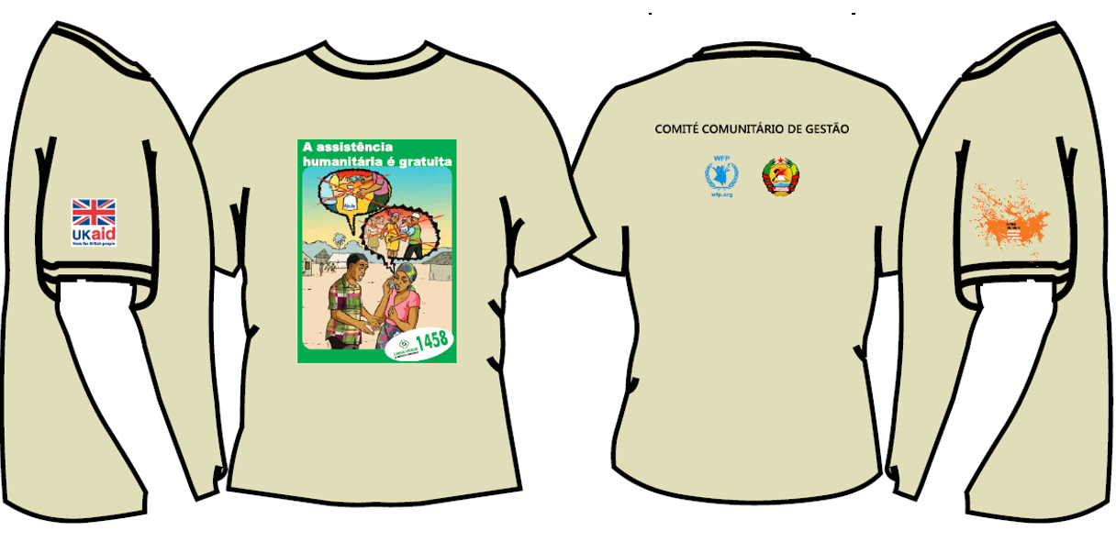
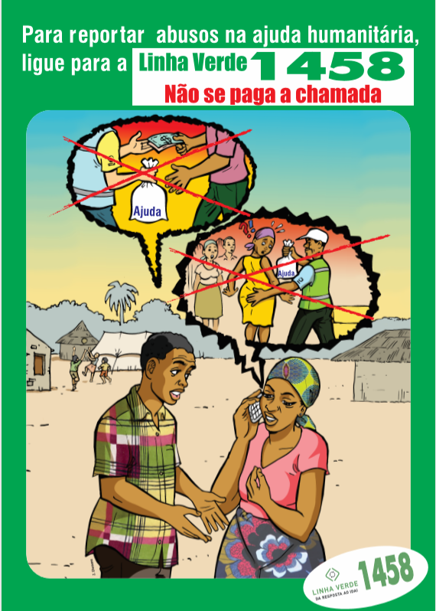
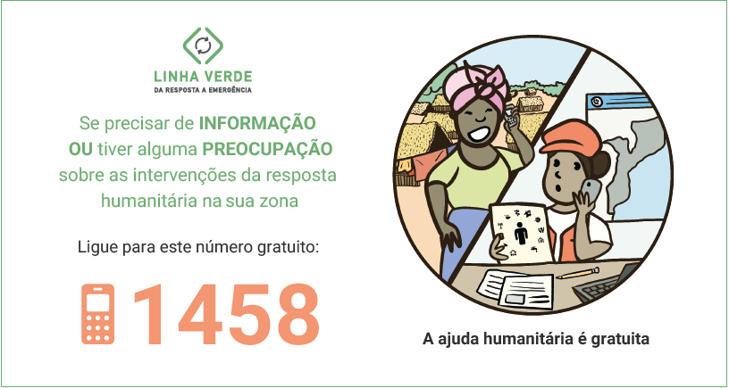
Communications

Slide 35
Thank you!
Questions?

