Slide 1

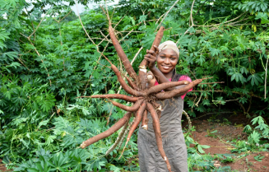

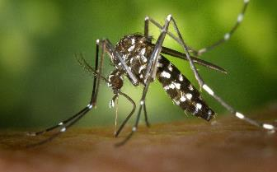
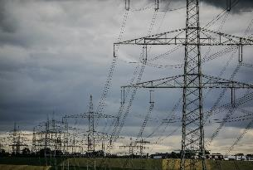
Updates On 2023
Seasonal Climate Prediction in
Borno, Adamawa and Yobe State
ABDULLAHI M.
Meteorologist/Forecaster
NIGERIAN METEOROLOGICAL AGENCY
1ST AUGUST, 2023

Slide 2
2023 RAINFAL PREDICTION RECAP FOR BAY
2023 predicted based on two ENSO phases;
  La Niňa phase for onset of rains
  Neutral phases – length of growing season, cessation and rainfall amount
Rainfall prediction –
  Onset Dates of Rainy season – Normal to long term average
    Early onset is started from early May in Adamawa to mid July in Northern Borno
  Cessation date of rainy season –
    Earliest cessation is anticipated to be ending September to early October (Late Cessation)
  Length of Growing Season- The average length of growing season is anticipated to vary between 170 to 90 days
  Rainfall amount -The annual rainfall for BAY State is predicted to range from 420mm to 1320 mm of rainfall

Slide 3
Determining Attributes
  La Niňa phase for onset of rains
  Neutral phases – length of growing season, cessation and rainfall amount
  Inter-tropical Discontinuity (ITD) Trajectory
  Pressure Intensification and weakening

Slide 4
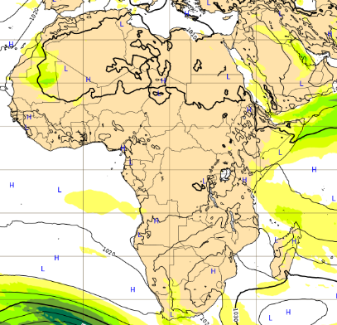
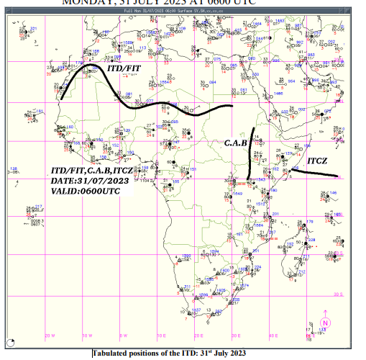
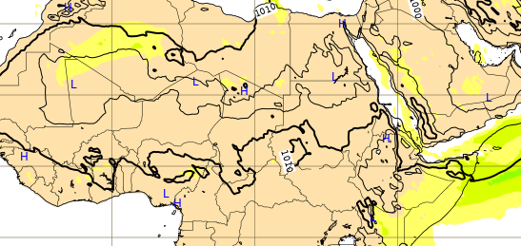
  Inter-tropical Discontinuity (ITD) Trajectory
MSLP in July
MSLP in August

Slide 5
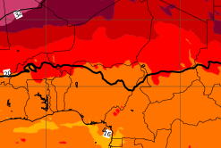
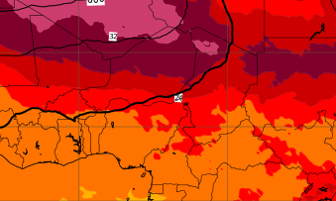

Slide 6
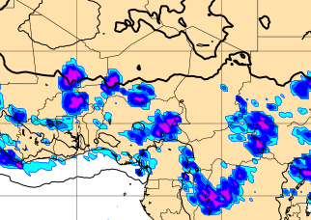
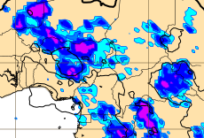
Rain accumulation in July
Rain accumulation in August

Slide 7
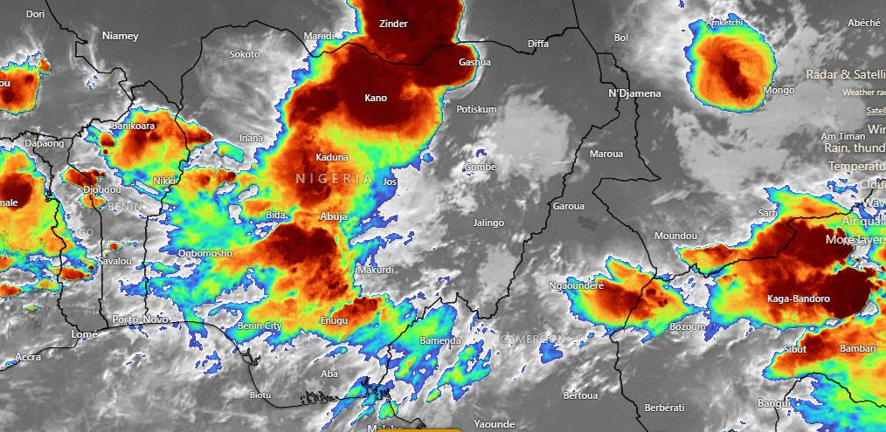
Satellite (IR) image of a system 31st July, 2023

Slide 8
Chad Basin Flood Risk region
Upper Benue Flood Risk region
Source: Nigerian Hydrological Agency(NIHSA), 2023

Slide 9
Expected changes in the 2023 Prediction
Prolongment of Little Dry Spell from normal to abnormal condition (>20days)
Decrease in Rainfall amount especially in northern Borno and Yobe state (<350mm)
Decline in Cumulative Number of rainy days from minimum of 90 days to 67days
Early cessation than forecasted in the BAY region (from Mid September to early October)

Slide 10
Adaptation and Mitigation strategies to Farmers
Early planting of farm crops to avoid early cessation impact
Use improved seed varieties with shorter duration
Plant crops that can be cultivated with the expected periods
Improved the quality of your farm yield
Following the trend of weather update and advisory from NiMet

Slide 11
THANK YOU

