Slide 1
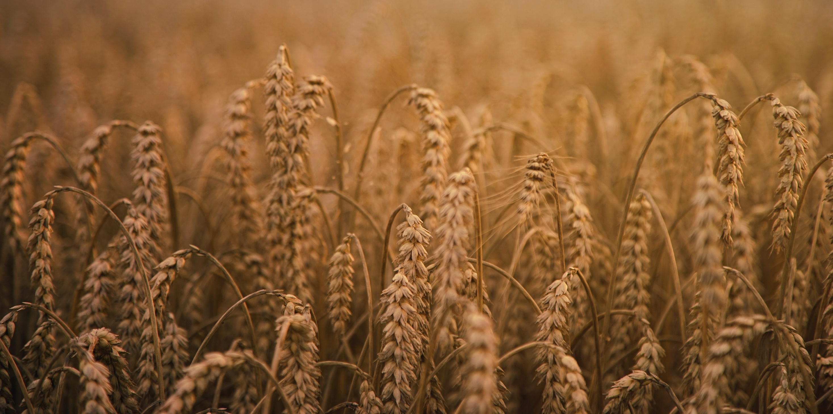
USAID AGRO: emergency support, recovery, and development of agriculture during the war
March 2024
Notes:
recovery and self-reliance agriculture

Slide 2
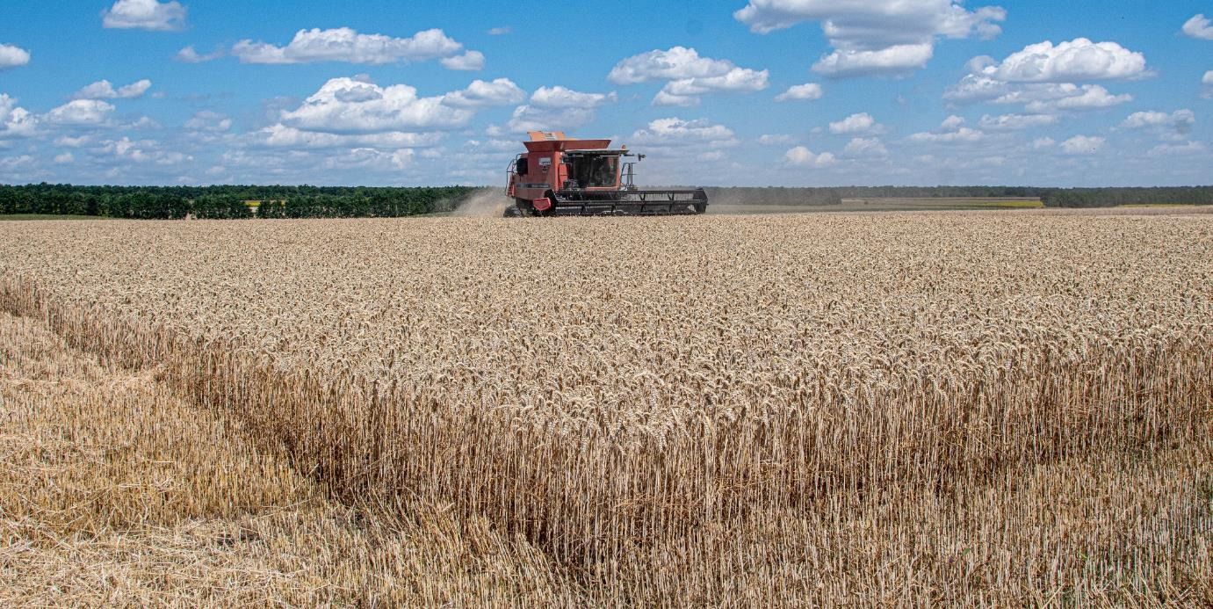
USAID AGRO ACTIVITY
FOCUS ON GLOBAL FOOD SECURITY AND RESILIENCE OF UKRAINE’S AGRICULTURE
Nationwide coverage
Over 15,000 agri-MSMEs reached since 2020
War response
106 private and public sector partners, 63 active ongoing projects all over Ukraine
Sustain & recover agri-sector
Part of USAID ARGI-Ukraine launched to bolster Ukrainian agricultural production and exports and to help alleviate the global food security crisis

Slide 3
Quick overview
Resources
Seed development program
Marketing
Production
Developing
В2В cooperation
Export-oriented program (trade missions)
Emergency response
Provision of seeds and fertilizers
Support local food security – seeds for households
Capacity building
Access to finance and services
Irrigation
Processing
Flour fortification
Processing to feed and food
LEAN – optimization of production processes
Skill development program for grain silo specialists
Potato post-harvest handling development
Storage
Grain sleeves and temporary storage
Expanded silo storage capacity

Slide 4
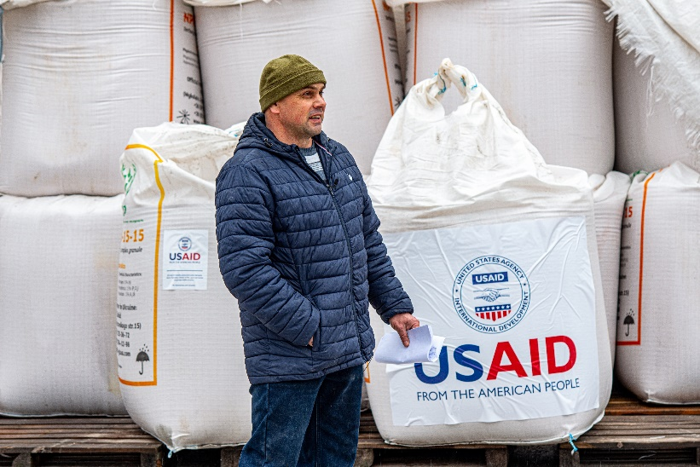
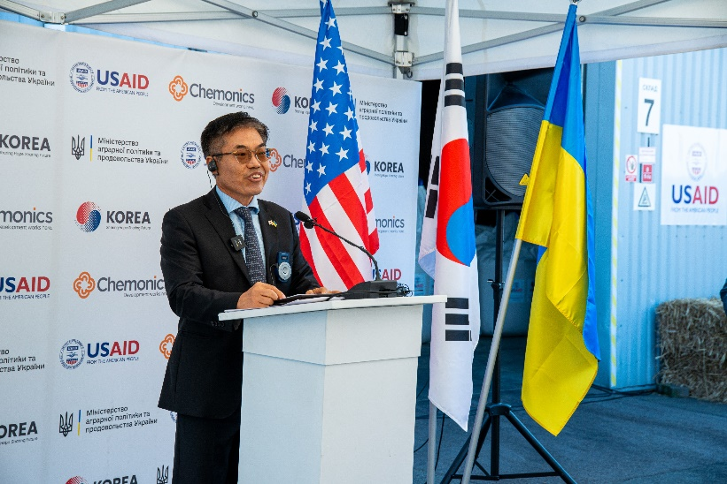
USAID Agriculture Resilience Initiative (AGRI)-Ukraine
Partnerships with public sector and international community
USAID’s financing under AGRI-Initiative
Private sector:
Bayer donated corn seeds and oilseed rape seeds
International partners:
Republic of Korea contributed to fertilizer purchase

Slide 5
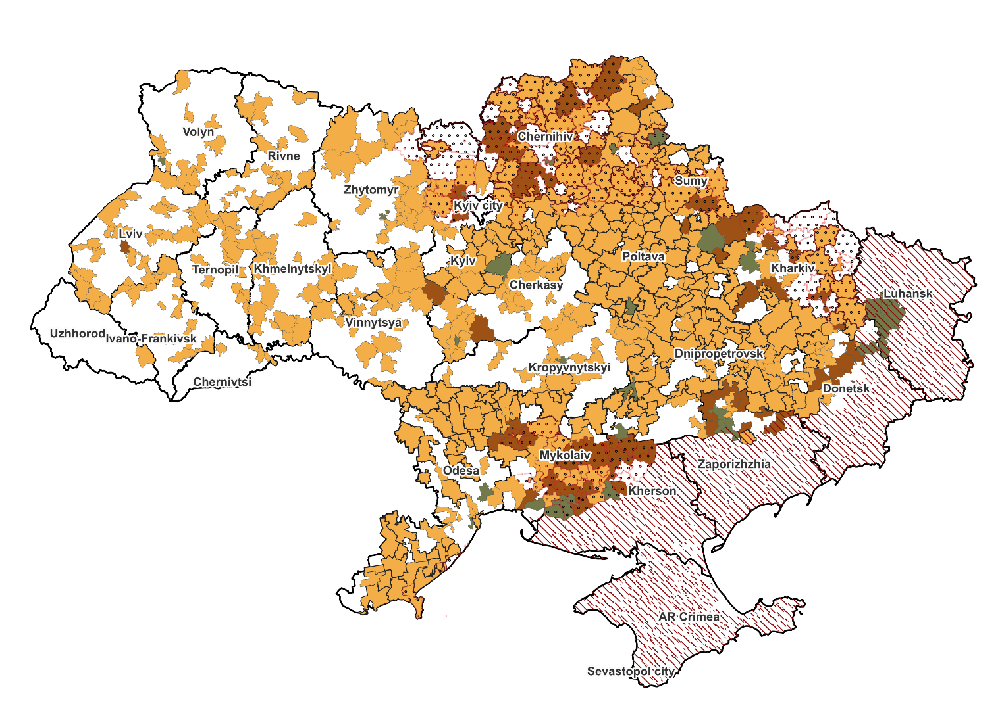
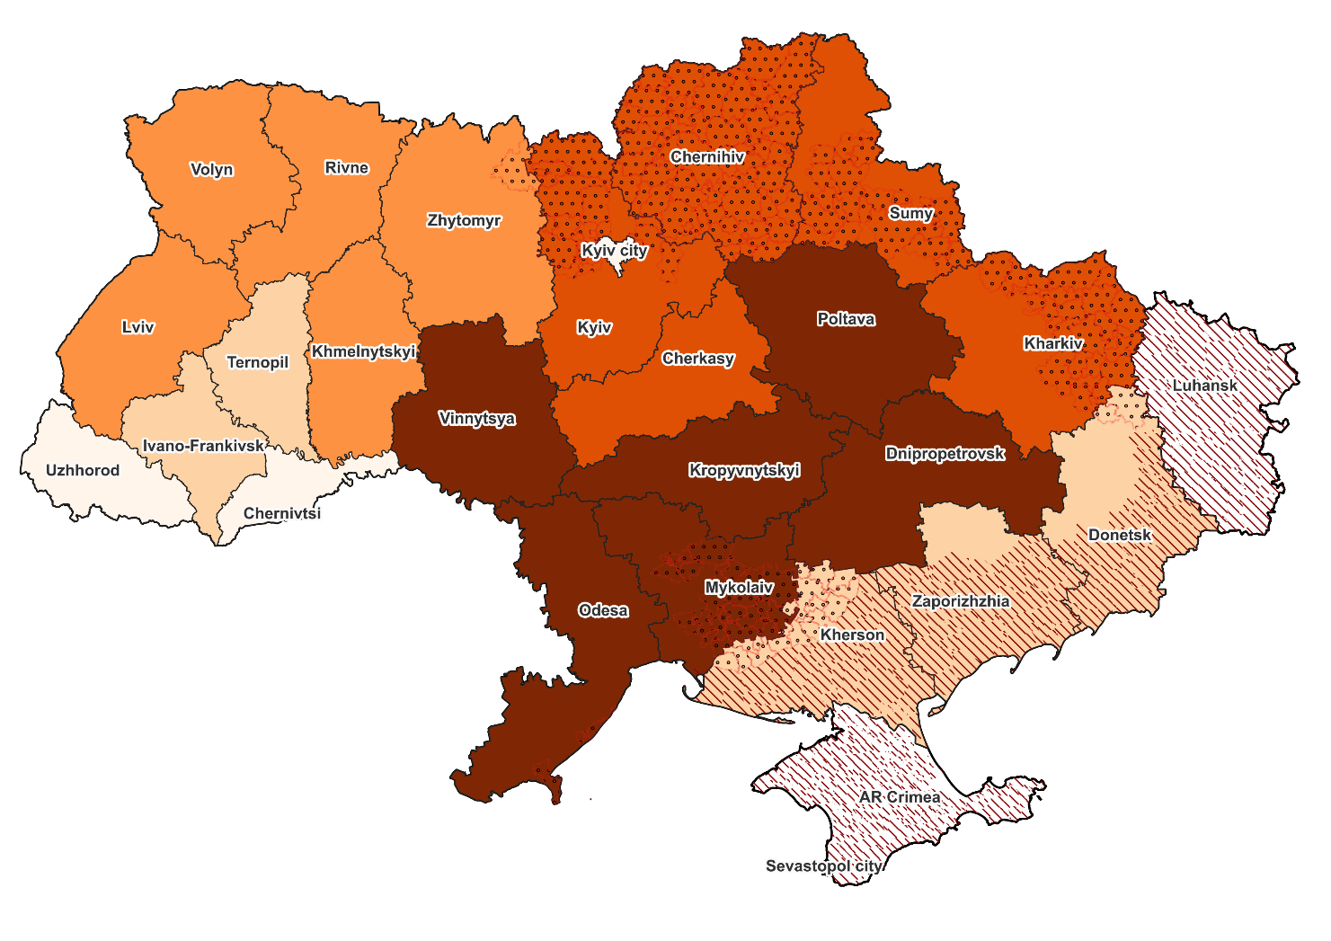
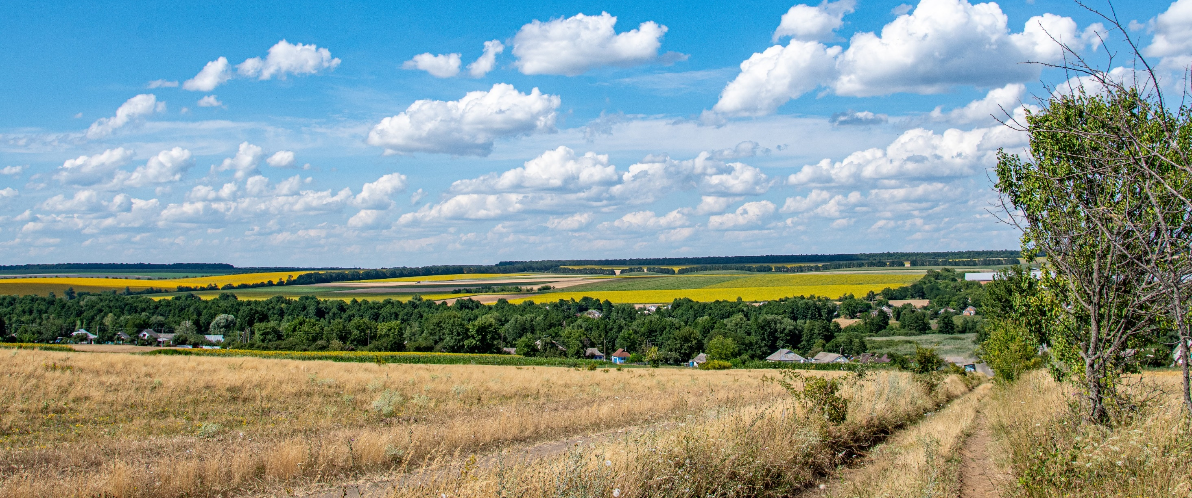
Emergency response to war in 2022-2023
<55 MSME
seeds & fertilizers
>500 MSME
vegetable seeds
critical goods
seeds & goods
14,153 unique farmers – 6 distributions
1,998 tons of help for 658 communities
Notes:
Ми почали роздавати добрива і насіння через ДАР і, розуміючи, як сильно страждають сільські громади, навіть доставляти допомогу від інших донорів.
Упродовж трьох роздач на посівні 2023 і весну 2024, 14,153 унікальних агровиробника отримали від АГРО добрива і насіння. Все, що для цього треба було – подати заявку через ДАР:
- 14,000 т карбаміду (7,600 ММСП)
- 12,000 т нітроамофоски (12,000 ММСП)
- 8 тис т добрив і насіння (8,222 ММСП)

Slide 6
Seeds and fertilizers for MSME farmers
AGRI-Ukraine
6,300+1,916 agricultural MSMEs* received inputs for the spring 2023 sowing campaign
12,000+7,691 agricultural MSMEs* received inputs for winter 2023 & spring 2024 sowing campaigns
Mineral fertilizers of total 6,300 tons
Fertilizers for winter crops 12,000 tons
Corn seeds for sowing 15,000 ha
Oilseed rape seed for sowing 5,100 ha
Fertilizers for spring crops 14,000 tons
Sunflower seeds for sowing 42,000 ha
* Agricultural MSMEs cultivating from 5 to 500 ha
Notes:
Весняна роздача: 6300 унікальних фермерів отримали добрива. 1916 унікальних фермерів отримали насіння (соняшник, кукурудза). Фермери, які отримали добрива та насіння перетиналися.
Осіння роздача: 12000 фермерів та 7691 фермер (дві роздачі, могли перетинатися) отримали добрива

Slide 7
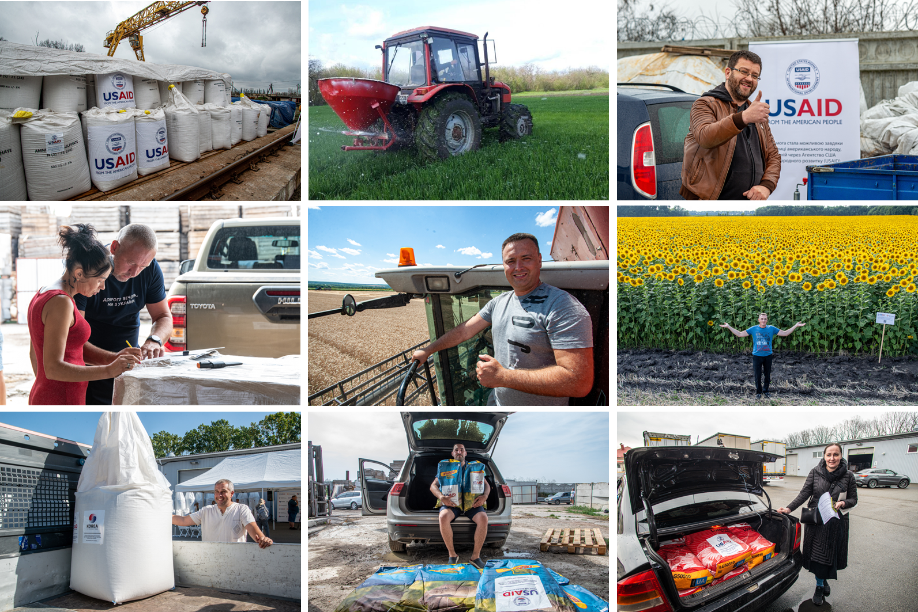
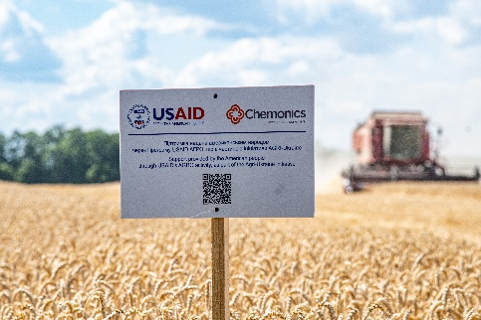
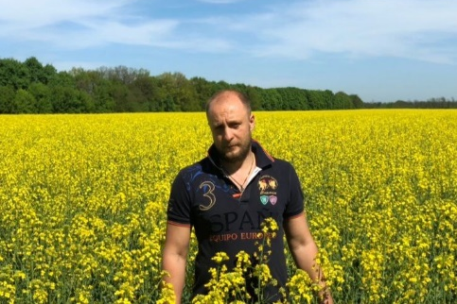
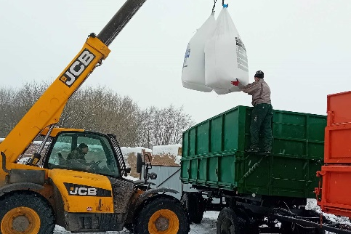
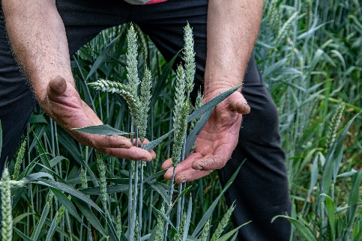
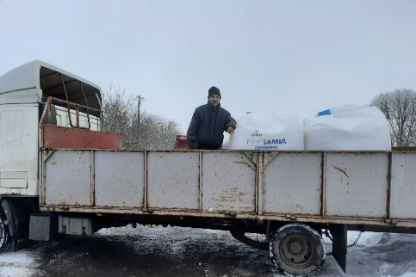
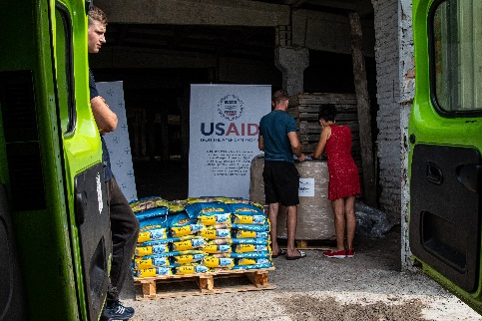
Inputs distribution modality
Collect applications via State Agricultural Register (DAR)
Local partner for administrating distribution and reporting
2-3 distribution hubs per oblast – farmers come to collect when notified
Telegram chat-bot for communicating with farmers-recipients
Monitoring results

Slide 8
Impact
30%
30%
of registered MSMEs received support from USAID AGRO
6 distribution programs supported the application of nutrients on 460,000 hectares during the 2023 and 2024 seasons
This resulted in an estimated additional crop production output of 278,000 tons of grain
Production volumes will be sufficient to feed 5-10 million people*.
Upcoming in 2024:
Partnering private sector to provide seeds
Provision of critical inputs throughout a season
*considering that on average one person consumes 26-50 kilograms of bread a year

Slide 9
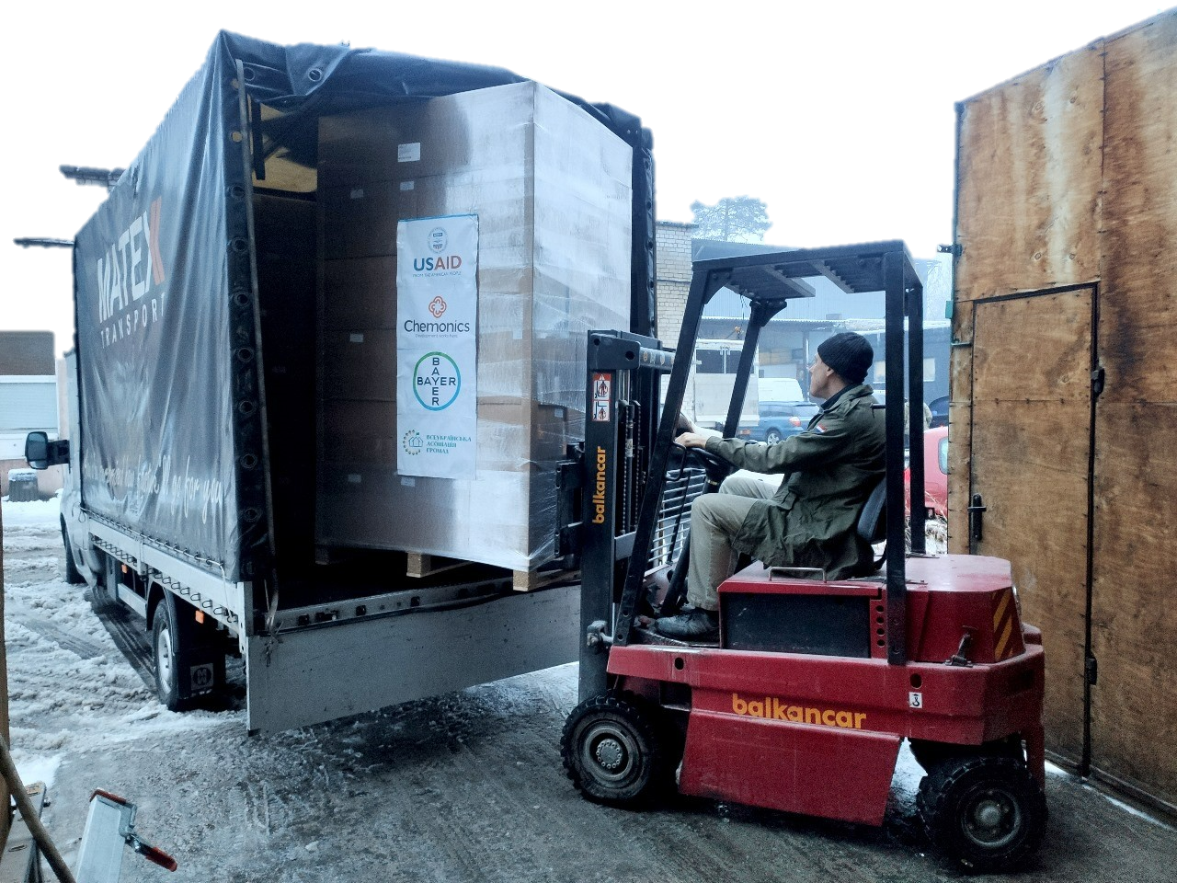
Emergency response: help to the communities and households
Strengthening the resilience of communities:
organizing the delivery of essential goods from Ukrainian and international donors to restore the vitality of communities
2022 – till now:
39 tons of vegetable seeds
35 tons of potato seeds
1,998 tons of necessities
17 modular houses
125 tons of humanitarian aid for affected communities due to undermining the Kakhovska HPP
279 household and industrial generators

Slide 10
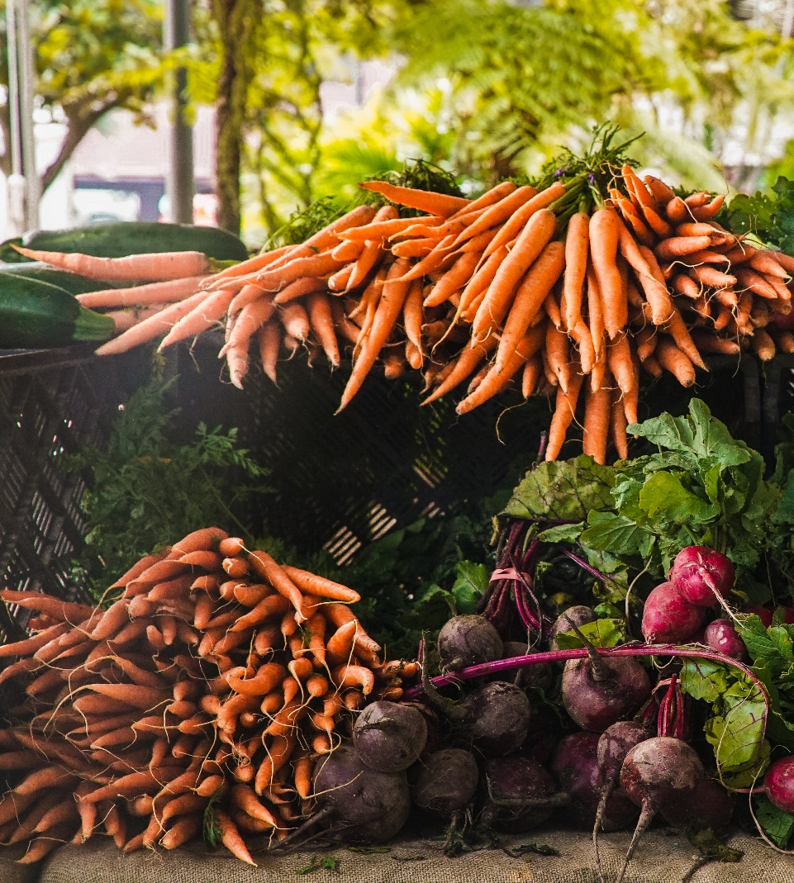
Vegetable seeds: spring 2022-2023
Delivered and administered by two USAID-supported associations:
All-Ukrainian association of communities (AUAC)
Ukrainian Agricultural Council (UAC)
29 tons 23 oblast 458 communities
Including:
530 kg of Bayer carrot seeds
Vegetable seeds (cabbage, carrots, raddish, tomato, cucumbers, sweet corn, onion, watermelon, melon, cuccini) from 7 companies (Enza Zaden, Lark Seeds, Nunhems, Hazera, Seminis, Rijk Zwaan, Syngenta and other donors)

Slide 11
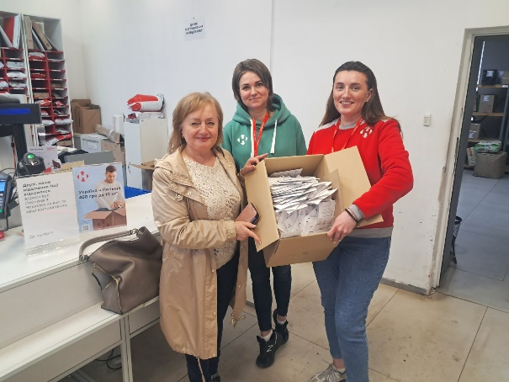
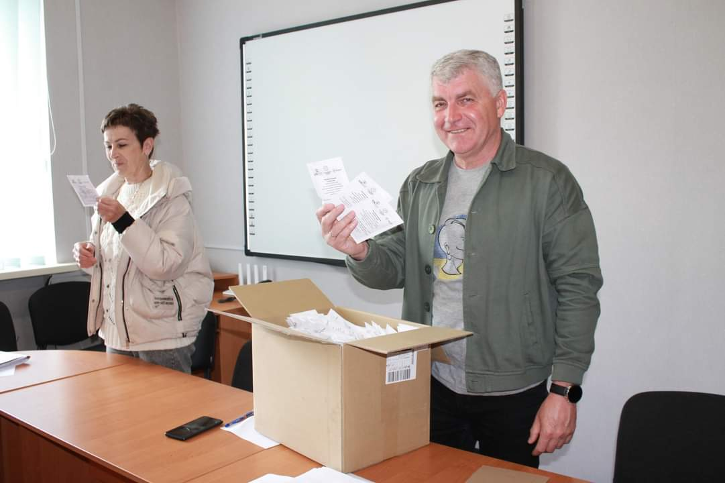
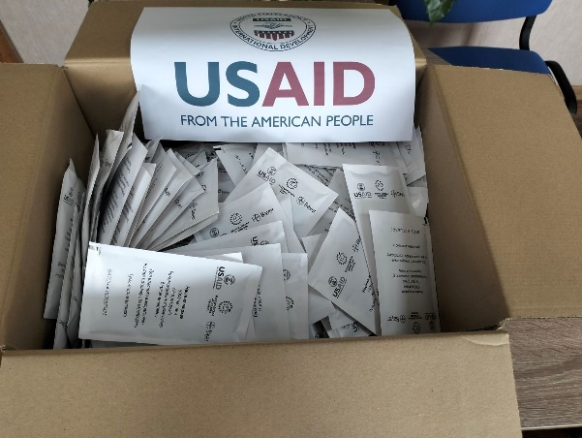
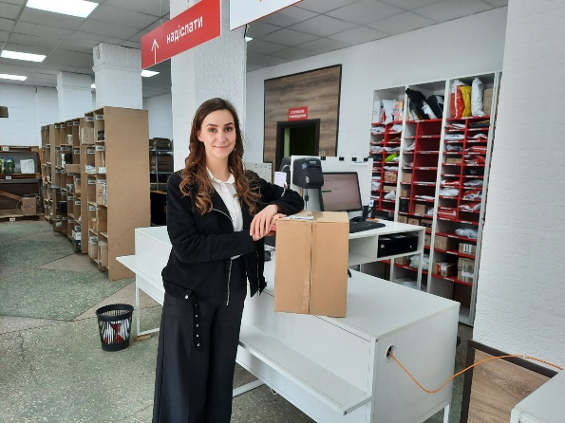
Vegetable seeds: 2023
Focus on de-occupied communities, internally displaced persons, vulnerable groups:
seeds quantity defined per community based on request
98,000 households received seeds
Planted 3,326 hectares
Harvested 121,549 tons of vegetables, one would need 5,064 trucks to transport the harvest

Slide 12
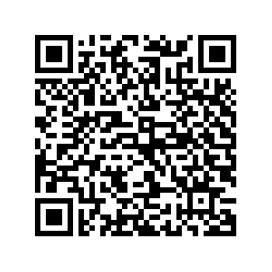
Vegetable seeds: spring 2024
200 958 households from 476 communities:
Liberated and front-line communities;
Internally displaced people
Low-income families (large families)
Pea
Bean
Beet
Mustard
45,46
326,59
148,63
87,86
Eggplant
Greens
Tomato
Carrot
1,16
746,50
42,33
678,38
the number of households in each community
Pepper
Melon
Cabage
Zuccini
19,21
37,79
156,90
3,43
Cucumber
Onion
Watermelon
Corn
7067,5
351,73
134,76
19,5
According to AUAC survey
359 708 households still need seeds
= 9 867 kg delivered by

Slide 13
Contact ua: agro.office@chemonics.com
Facebook, Twitter: @usaid.agro

